Slide 2
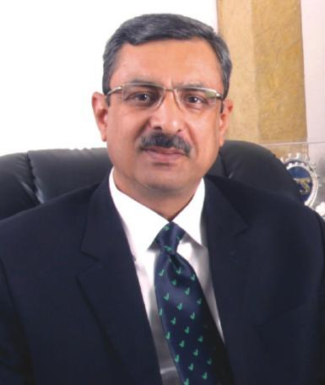
FOUNDER’S PHILOSOPHY
It’s about true freedom....
it’s about true success....
it’s time to live life the way you want to....
We are passionate about success and entrepreneurship & this reflects in our business. Our mission is to help you live a life of economic independence on your own terms; to fill your life with WELLTH – wealth through wellness.

Slide 3
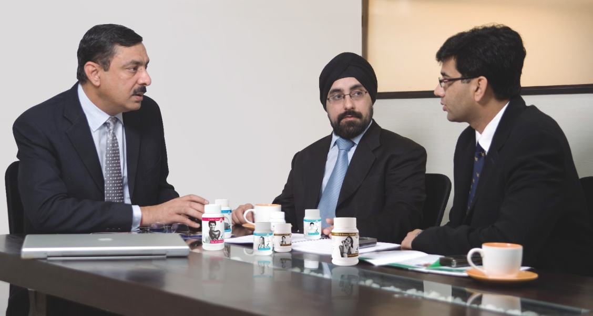
TEAM VESTIGE
..... your business is in safe hands and Vestige is a Win-Win business for you.
• Pioneers of Direct Selling in India
• Team Vestige was successfully managing Direct Selling Companies when India was waking up to the power of Direct Selling
• Successfully built and managed top Direct Selling Companies in the country
• All the Directors have an experience of over a decade in the Direct Selling industry

Slide 4
THE COMPANY
Vestige is one of the leading names in the health and wellness industry promoted by dynamic leadership and managed by a team of industry experts driven by the vision to excel.
Operations launched in 2004 with 2 offices and 6 distributors.
Now, Vestige is one of the Top 5 Direct Selling Companies in India
It has registered 100% growth y.o.y.
40 Branch Offices
2500+ DCCs (Distributor Consulting Centers)
40 DLCPs (District Level Contact Points)
11,00,000 + Distributor Base
International offices in Nepal and Dubai

Slide 5
VISION
To help people live a life of dignity and economic independence on their own terms.
MISSION
To grow to a global scale and become the benchmark in direct selling by 2018.

Slide 6
THE VESTIGE ADVANTAGE
Low financial risk
Most stable business plan
Returns commensurate with effort
International quality, value-for-money products
Effective and beneficial for all
A multi-national wellness brand with a better understanding of wellness needs

Slide 7
THE VESTIGE DIFFERENCE
Helping self + helping others
Gaining Respect in one’s own eyes as well as others by serving the society
Pride in being self-made

Slide 8
THE MARKETING PLAN
A well crafted marketing plan to give you -
Stability + Low Financial Risk

Slide 9
High Returns + Great Incentives
Car Fund
House Fund
Travel Fund

Slide 10
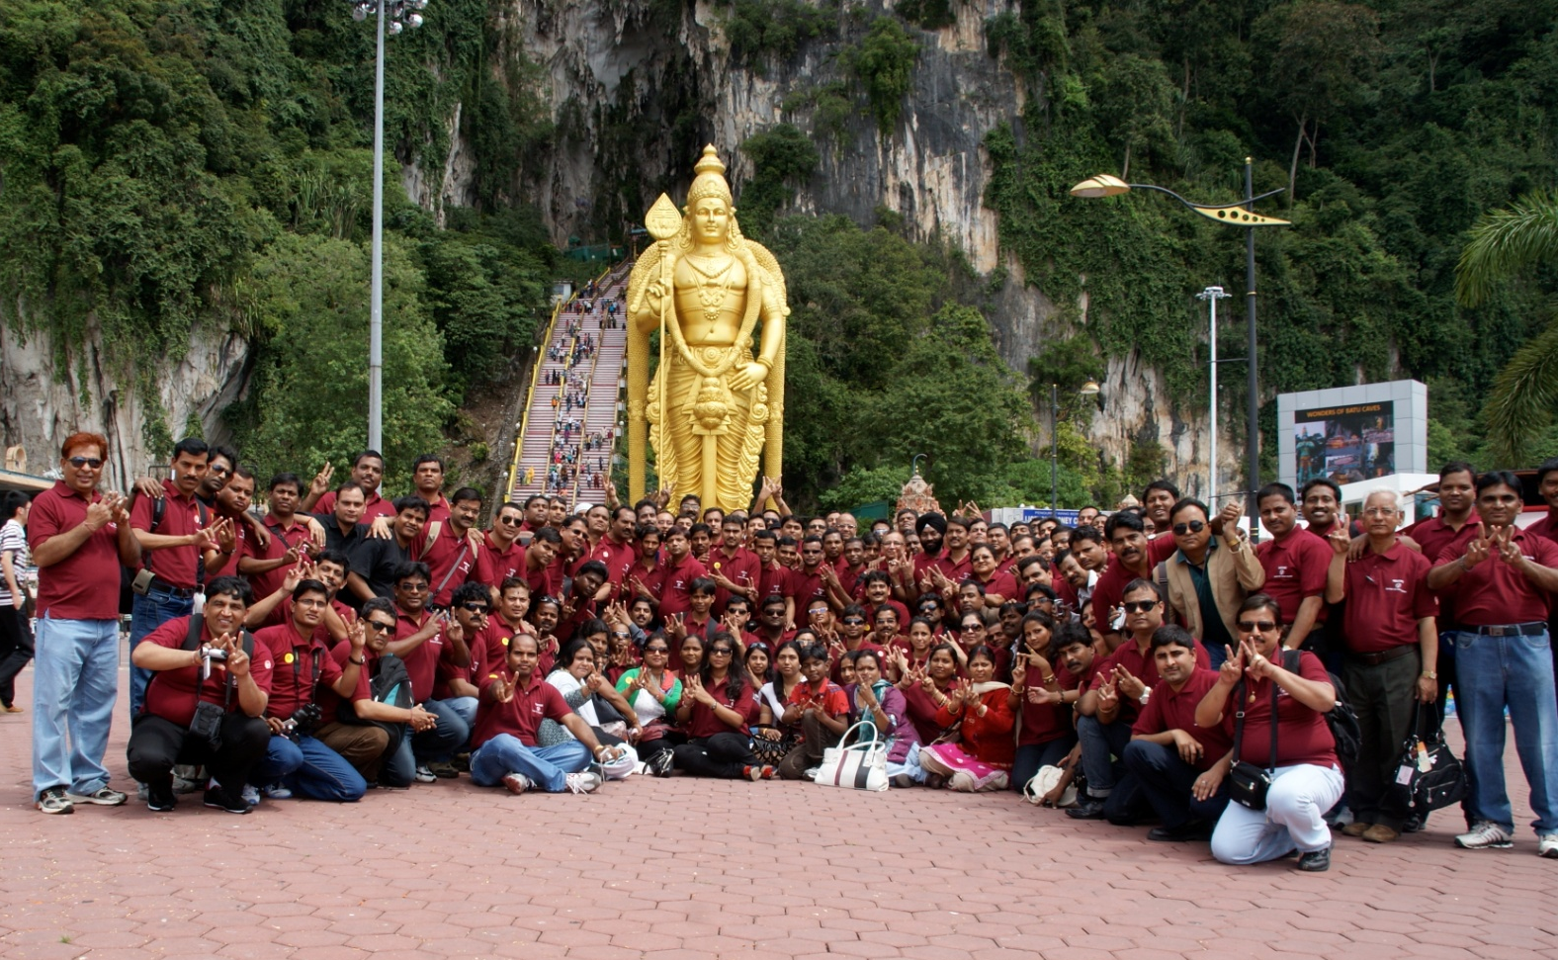
DESIGNED FOR SUCCESS
A plan that makes dreams come true!
Foreign Trip

Slide 11
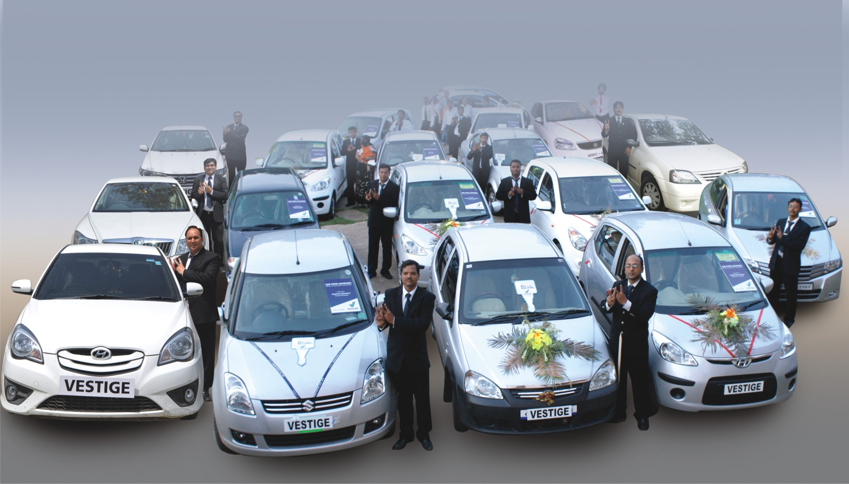
DESIGNED FOR SUCCESS
Car Fund

Slide 12
DESIGNED FOR SUCCESS
House Fund

Slide 13
THE PRODUCTS
Affordable, innovative, natural & highly effective
42 products across 5 categories-
Health Care, Personal Care, Oral Care, Health Food, Agri
Reflecting the best global standards
Deliver beyond expectations
‘Halal’ certified and adhering to FDA standards
With a legion of devoted consumers

Slide 14
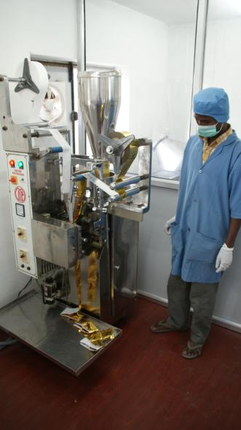
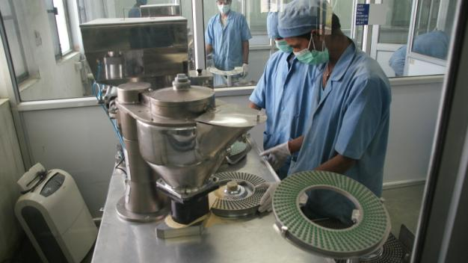
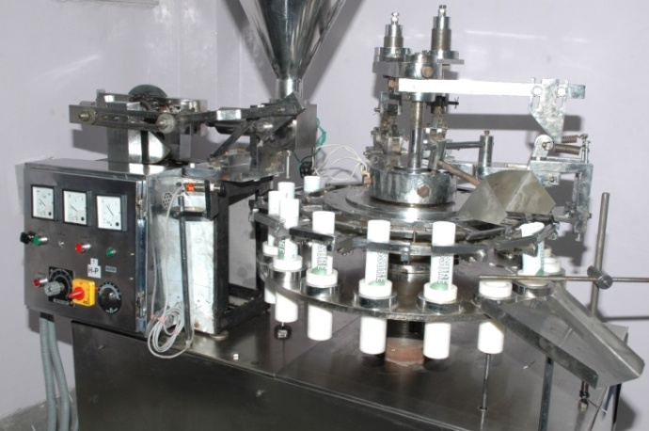
THE MANUFACTURING UNIT
A 75,000 sq.feet fully dedicated manufacturing unit at Baddi, H.P, India
State-of-the-art equipment and streamlined processes that comply with the highest global quality standards
An in-house R & D lab for innovative product development
A Quality control department to maintain international level quality standards
Manufacturing Facility ‘GMP’ & ISO 9001-2008 certified.

Slide 15
Member of IDSA
Vestige is a proud member of India Direct Selling Association (IDSA)
The Indian Direct Selling Association (IDSA) is an autonomous, self-regulatory body for the direct selling Industry in India
The IDSA stamp today is recognized as a doorway to success
IDSA strives to create an environment conducive to the growth of direct selling industry in India

Slide 16
THE NETWORK
Formidable distribution and service network of 11,00,000 + distributors
Our top achievers, a vivid testimony to the magic of Wellth
5 Double Universal Crown Directors
10 Double Crown Directors
38 Universal Crown Directors
116 Crown Directors
275 Diamond Directors
500 Star Directors
822 Gold Directors
3755 Silver Directors
9537 Directors

Slide 17
TRAINING SUPPORT
Vestige has an extensive education system to train our distributors. More than thousands of training seminars held every year to -
Enlighten and Enrich the distributors
To guide them on the road to success
To increase their knowledge and hone their skills
To turn them into effective leaders and team players
To continuously motivate them
To equip them in every way to be a Winner

Slide 18
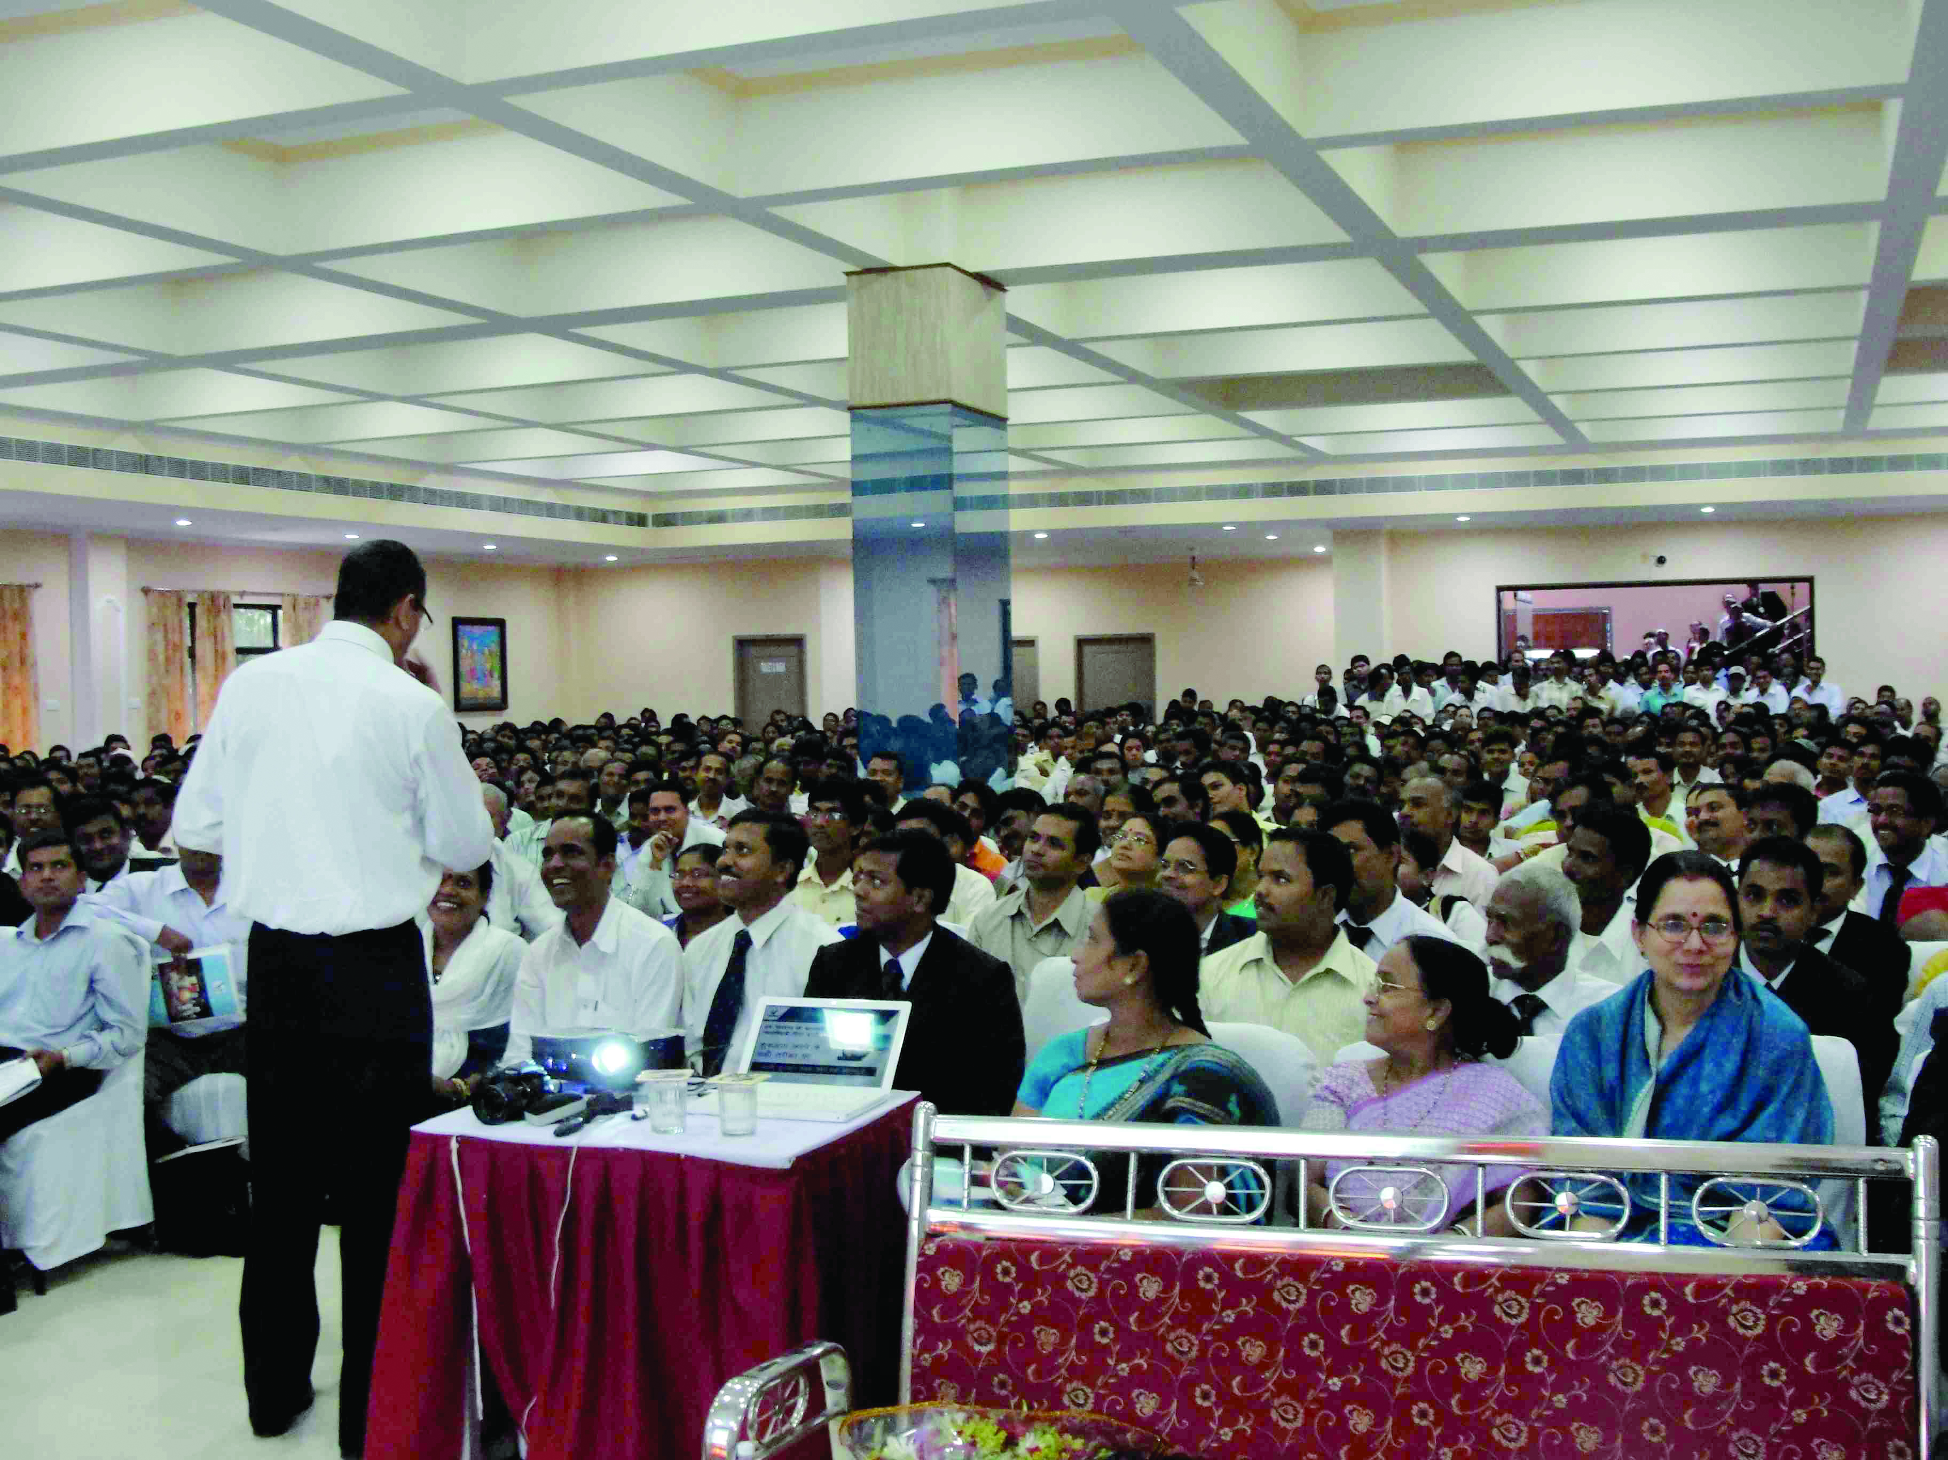
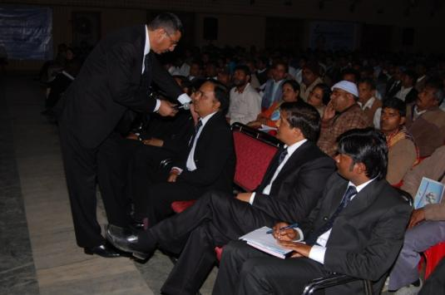
TRAINING SUPPORT
NDES
New Distributor Education Seminar -
To guide the new distributors on building their business
To educate them team work and leadership
To give them useful marketing and selling tips

Slide 19
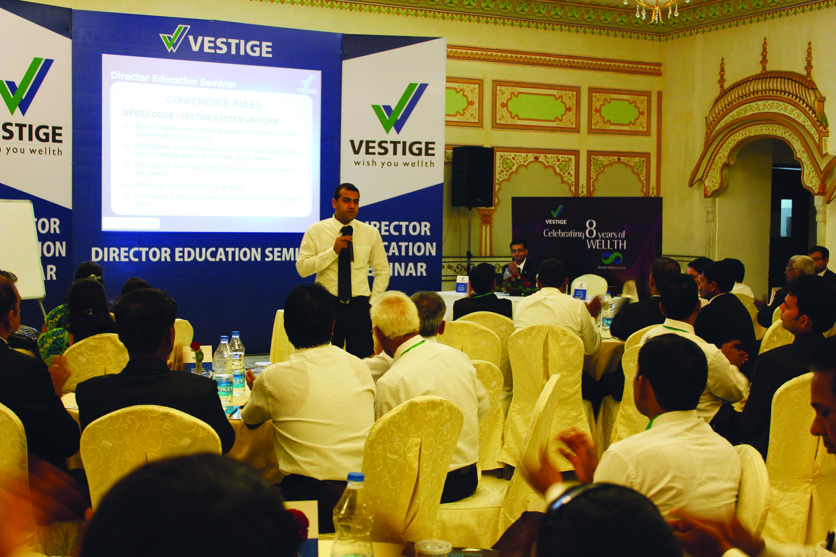
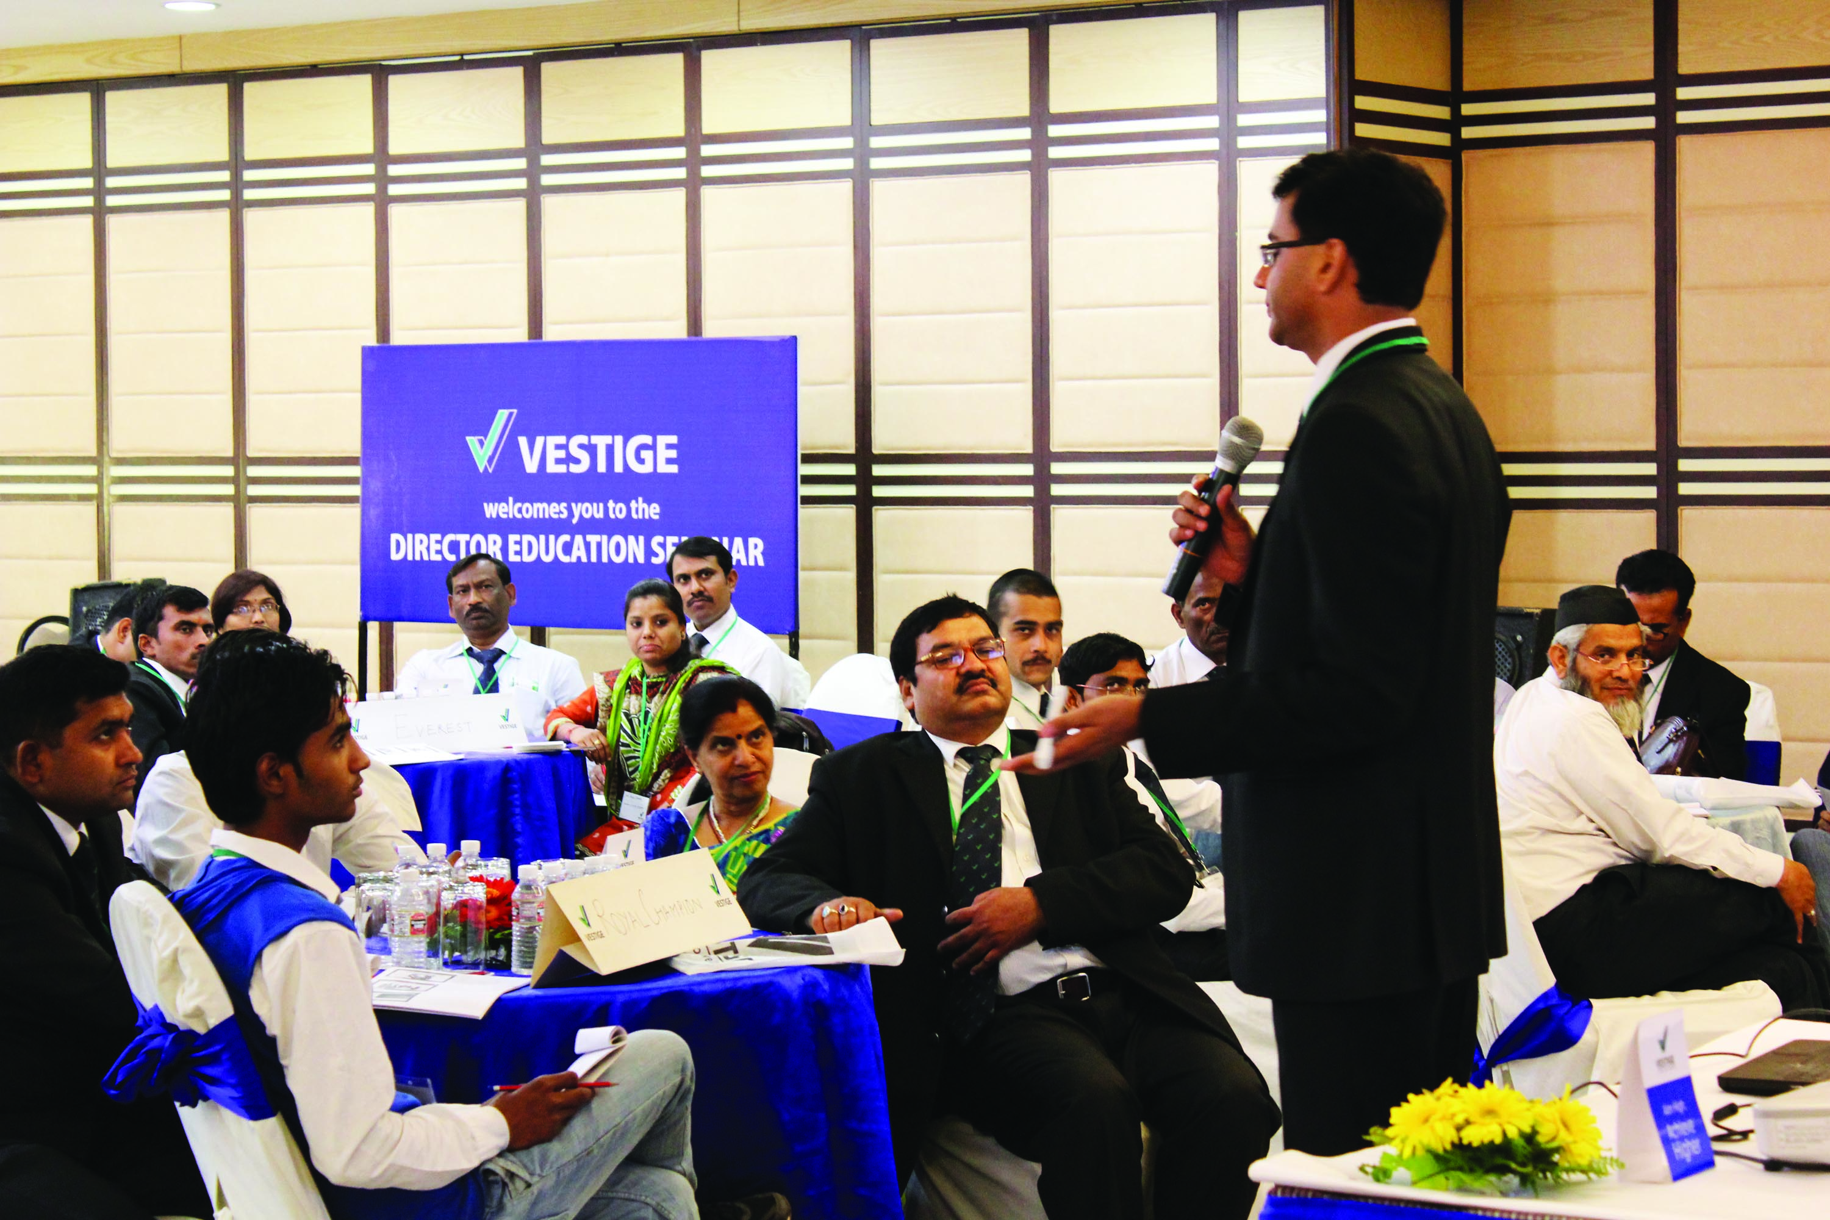
TRAINING SUPPORT
DES
Director Education Seminar -
To transform the Directors and above into effective leaders
To motivate them and increase their knowledge

Slide 20
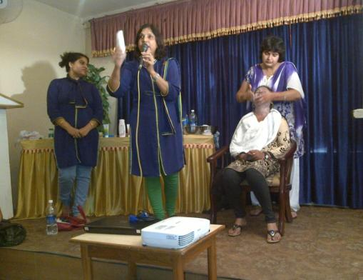
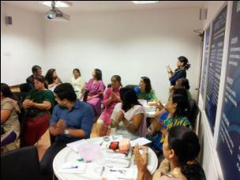
TRAINING SUPPORT
Assure Trainings-
To explain the benefits and usage of Assure products
To teach the distributors demonstration techniques and give them selling tips

Slide 21
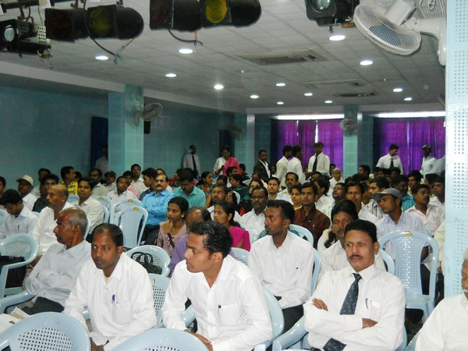
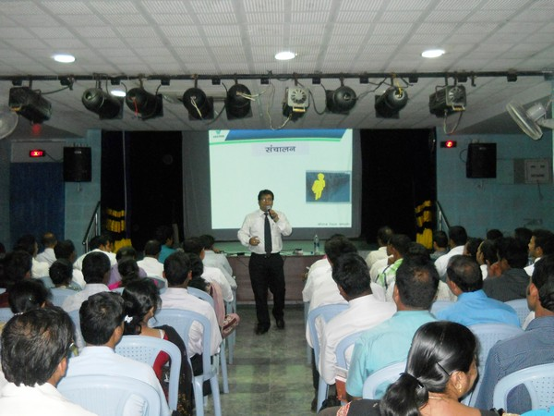
TRAINING SUPPORT
CNT
Cellular Nourishment Therapy –
An intensive training of the Vestige product range and marketing plan.

Slide 22
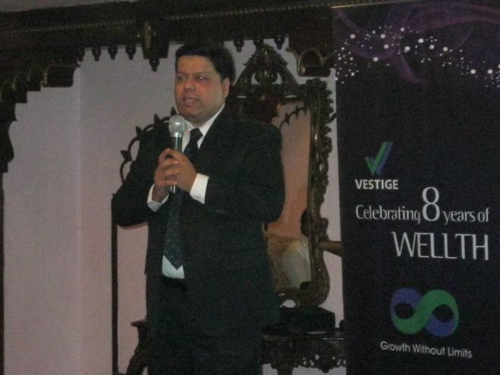
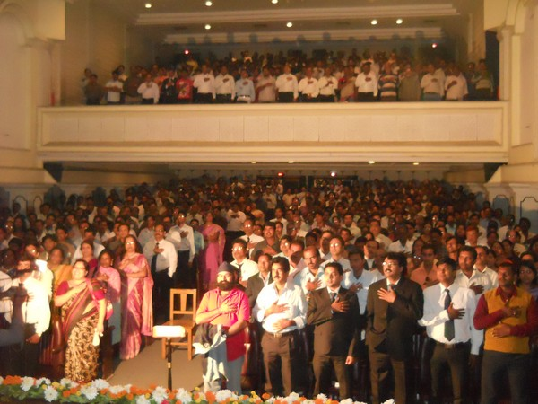
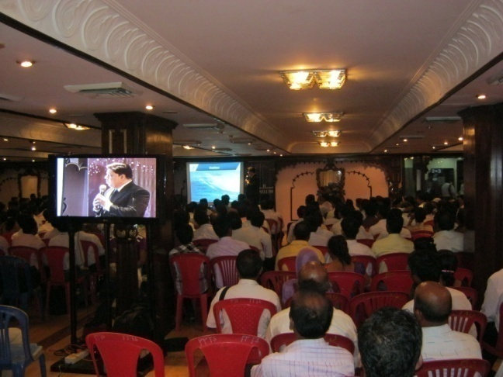
TRAINING SUPPORT
MTM
Meet the Millionaire –
A special seminar where top leaders share their success story.
Leaders motivate existing distributors as well as new prospects.
They give useful advice and tips on growing and maintaining the business.

Slide 23
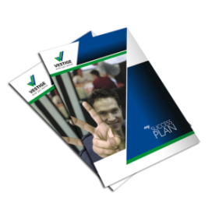
TRAINING SUPPORT
A range of extensive training and communication tools in more than 19 languages.
Product Catalogue
Success Plan
Health Guide
Flip Chart
Voice
Education CDs
Product CDs

