Slide 1
Corporate Video

Slide 2
FOUNDER’S PHILOSOPHY
Believing in yourself is the first secret to SUCCESS
We have come a long way in the last 10 years. Our growth in the past decade has been an outcome of a forward-looking approach, and with our dedicated team and commitment to quality, we are indeed geared up for the future. Vestige has set ambitious goals for itself and is striving hard towards their accomplishment.

Slide 3
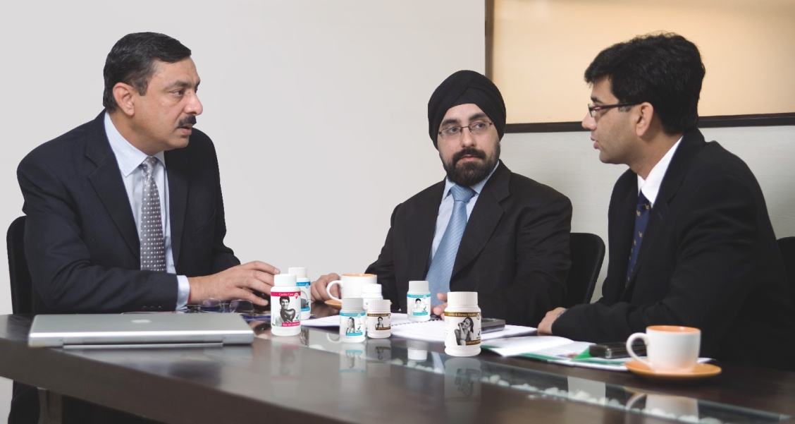
VESTIGE MANAGEMENT
Transforming dreams into reality.
The Vestige Management Team encompasses a unique group of visionary leaders that are admired and respected around the world.
The Management Team at Vestige brings decades of diverse experience and a history of success to the company that has helped so many people to live the life of their dreams.

Slide 4
THE COMPANY
Vestige Marketing Pvt. Ltd., which started its operation in the year 2004, is a leading direct selling company dealing in world class health and personal care products
Vestige is constantly growing at a phenomenal rate every year. The growth rate in itself speaks volumes about the quality of the products, the marketing plan and the management that has been able to deliver such a rewarding and sustainable system to the distributor
Vestige believes in empowering its members with the opportunity to lead their lives on their own terms
92+ Branch Office
s
3000+ DCCs (Distributor Consulting Centers)
100+ DLCPs (District Level Contact Points)
50,00,000 + Distributor Base
International offices in Nepal and Dubai

Slide 5
THE COMPANY
VISION
To help people live a life of economic independence on their own terms.
MISSION
To grow to a global scale and become the benchmark in direct selling by 2018.

Slide 6
VHTHF is an initiative by the Vestige family to empower the children of our nation by alleviating their physical, mental and economic suffering. In partnership with the Miracle Foundation of USA, we strive to provide various children's homes in the rural regions of our country with the three basic yet highly significant needs - Food, Health and Education.
We are currently providing aid to 150 children from a village near Madurai, known as Dindigul and soon will be expanding to other regions as well.
Vestige has always been committed to contributing to the advancement of health and wellness in society. With the help of this initiative, we will continue in this endeavor by reaching out to the thousands of impoverished souls in need.
Mission
1. To provide various children's homes in the rural regions of our country with the three basic yet highly significant needs...- Food, Health and Education. 2. To fight hunger and malnutrition 3. To donate medical equipment to doctors, health practitioners and hospitals

Slide 7
THE VESTIGE ADVANTAGE
Low Financial Risk
A Well Crafted Marketing Plan
World Class Products
Income Stability
High Returns
Reliable & Profitable
Great Incentives
Extensive Trainings

Slide 8
THE MARKETING PLAN
A well crafted marketing plan to give you -
Stability + Low Financial Risk
High Returns + Great Incentives
Car Fund
House Fund
Travel Fund

Slide 9
THE PRODUCTS
Affordable, innovative, natural & highly effective
Extensive range of products across Health Care, Personal Care, Oral Care, Health Food, Agri & Self Health Series categories
International Quality Standards
Profit based products
True Value for Money

Slide 10
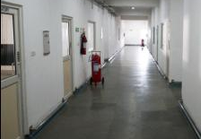
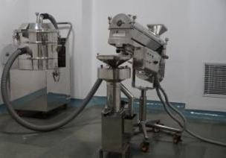
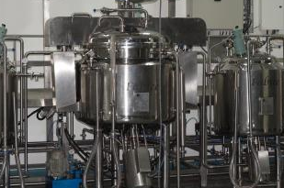
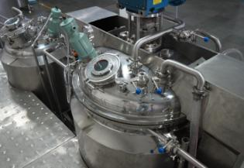
THE MANUFACTURING UNIT
State-of-the-art equipment and streamlined processes that comply with the highest global quality standards
An in-house R & D lab for innovative product development
A Quality control department to maintain international level quality standards
Manufacturing Facility ‘GMP’ & ISO 9001-2008 certified.
World Class Manufacturing Unit

Slide 11
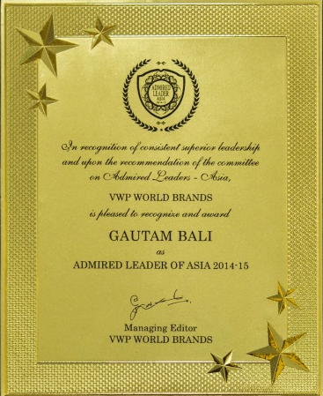
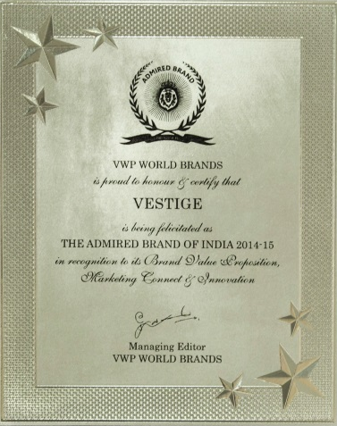
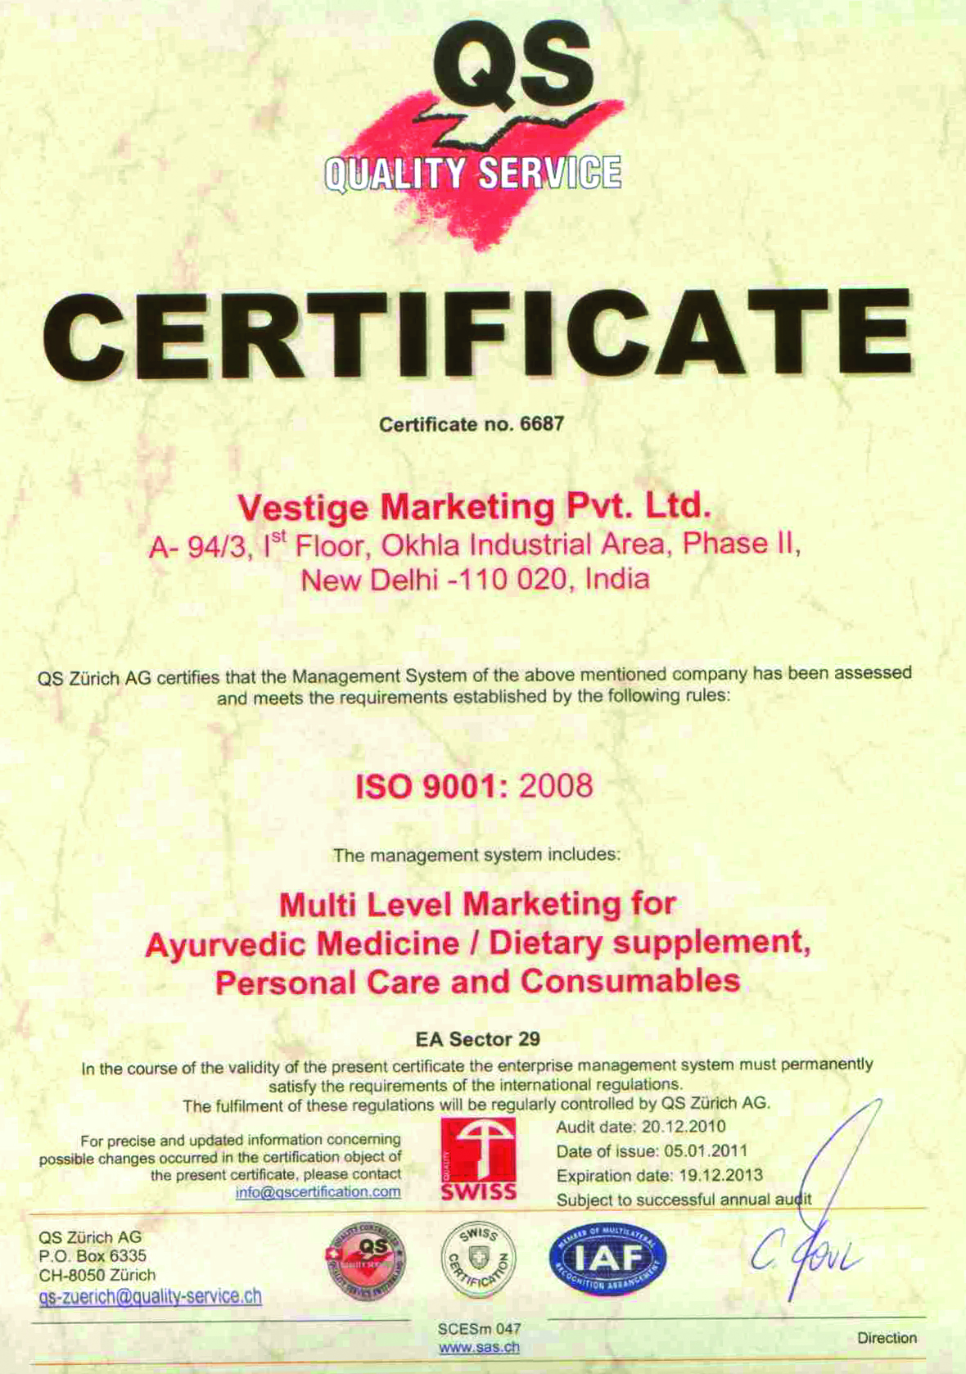
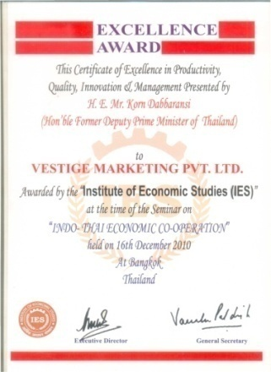
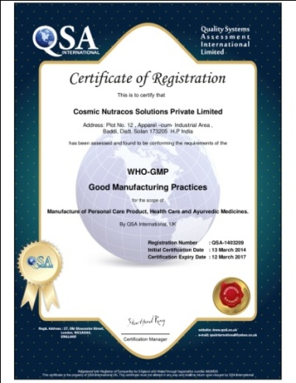
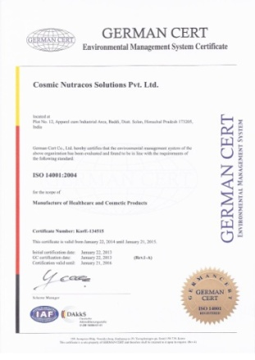
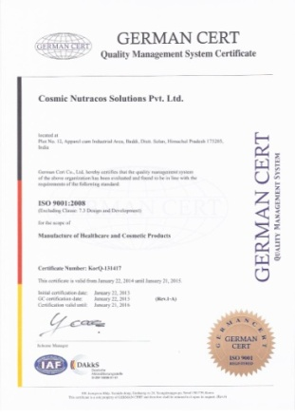
VESTIGE SHINING GLORY
Vestige has been awarded with many prestigious awards & certificates in the past.
Vestige is a a member of “Health Foods and Dietary Supplements Association”
Manufacturing facility received the “Good Manufacturing Practices” Certification- GMP certificate renewed annually
Vestige was awarded with “Certificate of Excellence in Productivity, Quality, Innovation and Management” by the Institute of Economic Studies (IES)
Mr. Gautam Bali honoured with the prestigious Best CEO award – 2012 at Obtainer Direct Selling Forum
Vestige awarded as “Most Admired Brands & Leaders – Asia”
Vestige upgraded to ISO 9001:2008 certification in 2011
Manufacturing Facility ‘GMP’ & ISO 9001-2008 certified
‘Halal’ certified products
Certificates

Slide 12
Member of IDSA
Vestige is a proud member of India Direct Selling Association (IDSA)
The Indian Direct Selling Association (IDSA) is an autonomous, self-regulatory body for the direct selling Industry in India
The IDSA stamp today is recognized as a doorway to success
IDSA strives to create an environment conducive to the growth of direct selling industry in India

Slide 13
FICCI
FSSAI

Slide 14
THE NETWORK
Formidable distribution and service network of 50,00,000 + distributors
Our top achievers, a vivid testimony to the magic of Wellth
15 Brand Ambassador
4 Double Universal Crown Directors
22 Double Crown Directors
108 Universal Crown Directors
322 Crown Directors
833 Diamond Directors
1260 Star Directors
2204 Gold Directors
9801 Silver Directors
27047 Directors

Slide 15
TRAINING SUPPORT
Vestige has an extensive education system to train our distributors. More than thousands of training seminars held every year to -
Enlighten and Enrich the distributors
To guide them on the road to success
To increase their knowledge and hone their skills
To turn them into effective leaders and team players
To continuously motivate them
To equip them in every way to be a Winner

Slide 16
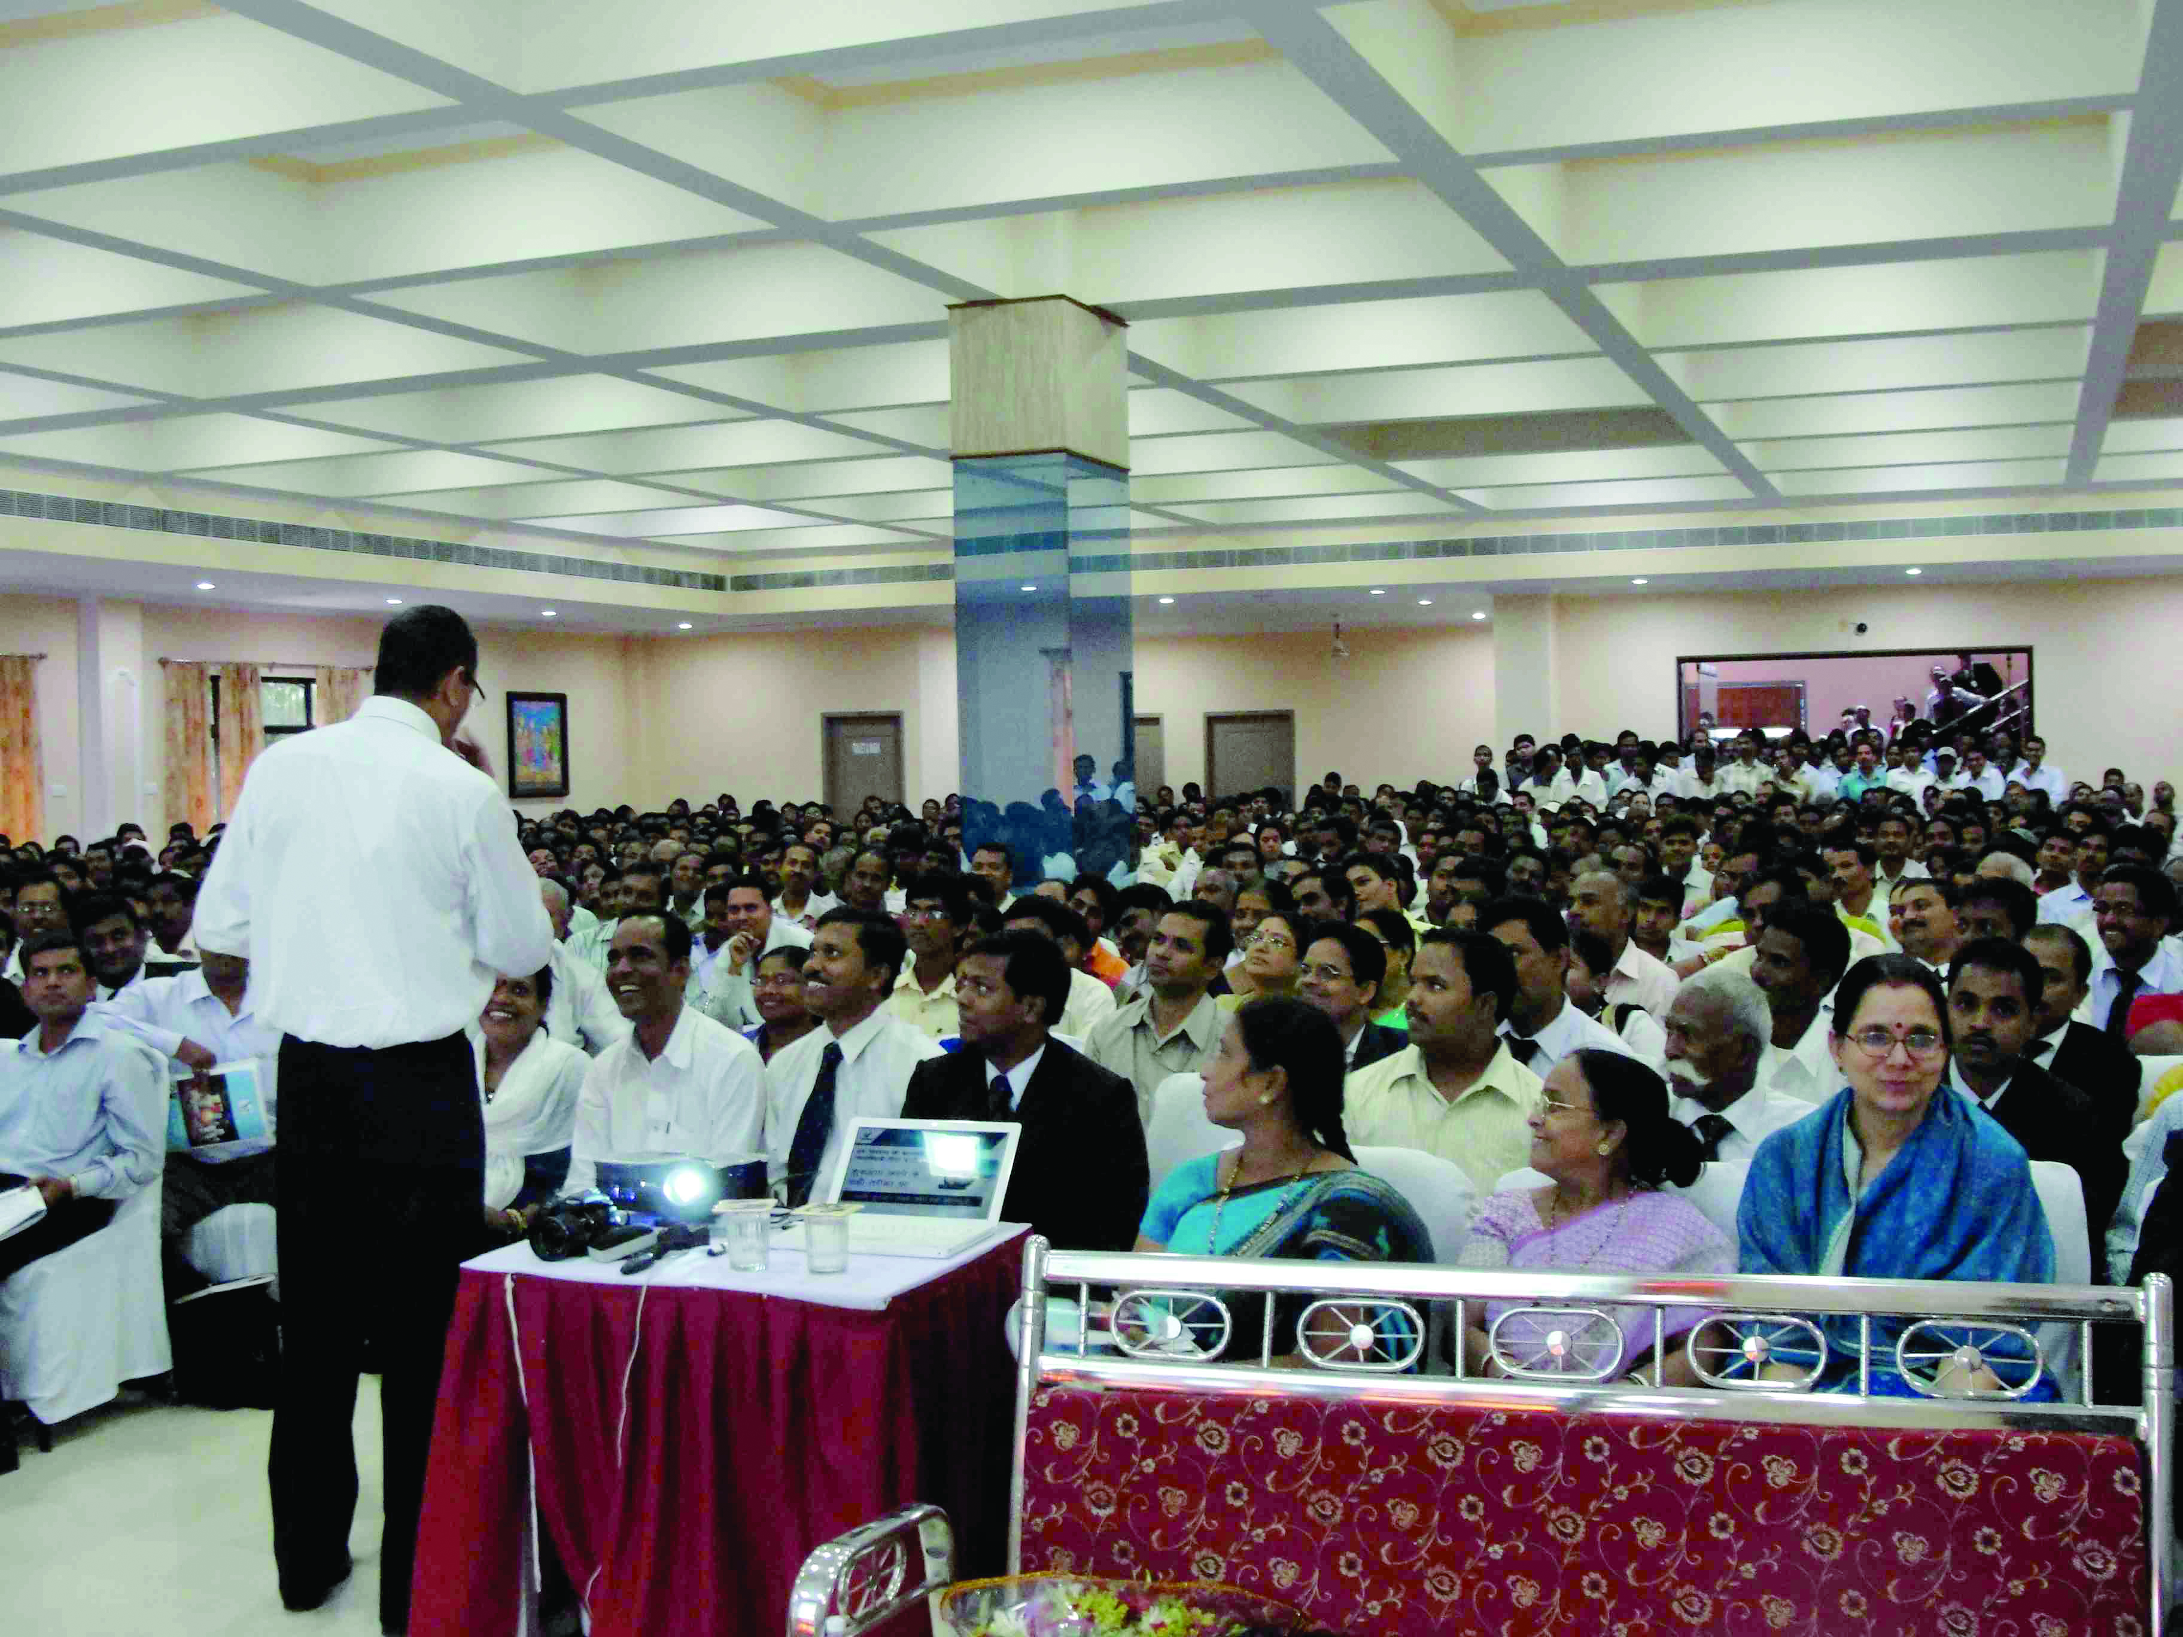
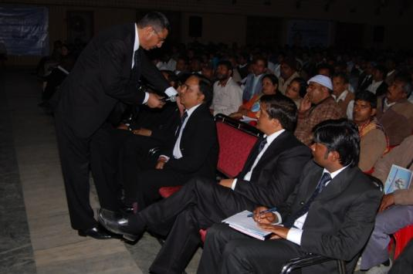
TRAINING SUPPORT
Vestige Initiation Programme
To guide the new distributors on building their business
To educate them team work and leadership
To give them useful marketing and selling tips

Slide 17
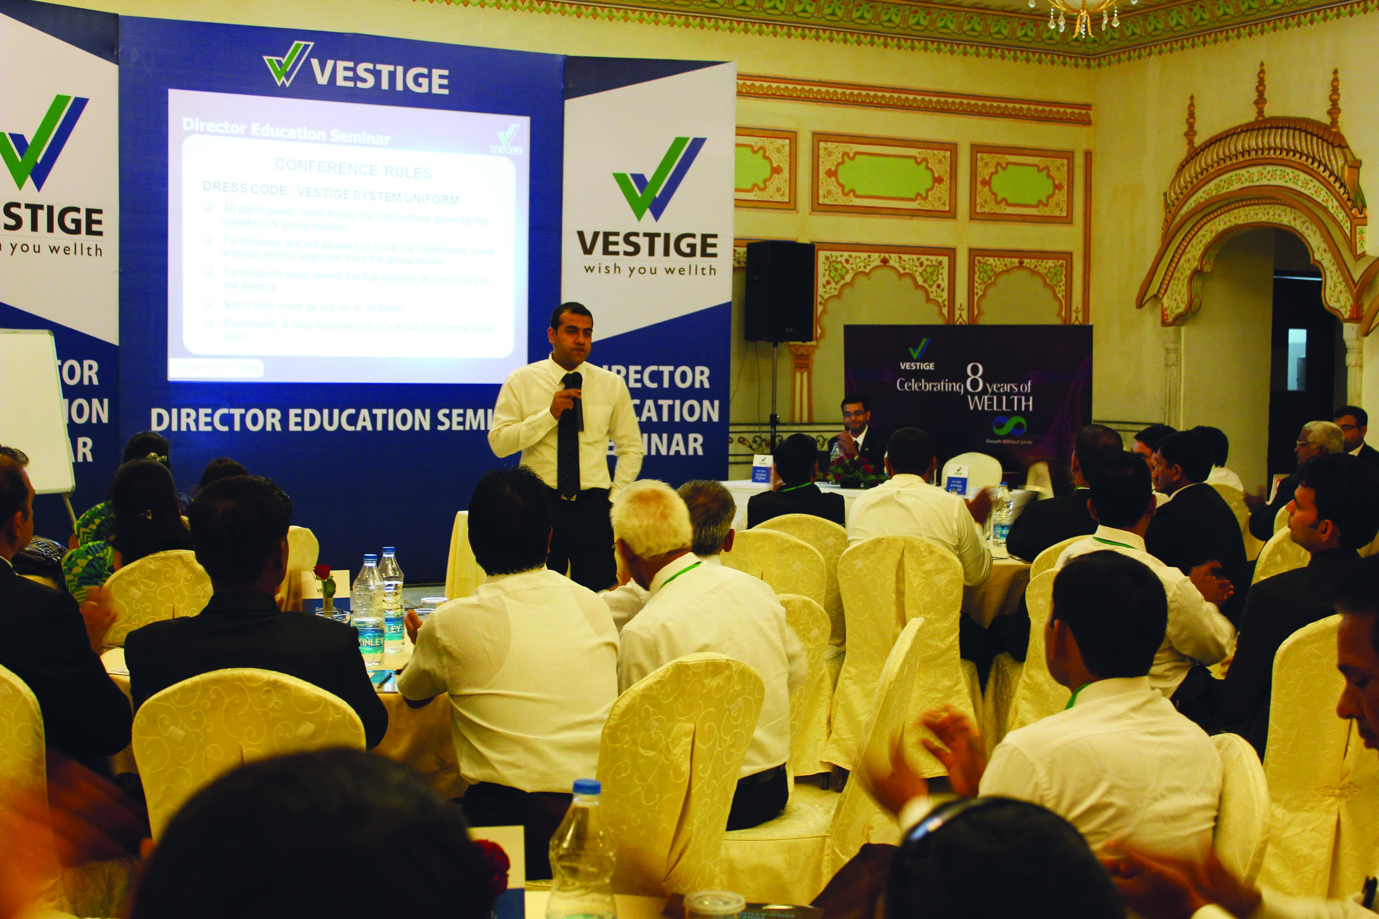
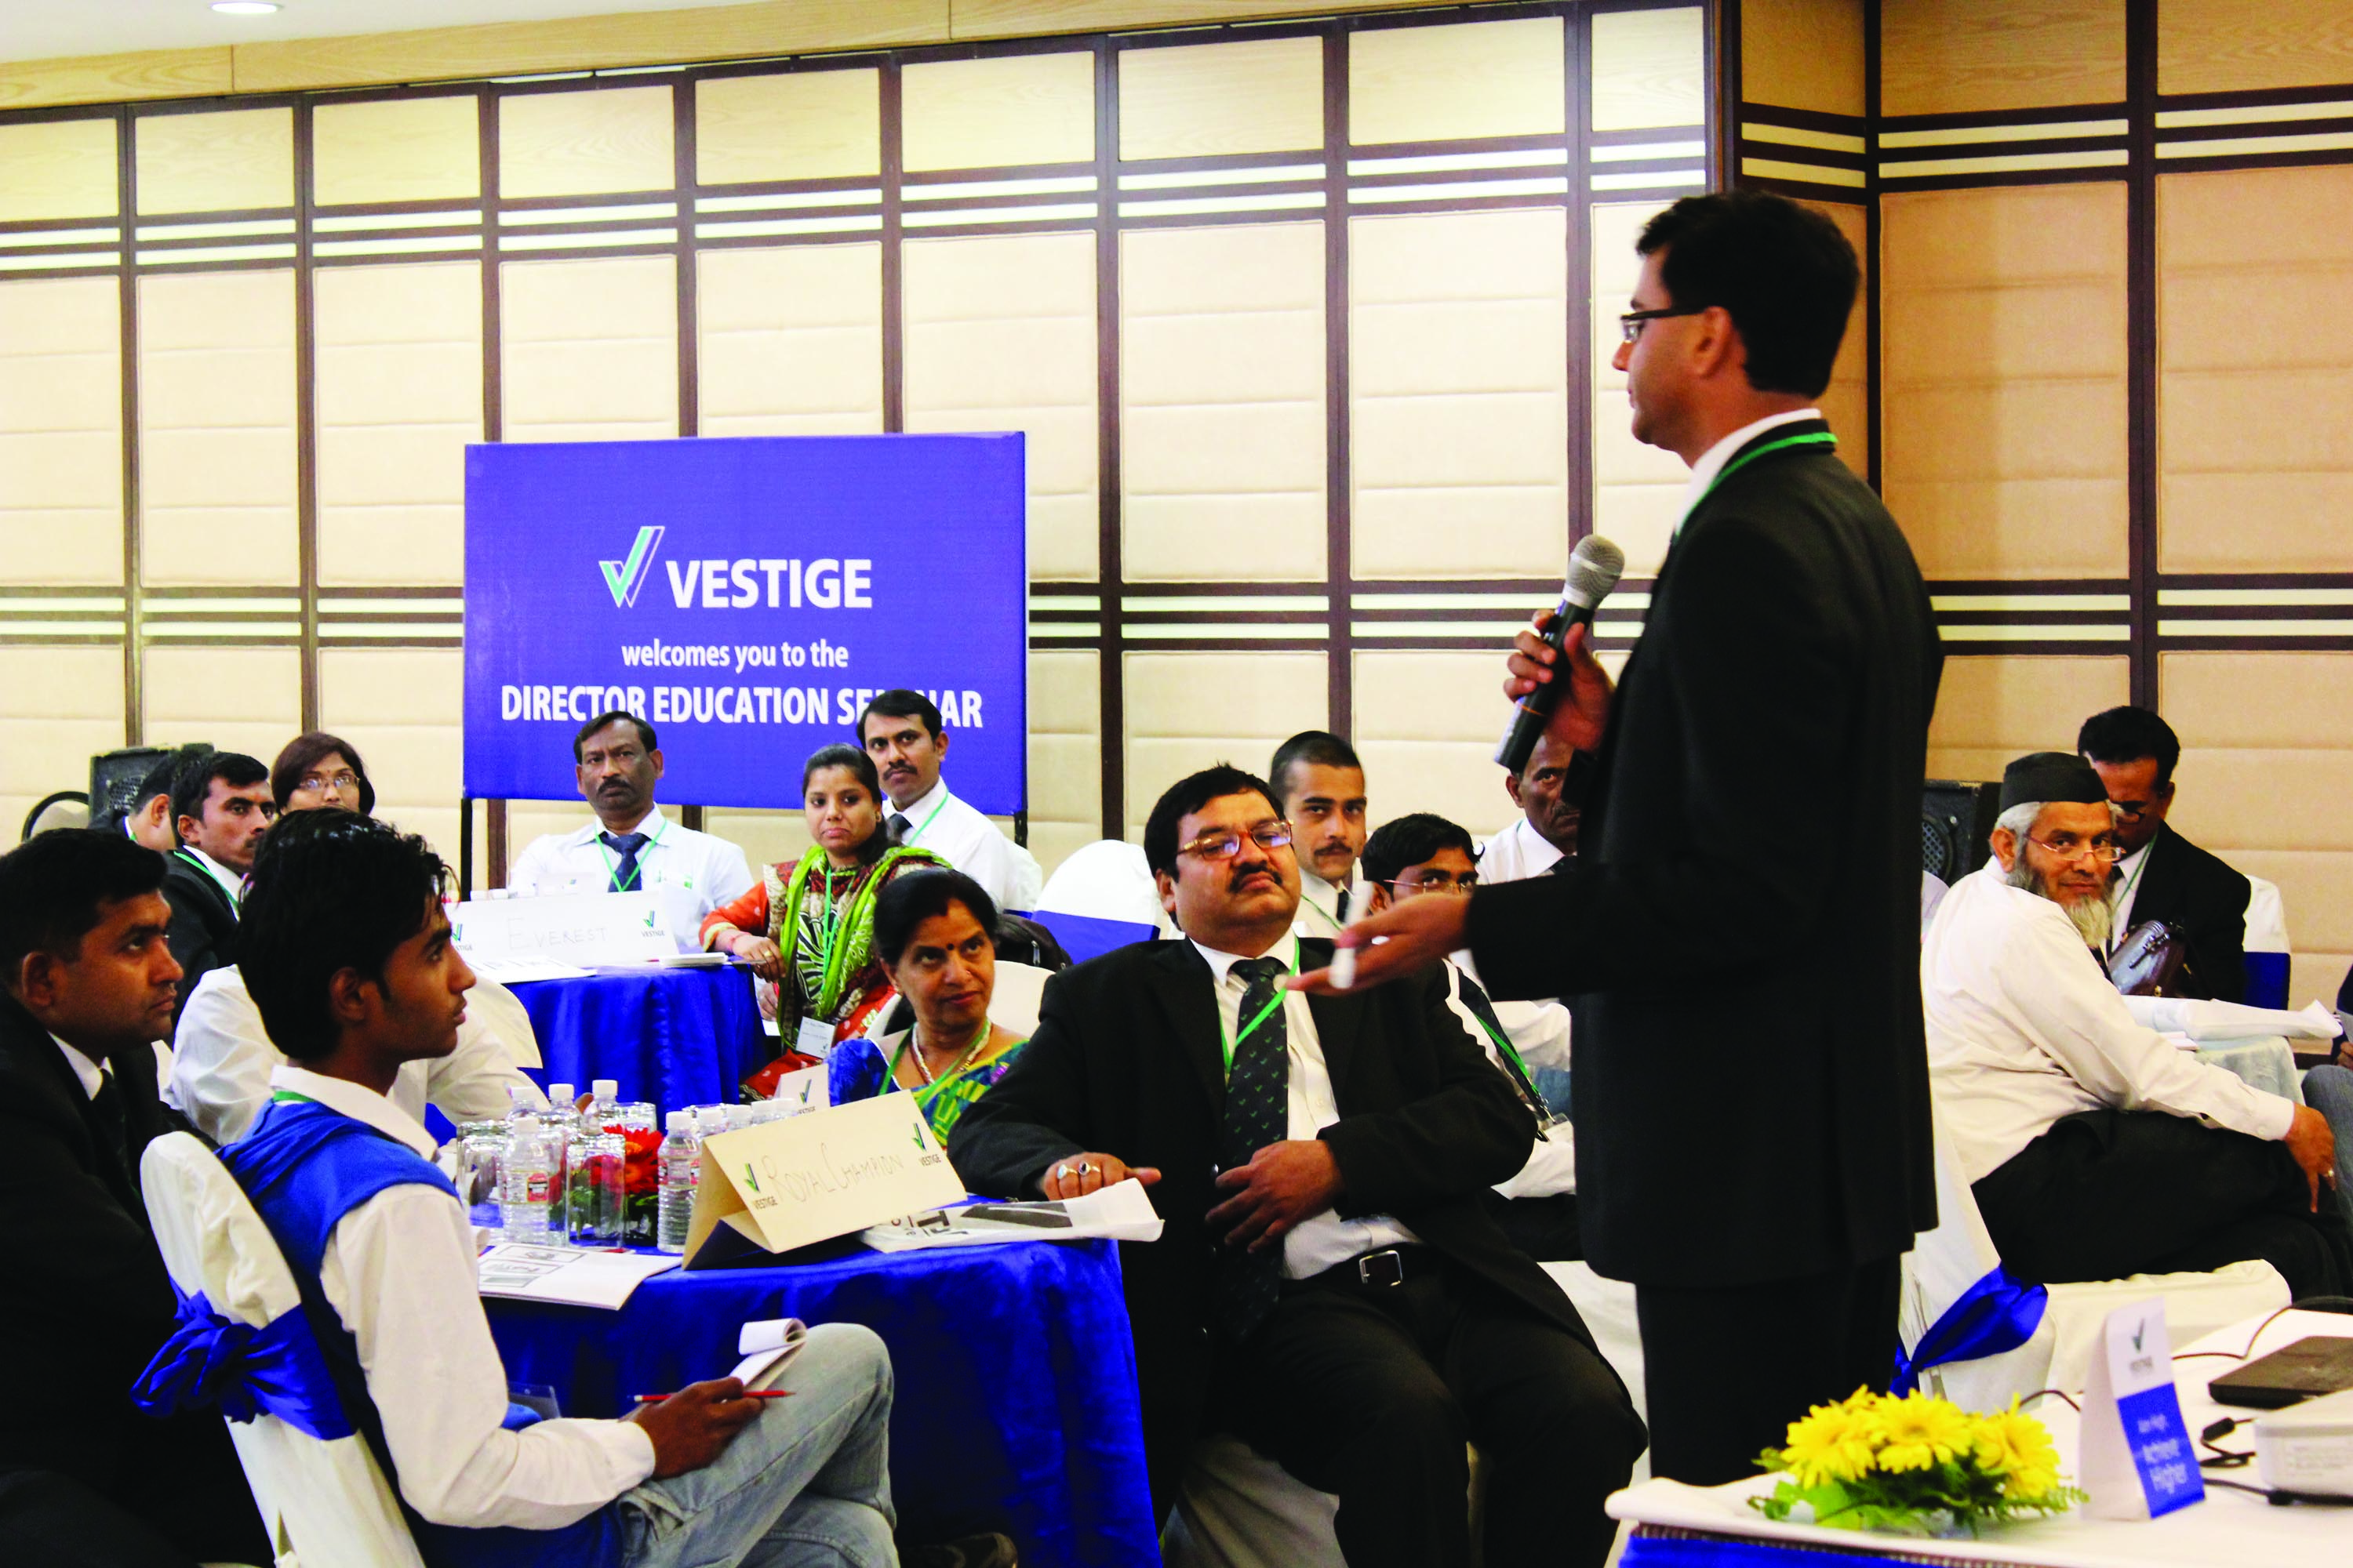
TRAINING SUPPORT
Vestige Leadership Conclave -
To transform the Directors and above into effective leaders
To motivate them and increase their knowledge

Slide 18
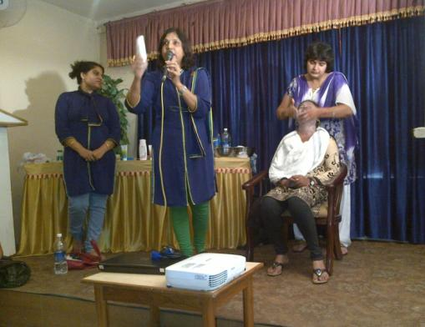
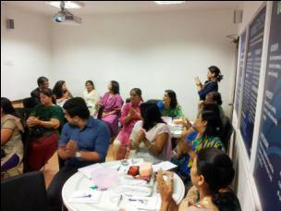
TRAINING SUPPORT
Assure Trainings-
To explain the benefits and usage of Assure products
To teach the distributors demonstration techniques and give them selling tips

Slide 19
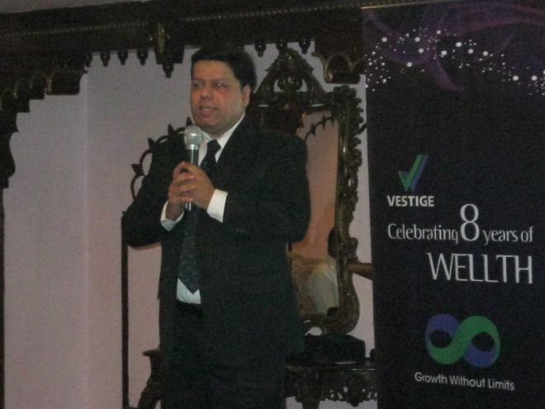
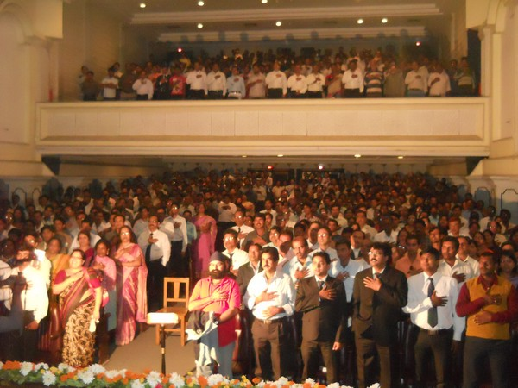
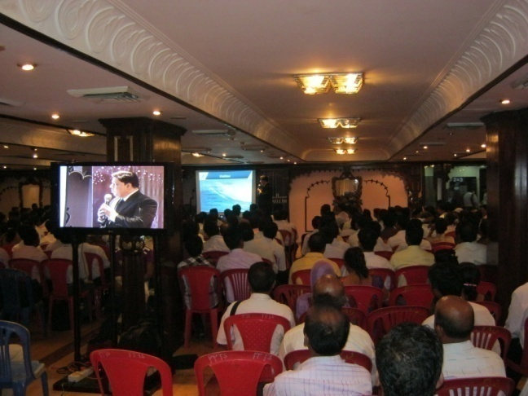
TRAINING SUPPORT
MTM
Meet the Millionaire –
A special seminar where the top leaders share their success story.
The leaders motivate existing distributors as well as new prospects.
They give useful advice and tips on growing and maintaining the business.

Slide 20
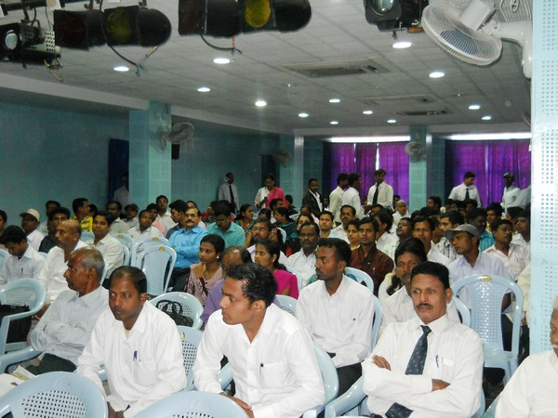
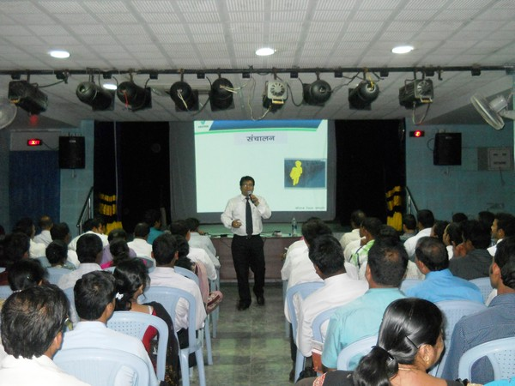
TRAINING SUPPORT
CNT
Cellular Nourishment Therapy –
An intensive training of the Vestige product range and marketing plan.

Slide 21
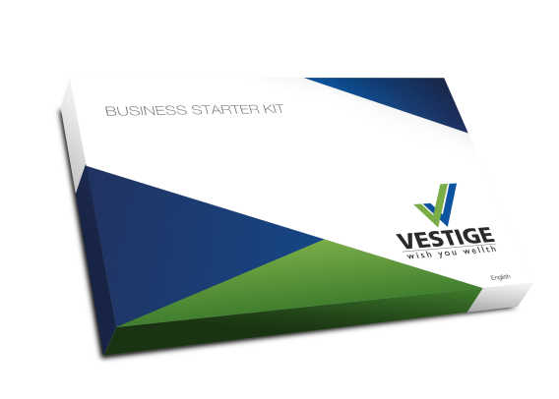
TRAINING SUPPORT
A range of extensive training and communication tools.
Car Book
Corporate AV
Business Starter Kit
Product Catalogue
Success Plan
Health Guide
Voice
Education CDs
Product CDs
Flip Chart

Slide 22
The Future of VESTIGE-Dream 11

Slide 23
Corporate Video

Slide 24
CELLULAR NOURISHMENT THERAPY
• CNT - is a Holistic Approach
• The Human Body is made up of more than 63 trillion Cells
• Our poor dietary habits lead to poor cell nourishment, hence weak immune systems
• Balanced nutrition & increased absorption leads to optimum functioning of our body
Digestive System

Slide 25
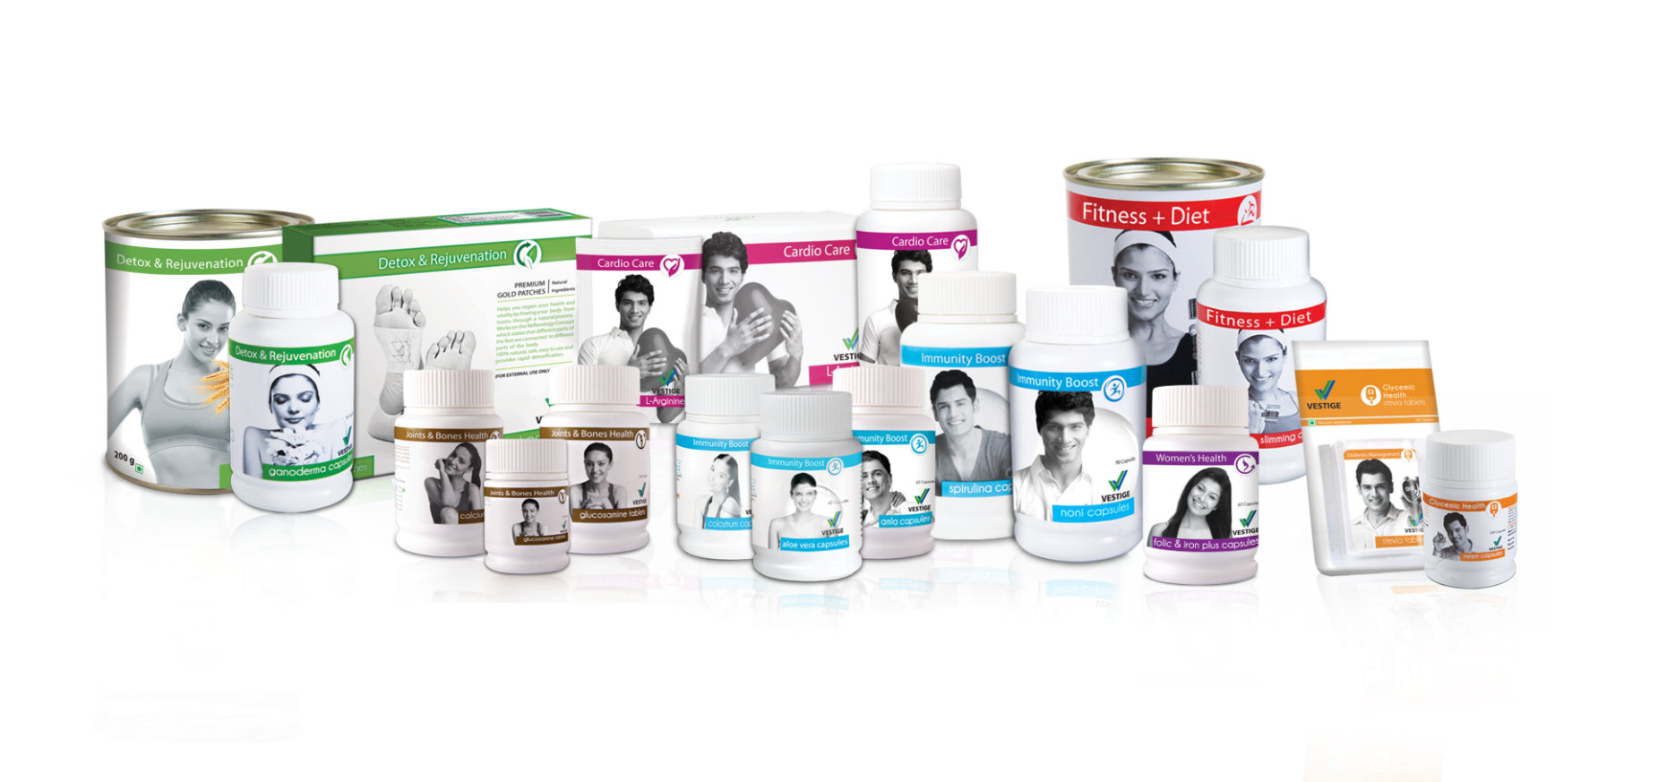
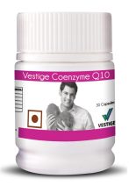
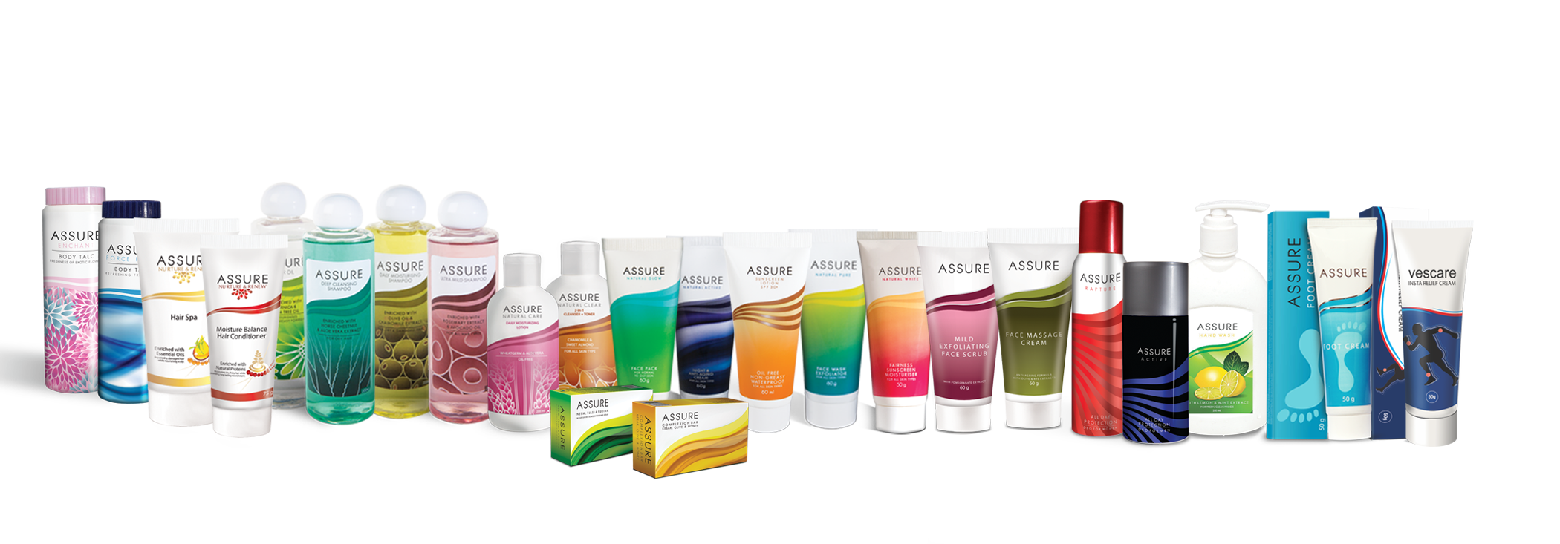
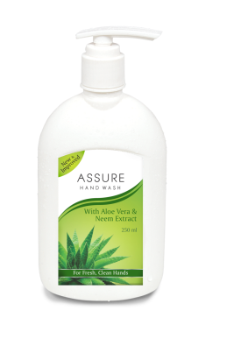
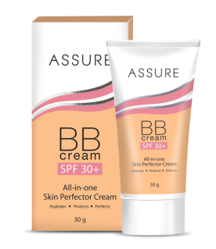
PRODUCT OVERVIEW
HEALTH CARE
PERSONAL CARE

Slide 26
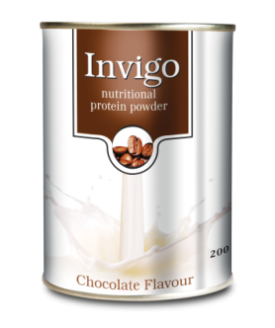
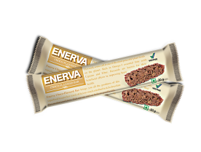
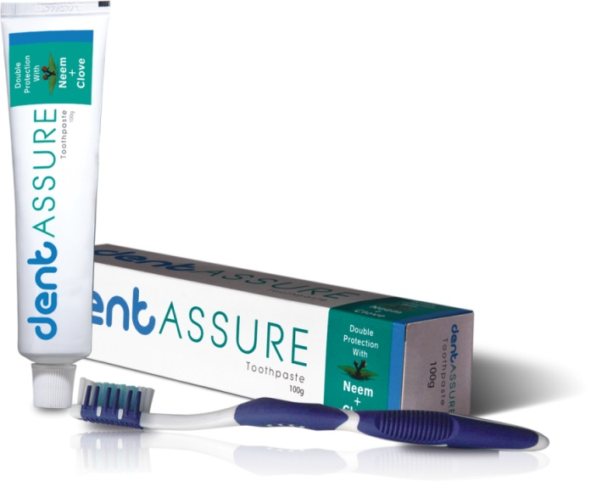
PRODUCT OVERVIEW
HEALTH FOOD
AGRI-PRODUCT
Extensive Range
World Class Products
ORAL CARE
True Value for Money
Profit based Products
International Quality Standards

Slide 27
HEALTH CARE
A range of highly effective and natural health products.
Detox & Rejuvenation
Joints & Bones
Health
Immunity Boost
Cardio Care
Women’s Health
Fitness + Diet
Glycemic Health
Vitamines

Slide 28
JOINTS & BONES HEALTH

Slide 29
HEALTH CARE
Joints & Bones Health
JOINTS AND BONES HEALTH
• Bone and joint conditions are mostly due to calcium deficiency, lack of physical exercise, age related, loss of cartilage etc.
Associated problems are arthritis, osteoporosis and joint pain
The most common type of arthritis is, Osteoarthritis – associated with wear and tear of cartilage
Who is at risk?
It affect anyone regardless of their age, gender, or race
Women are affected more than men

Slide 30
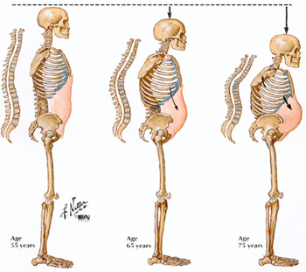
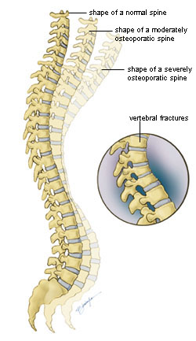
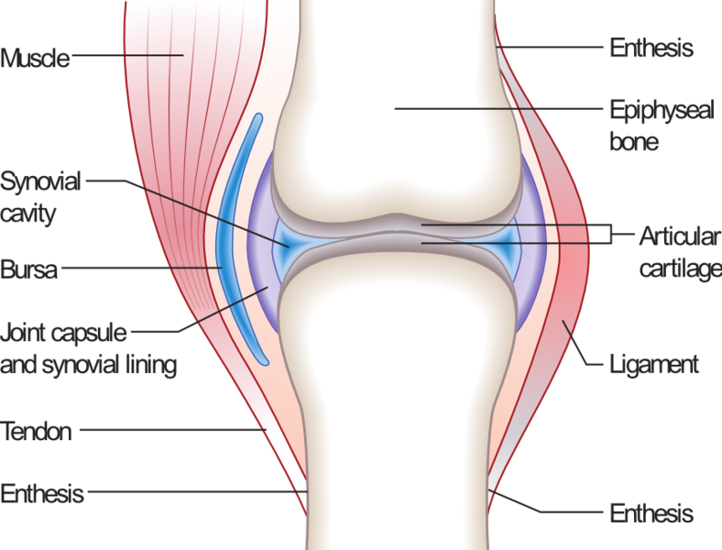
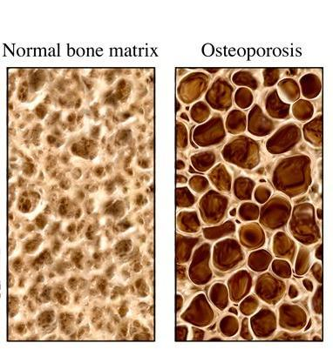
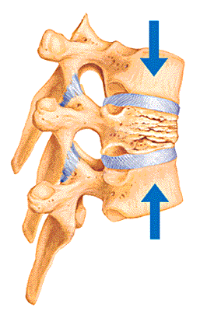
Joints & Bones Health
EFFECTS OF OSTEOPOROSIS

Slide 31
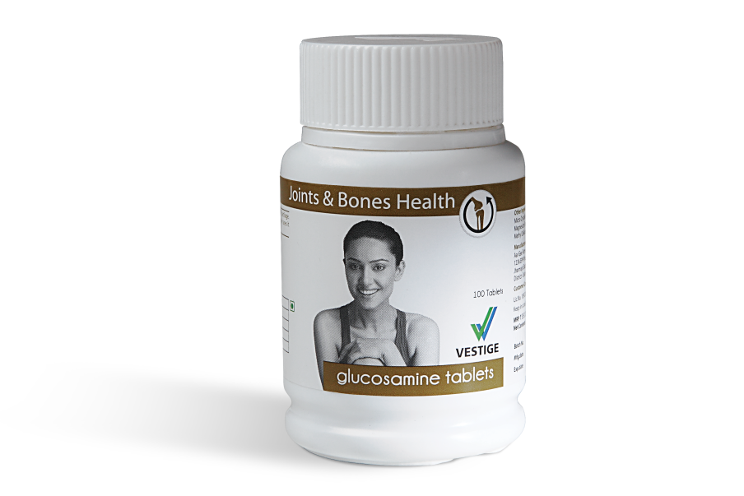
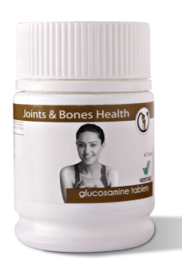
HEALTH CARE
Joints & Bones Health
VESTIGE GLUCOSAMINE
• Helps in the formation of new cartilage & protects the existing cartilage
• Lubricates joints and stimulates synovial fluid production
• Provides analgesic & anti-inflammatory effect

Slide 32
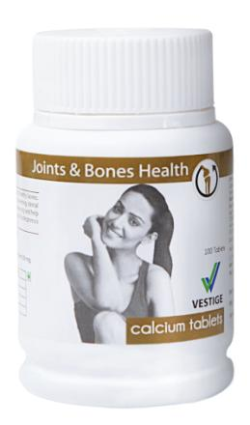
HEALTH CARE
VESTIGE CALCIUM
Joints & Bones Health
• Helps in building and maintaining strong and healthy bones
• Useful in preventing dental problems
• Helps increase bone density
Age Group | Calcium per day (mg)
Children and adolescents | 1000 – 1300
Adult Males and Females | 1000 – 1200
Pregnant and lactating females | 1300

Slide 33
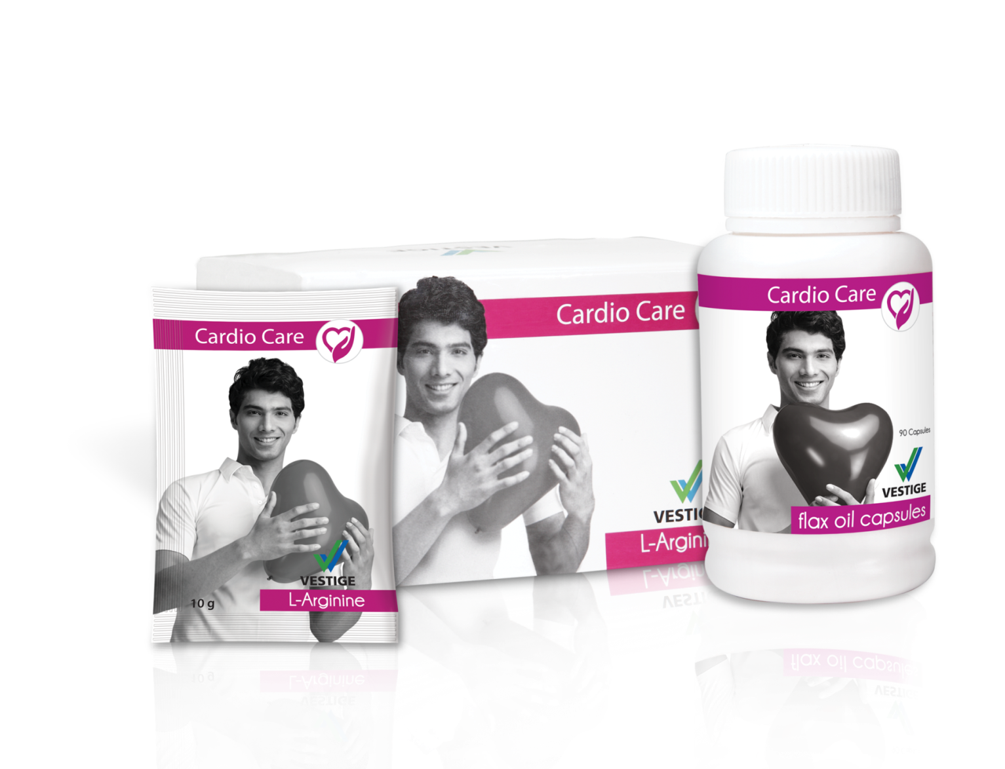
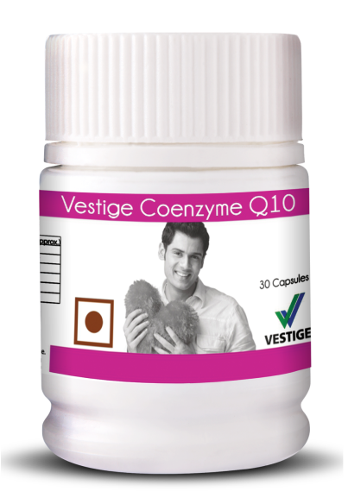
CARDIO CARE
DR DEBI SETTY

Slide 34
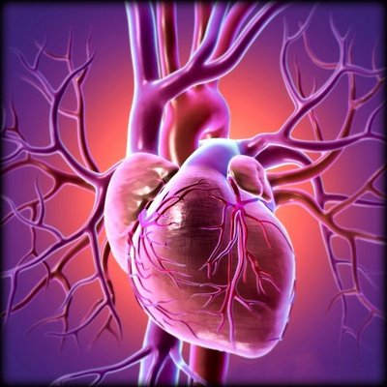
CARDIOVASCULAR HEALTH
HEALTH CARE
Cardio Care
The key areas central to cardiovascular wellness are blood pressure, cholesterol and the health of the heart
For cardiovascular fitness each of these key areas should be maintained, by natural methods and with the help of food supplements
HEART ATTACK

Slide 35
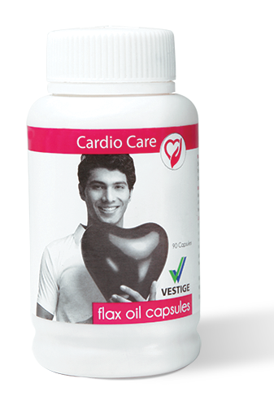
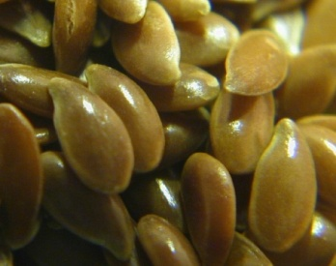
HEALTH CARE
Cardio Care
VESTIGE FLAX OIL
Helps lower ‘bad’ cholesterol in the blood
Helps in stabilizing blood sugar levels and aids in regulating high blood pressure
Helps in normalizing menstrual cycles and eases menopause
FLEX OIL (ASSAMESE)
FLEX OIL (ENGLISH)
FLEX SEED

Slide 36
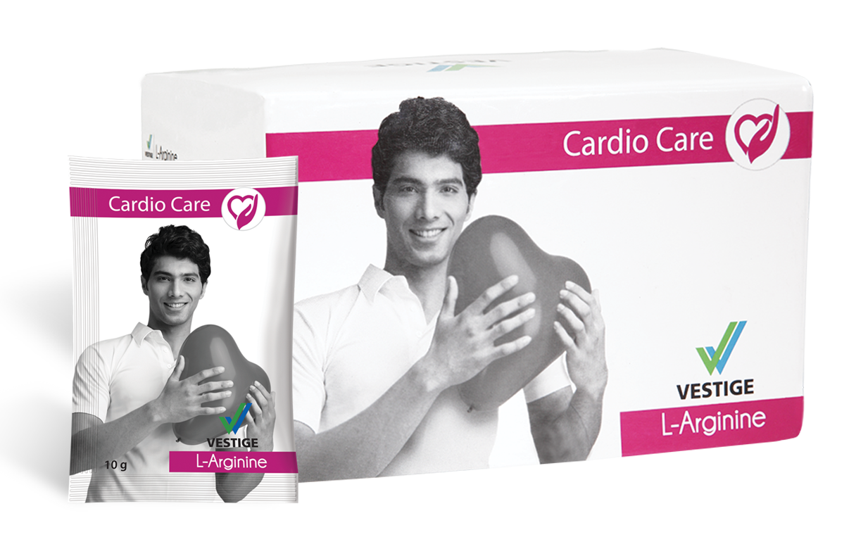
HEALTH CARE
Cardio Care
VESTIGE L-ARGININE
Packed with 5 super heart health enhancing ingredients
Helps regulate blood cholesterol and blood pressure levels
Improves fitness and endurance
Packed with strong antioxidants
Boosts Immunity
L-ARGININE (ASSAMESE)
L- ARGININE (ENGLISH)
DETAIL PPT

Slide 37
HEALTH CARE
VESTIGE Coenzyme Q10
‪Infuse new energy into your heart
‪It’s a natural anti-oxidant‬
‪Boost energy generation capacity‬
‪Boosts the immune system‬
‪An important nutrient to support healthy heart‬
PPT

Slide 38
GLYCEMIC HEALTH
DIABETES

Slide 39
HEALTH CARE
Glycemic Health
IMPORTANCE OF MAINTAINING GLYCEMIC HEALTH
Glycemic health refers to healthy levels of blood sugar
Studies shows that cases of pre-diabetes and diabetes is increasing steadily in India
This rise in unhealthy sugar levels coincide with several other risk factors:
Obesity
Hypertension or high blood pressure
High levels of cholesterol
Cardiovascular disorders
>126 mg/dl DIABETES
100-126 mg/dl PRE-DIABETES
<100 mg/dl NORMAL

Slide 40
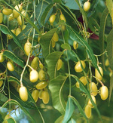
HEALTH CARE
Glycemic Health
VESTIGE NEEM
Powerful blood purifier
Anti-bacterial & Anti-fungal
Helps to regulate blood sugar levels
Useful in treating blemishes and skin disorders
BENEFITS OF NEEM

Slide 41
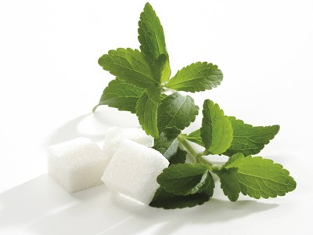
HEALTH CARE
Glycemic Health
VESTIGE STEVIA
100% natural sugar substitute
Calorie free
Fat free
Useful for diabetics and weight conscious
100-300 times sweeter than sugar
No bitter after taste

Slide 42
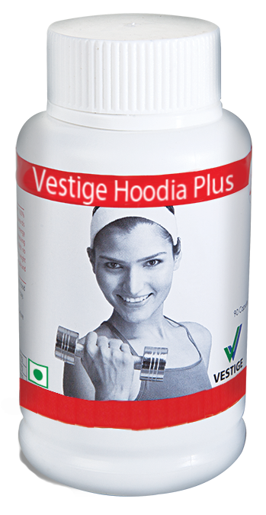
FITNESS + DIET

Slide 43
HEALTH CARE
Fitness + Diet
IMPORTANCE OF FITNESS AND DIET
Right nutrition and physical activity are key to a healthy mind and body
Fitness can make all the difference in how your body looks and feels
Gaining control over your weight improves your self-esteem and renews your confidence
Increased or over weight may also be associated with several other health conditions:
High blood pressure
High cholesterol
Type 2 diabetes
Sleep disorders
Respiratory problems
BMI

Slide 44
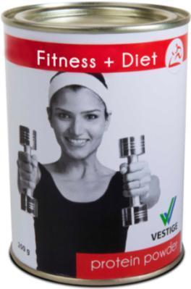
HEALTH CARE
Fitness + Diet
VESTIGE PROTEIN POWDER
Rich source of 20 amino acids
Contains Whey Protein and Soy Isolate
Low in fat & high in protein
Easy to digest
Aids in weight management
PPT

Slide 45
HEALTH CARE
Fitness + Diet
VESTIGE HOODIA PLUS CAPSULES
Naturally suppresses appetite
Converts fat into usable energy
Increases stamina and endurance
Improves metabolism
Strengthens immunity
Helps in weight management
VEDIO

Slide 46
IMMUNITY BOOST

Slide 47
HEALTH CARE
Immunity Boost
IMPORTANCE OF IMMUNITY
Human body has an ability to protect itself from infections that causes diseases – which is called immunity
A healthy immune system is vital for a healthy body, free of disease
It also helps to flush out harmful toxins from the body
Immunity starts at birth, when the mother’s first milk is expressed in the form of colostrum
Vestige offers a wide range of immunity boosting food supplements that helps build a strong immune system and supply the body with adequate nutrients

Slide 48
HEALTH CARE
Immunity Boost
VESTIGE NONI
Benefits of Vestige NONI
Xeronine in Noni enlarges the pores in the walls of the human cells to enable nutrients to enter the cells easily & increase the absorption of nutrients.
Strengthens the immune system as it contains a number of essential vitamins and minerals
People suffering from respiratory problems benefit from its consumption
Helps in case of various skin diseases
Helps promote a healthy digestive system
NONI (ASSAMESE)
NONI (ENGLISH)
NONI BENEFITS

Slide 49
HEALTH CARE
Immunity Boost
VESTIGE SPIRULINA
Benefits of Vestige SPIRULINA
Contains:
13 Vitamins
13 Minerals
3 Natural Pigments
4 Natural Phytonutrients
8 Natural Carotenoids
18 Amino Acids
Strengthens the immune system
Improves digestive health
Enhances natural cleansing & detoxification
Rich in antioxidants
SPIRULINA (ASSAMESE)
SPIRULINA (ENGLISH)
VALUE

Slide 50
HEALTH CARE
Immunity Boost
VESTIGE COLOSTRUM
Helps boost the body’s immune system
Rebuilds & repairs cellular tissues
Energizes the body
Contains 5 vital Immunoglobulins & protease inhibitors
VEDIO
COLOSTRUM PPT
BRIEF

Slide 51
HEALTH CARE
Immunity Boost
VESTIGE ALOE VERA
• Contains more than 20 Amino Acids
• Aids in proper digestion
• Useful in the cases of constipation, acidity, liver weakness and dyspepsia
• Helps treat skin disorders
• Suitable for hair related problems
BENEFITS

Slide 52
HEALTH CARE
Immunity Boost
VESTIGE AMLA
The rich antioxidant content of Amla supports the immune system and prevent premature ageing
A rich source of Vitamin C that help fight cold and coughs naturally
It detoxifies the digestive system and GI tract
It reduces acidity by balancing pH levels and supporting healthy liver function
It is good for the skin and Lustrous hair

Slide 53
DETOX & REJUVENATION

Slide 54
HEALTH CARE
Detox & Rejuvenation
IMPORTANCE OF DETOXIFICATION
Throughout the day our body is in constant contact with environmental toxins
We absorb toxins through our skin, from the air we breathe, the chemicals in our foods, and from the chemicals released in our homes and workplaces
These toxins can harm our body in several ways and lead to many diseases
Detoxification helps in normalizing these toxins and helps process and excrete these toxins out of our system

Slide 55
HEALTH CARE
Detox & Rejuvenation
VESTIGE GANODERMA
Also known as the king of herbs
Regenerates and revitalizes cells by removing free radicals
Scans, checks and detects body disorders
Builds immunity
ASSAMESE
ENGLISH
PPT

Slide 56
HEALTH CARE
Detox & Rejuvenation
VESTIGE DETOX FOOT PATCH
• Works on the principles of foot reflexology
• Removes toxins from our body
• Improves our immune system
• Promotes better health & longevity
ASSAMESE
ENGLISH
PPT

Slide 57
HEALTH CARE
Detox & Rejuvenation
VESTIGE DIETARY FIBRE
It is a special blend of 3 natural soluble fibres sources
Chicory root extract, maltodextrin and Guar Gum
It is a low calorie yet high in fibre that promotes healthy digestive system
It contains natural soluble fibre that may help in weight management as it provides a feeling of fullness when consumed
PPT
HOW IT WORKS

Slide 58
WOMEN’S HEALTH

Slide 59
HEALTH CARE
Women’s Health
IMPORTANCE OF WOMEN’S HEALTH
Today’s lifestyle poses a major burden on women’s health
Empowering women with knowledge of health is the key to women empowerment
Women’s health is of great importance today because a healthy woman nurtures a healthy family
They are often occupied with daily household chores and don’t get time to take care of their health
Understanding about key health issues affecting women and its prevention are important to stay healthy
PPT
WHO & UNICEF

Slide 60
HEALTH CARE
Women’s Health
VESTIGE FOLIC & IRON PLUS
Vestige Folic & iron plus is a combination of Iron, folic acid, Vit. C, B12 and zinc
Iron is an important mineral that the body needs to produce red blood cells (RBCs) and improves hemoglobin levels
Folic acid is needed to form healthy cells, especially RBCs
Vitamin C improves the absorption of iron from the stomach
Vitamin B12 helps in maintaining the health of the nerve cells and for the synthesis of the RBCs
Zinc may help prevent osteoporosis in women during menopause, it also helps to strengthen the immune system

Slide 62
Indoor Air Pollution
HEALTH CARE
Therapeutics
Indoor air can be 5 to 10 times more polluted than the air outside your house
The air we breathe contains the poisonous substances
We Spend 90% of our time Indoors - WHO
There are more allergic elements indoor than outdoor

Slide 63
Indoor Air Pollution – Poses a huge risk to health
HEALTH CARE
Therapeutics
Several studies have shown that there is a direct relationship between exposure to air pollutants and aggravation of asthma
The volume of air that we breath are mostly polluted indoor air full of poisonous harmful substances which accumulates in the airway passage, resulting in infection and contraction of the airway muscles
The common indoor triggers are – pet dander, dust mites, pollen, perfumes, mold, fungus etc.
Continuous exposure to polluted air can lead to wheezing, coughing, shortness of breath, or tightness and pain in the chest

Slide 64
How Air Purifier works
HEALTH CARE
Therapeutics

Slide 65
HEALTH CARE
Therapeutics
Air Purifier…
The One And Only Mechanism to
Generate forest fresh air
Kill infection causing substances not only from air but also from surface
Neutralize smell and unpleasant odours
Remove static electricity
Improve skin hydration
VEDIO
DEMO
PPT

Slide 66
VESTIGE
introduces
VEDIO
PPT

Slide 67
Vital Complex
Lutein, Green Tea, Grape Seed Extracts

Slide 68
Benefits
Protects from the damage of oxidative stress
Helps to nourish body tissues
Helps to accelerate cell regeneration processes
Facilitates better immunity
Tackles fatigue
Provides strength, dynamism and vitality to withstand stress
Assists in prevention of lifestyle diseases

Slide 69
Glucohealth
Maintain Health, Naturally!

Slide 70
Glucohealth Benefits
Assists the body to maintain normal glycemic health
Helps strengthen the pancreas
Helps to optimize insulin secretion
Facilitates gradual glucose absorption
Helps to prevent oxidative damages
Regulate appetite to maintain a healthy body weight
Helps to provide strength to keep body free from chronic ailments of hyperglycemia

Slide 71
Procard
Maintain Health, Naturally!

Slide 72
Procard Benefits
Acts as a cardio-tonic
Helps to manage lipid profile and reduce the risk of atherosclerosis
Helps regulates cholesterol and LDL – “Bad Cholesterol” levels in the blood
Helps to improves HDL – “Good Cholesterol” levels in the blood
Helps to improves blood circulation and useful in management of cardio vascular disease

Slide 73
Toxclean
Detox, Naturally!

Slide 74
Toxclean Benefits
Helps to cleanse colon and purify blood
Helps to relieve constipation
It has Hepato-protective properties – helps to support liver function
Helps to regulate digestion and metabolism
It has anti – microbial properties and helps promote skin health (acne, pimple, etc.)

Slide 75
HEALTH FOOD

Slide 76
HEALTH FOOD
Vestige Health Food helps in having a balanced diet, thus a healthy body
Good nutrition helps maintain a healthy weight and helps all its systems to function optimally
The benefits of good nutrition can be found in physical and mental health because a healthy diet gives the body what all it needs to stay healthy

Slide 77
LITE HOUSE RICE BRAN OIL
The most balanced and versatile oil, closest to recommendations of-
WHO (World Health Organization)
NIN (National Institute Of Nutrition)
AHA (American Heart Association)
Helps manage health of the heart due to the presence oryzanol
Nutritionally superior compared to other cooking oils
Rich in antioxidants
Economical – 15% less absorption of oil during frying
It has a light and neutral flavor, compatible with both, low heat & high heat cooking
Rice Bran Oil is truly "The Healthiest" edible oil, containing antioxidants, nutrients and good fats
INDIA TV REPORT
PPT

Slide 78
HEALTH FOOD
VESTIGE ZETA TEA
• Exquisite blend of pure Assam and long leaf tea
• Rich in antioxidants
• Protect the cells and tissues in the body

Slide 79
HEALTH FOOD
VESTIGE ZETA COFFEE
• A premium blend of carefully selected Robusta and Arabica coffee beans with an intense aroma and a rich full-bodied flavor
• Loaded with natural antioxidants

Slide 80
HEALTH FOOD
INVIGO NUTRITIONAL PROTEIN POWDER
Rich source of amino acids
Contains low-fat soy and whey protein
Enriched with DHA - an important Omega-3 fatty acid
Promotes growth and development in children
Enhances bone health
Aids in weight management
Easy to digest
PPT

Slide 81
HEALTH FOOD
ENERVA CHOCO-FLAXSEED BAR
A tasty wholesome nutrition bar prepared with healthy ingredients
It contains heart healthy flaxseeds
It is high in energy and low in fat
It is also rich in fibre
It helps curb untimely hunger pangs

Slide 82
ORAL CARE

Slide 83
ORAL CARE
IMPORTANCE OF ORAL HEALTH
Oral health is a window to your overall health
Proper oral hygiene like brushing, regular flossing keeps unhealthy infections at bay and prevents tooth decay & gum diseases
Oral health may be related to several health conditions like
Stomach ulcers
Diabetes
Blocked arteries etc.

Slide 84
ORAL CARE
DENTASSURE TOOTHPASTE
Contains Neem, Clove Oil and Calcium
Fights germs & prevents cavities
For clean, white teeth and fresh breath

Slide 85
Dentassure Toothpaste
ORAL CARE
Dentassure Toothpaste is a foaming fluoridated paste for daily use
It is a unique formula with dual protection of Neem and Clove that fights germs and prevents dental cavities
It also helps support gum health
It contains calcium that strengthens the teeth
Use it daily for fresh breath and stronger teeth

Slide 86
ORAL CARE
Dentassure Whitening Toothpaste
Dentassure Whitening Toothpaste whitens teeth by removing surface stains, such as those caused by drinking coffee or smoking
It gently polishes the teeth and removes stains
It helps to retain natural whiteness of the teeth
Cool mint flavour gives long lasting fresh breath

Slide 87
Dentassure Toothbrush
ORAL CARE
An international quality toothbrush, scientifically designed to take complete care of your teeth and gums
Dentassure Toothbrush is made of 100% DuPont bristles with rounded ends that reach between teeth and remove food particles and help prevent dental plaque
Its unique gum massager gently cleans the teeth and massages the gums
It has a special tongue cleaner for better oral health
Dentists recommend replacing your toothbrush every 3-4 months

Slide 88
ORAL CARE
DENTASSURE TOOTHBRUSH
100% Dupoint bristles
Rounded bristles that reaches between teeth & take out food particles and help prevent dental plaque
Cleans the teeth & massages the gums
Unique gum massager & tongue cleaner provide better oral health

Slide 89
PERSONAL CARE

Slide 90
PERSONAL CARE
Proper skin, hair and body care is important to maintain your external health and appearance
Different skin and hair types have different needs
Every effective regimen must include three fundamental elements
Prevention: of skin ageing and hair damage
Protection: from sun damage and environmental pollution
Correction: of lines, wrinkles, discoloration spots and blemishes
Vestige personal care portfolio provides the above benefits with high performing products in the following ranges:
Hair care
Face care
Body care
Self care

Slide 92
HAIR CARE
Assure Deep Cleansing
Shampoo
For Oily Hair
Assure Daily Moisturizing
Shampoo
For Dry + Damaged Hair
z
Assure Ultra Mild
Shampoo
For all Hair Types
Assure Hair Oil
• Enrichedwith Sebaryl that makes the scalp healthy
• Prevents thinning of hair
• Reduces excess oil and controls sebum secretion
• Enriched with chamomile extracts
• Refreshes hair and scalp
• Cleanses, soothes, restores dry hair and repairs split-ends
• Enriched with Avocado Oil
• Restores hair luster and hydrates the hair
• D-Panthenol (Vit-B5) provides long-lasting moisturization
• Special blend of Arnica and tea tree oil
• Helps prevent hair loss
• Adds sheen and prevents dandruff

Slide 93
HAIR CARE
Assure Moisture Balance Hair Conditioner
Assure Hair Spa
It is a unique blend of natural proteins of silk, soy and wheat that transforms the hair from frizzy rebellious to smooth, repaired and shiny hair
It also gives extra protection to hair from daily stresses like sunlight, pollution and dust
It is a unique blend of natural essential oils of Argan, rosemary, tea tree and lavender repairs damaged hair and give it bouncy and shiny effect
This relaxing spa offers deep nourishment that helps the hair from root to tip

Slide 94
FACE CARE
Assure Natural Pure
Face Wash with Exfoliator
Assure Natural Active
Anti-Aging Night Cream
Assure Natural White
Fairness + Sunscreen +
Moisturizer
Assure Natural Glow
Face Pack
Assure Shaving Gel
• Helps clear skin and prevents blemishes
• Includes innovative moisturizing beads
• Cleanses and nourishes the skin
• Replenishing night cream with anti-aging formula
• Contains Pro-retinol and beta-hydroxy
• Dermatologically tested, oil free and does not clog pores
• Oil-free, skin- clearing mask for prevention and treatment of acne
• Helps eliminate blemishes
• Reduces excess oil
• Contains Phyto-white Active, Cucumis Sativus (cucumber), Morus Alba and Hibiscus Sabdariffa extracts
• Gives natural skin lightening effect
• Moisturizes the skin & protects from UV rays
• Enriched with Aloe Vera extract
• Ensures a smooth shave

Slide 95
FACE CARE
Assure Mild Exfoliating Face Scrub
Assure Face Massage Cream
Assure BB Cream
A mild and creamy exfoliating face scrub that effectively removes dead skin cells without over drying the skin
It leaves the skin soft and velvety clean with a radiant and youthful glow
It has rich anti-ageing ingredients that effectively fights wrinkles and fine lines
Provides skin softness, smoothness, fairness and youthfulness
• Brightens, smoothens, moisturises skin and gives an even tone
• Blends perfectly with all skin tones
• An effective and broad spectrum sun protection with SPF 30+
• Helps conceal blemish marks, pores and flaws with a natural tint

Slide 96
FACE CARE
Assure Natural Clear
2-in-1 Cleanser + Toner
Assure Natural Care
Daily Moisturizing Lotion
Assure Sunscreen
SPF 30+
• Cleanses & tones the skin
• Removes make up, dirt, sebum etc.
• Enriched with Chamomile and Sweet Almond
• Brings a radiant glow
• Improves skin elasticity
• Light and oil-free
• Deep nourishing formula
• Goodness of Wheat germ Oil, Aloe Vera & Vitamin E
• All day moisturization
• For soft, younger looking skin
• Forms a protective layer
• Guards against UVA & UVB rays
• Helps prevent tanning and dryness
• Oil-free formula combined with Aloe Vera
• Non-greasy & Waterproof

Slide 99
BODY CARE
Assure Deodorant
for men & women
Assure Body Talc
for men & women
Assure Foot Cream
•Invigorating, refreshing fragrance.
•Unique anti-bacterial formula with natural extracts.
•All day long protection against perspiration and body odour.
Refreshing fragrance
Keeps body odour away
Energizes the body
For a fresh and active feeling.
Nourishes and softens dry and rough feet.
Enriched with extract of witch hazel and effective skin emollients, that hydrates dry and rough skin and locks moisture for longer time

Slide 100
BODY CARE
Assure Complexion Bar
Assure Nourishing & Moisturising Soap
Assure Hand Wash
• Glycerin based Bathing Bar.
• Enriched with Kesar, Olives and Honey.
• Cleanses skin, enhances complexion, moisturizes from within.
• Unique blend of Neem, Tulsi and Pudina.
•Cleanses, disinfects and refreshes skin.
• Enriched with neem and Aloe Vera extracts
• Offers gentle yet effective care for hands

Slide 101
SELF CARE
Vescare Insta Relief Cream
Body Wash
Body Polish
Body Butter
Fast acting relief formula, enriched with eucalyptus and wintergreen oil to relief discomfort
Non-greasy cream that absorbs easily into the skin giving an instant cool sensation
Enriched with Wheat, Soy Proteins and Ginseng Root Extract
Enriched with Kiwi and Strawberry Extracts
Enriched with
Cocoa & Shea Butter

Slide 102
About Skin Formula 9
SKIN CARE
An advanced and sophisticated skincare range from Vestige
The result of our relentless quest to create the perfect skincare range to fulfill every woman’s wish of beautiful immaculate skin

Slide 104
Complete Range
Bond with the Legend
PPT

Slide 105
Flawless beauty
demands a little
mystery each day!

Slide 106
Market Trends
Growing at a vigorous pace, the Indian cosmetic industry is estimated to worth around Rs. 537 billion at present and as per forecasts, it can reach Rs.1032 billion by 2018. The rural market, which currently contributes 30 percent to the overall sales, will play a crucial part in this growth
Nail colour segment in India is estimated to worth Rs. 250 crore
The trend indicates a growing demand for beauty and cosmetic products even in small towns apart from metropolitans
Source: RNCOS, a market research firm

Slide 107
Colour Cosmetics Market
According to “India Women’s Cosmetics Market Forecast & Opportunities, 2020”, the market in India is expected to grow at a CAGR of 16% during 2015-20.

Slide 108
Vestige’s new make up range is all set to arrive and storm the colour cosmetics market.

Slide 109
Mistral – Masked in mystery, the modern woman is a wind of change, carrying success, confidence along with her beauty.
Mistral signifies the wind of change that Vestige will bring in the Indian Colour Cosmetics Market.
Milan - Signifies the Italian Connection! The product formulations are sourced from one of Italy’s best colour cosmetics manufacturer, Ancorotti Cosmetics.

Slide 110
We salute the woman of today and we bring for her the ultimate accessory to her beauty-a complete range of premium quality colour cosmetics that let her be anything she wants to be.

Slide 111
Product Portfolio
Lips
Lipstick (24 shades)
Lipgloss (6 Shades)
Liquid Lipstick (6 shades)
Lip Liner (4 Shades)
Eye
Eye Shadows (3 Trios)
Eye Liners
Kajal
Liquid Eyeliner
Face
Blusher (3 shades)
Compact Powder (4 Shades)
Liquid Foundation (4 Shades)
Face & Eye Make-up Remover
Nail
Nail polish (25 Shades)
Nail Polish Remover

Slide 112
LIPS

Slide 113
EYES

Slide 114
FACE

Slide 115
NAILS

Slide 116
Mistral Tester stands
Designed specifically to help showcase the complete line of colour cosmetics products of Mistral
It will act as a strong medium for customers to check the shades, textures, pay off, etc. of the products before buying them
These Tester stands will be installed in all the centres, including DLCPs

Slide 117
The store will be branded with Mistral of Milan theme, with a Beauty Advisor to help customers explore shades and assisting them in product selection and purchase.
In Store Set-up

Slide 118
AGRI

Slide 119
AGRI PRODUCT
VESTIGE AGRI 82
• Highly concentrated non ionic spray adjuvant with 82% active ingredients
• Increases crop yield by improving pesticide coverage
• Improves water absorption in soil
•Excellent Spreader, Activator and Wetter
Video

Slide 120
Benefits
PPT

Slide 121
Benefits
Improves soil aeration and water holding capacity by making the soil more porous, permeable and aerated
Increases the efficiency of added fertilizers and liberates locked up plant nutrients in the soil
Facilitates higher uptake of nutrients by chelation of already available nutrients in the soil
Increases the capacity of retaining and exchanging soil nutrients, thereby helping the plants to assimilate nutrients from the soil easily
Increases crop tolerance to abiotic stress
Activates the plant metabolic processes due to the presence of phytohormone like activity

Slide 123
SELF HEALTH SERIES
Now available in
8 GB Pen Drive
In Hindi
The Four-Week Countdown Diet
Healthy Living
Think And Grow Rich
Stress Proof Your Business And Your Life
Stress Free Living
The Habit of Winning

Slide 125
For Details Please Contact: Chanakya Sharma
:96780 03463
Success Story

