Slide 1
Skin Formula 9
PRODUCT TRAINING

Slide 2
Good skin is the only ornament that a woman needs to look beautiful
The appearance of the skin is the “first image” that others have of us
Healthy skin is the sign of:
A Healthy body
It boosts self confidence
Makes you look good in everything and anything you wear
Makes you look attractive
Keeps you glowing at every age
Skin Formula 9
Product Training

Slide 3
Skin Basics
Skin is the largest organ of the body
About 2 mm thick & weighs approx. 15 – 17 kg
Its main Function is
Protection
Regulation
Sensation
Comprised of 3 layers:
Outermost layer - Epidermis - A tough protective layer that contains the skin cells (keratinocytes), melanin-producing (melanocytes) and immune cells
Mid layer - Dermis – Composed of the collagen and elastin fibers. Contains nerve endings, sweat glands, oil glands & hair follicles. Dermis is home to the oil glands (sebaceous glands) which produce sebum - your skin's own natural oil
Innermost layer - Hypodermis – Composed of fatty tissue, sweat glands and blood vessels. Provides cushion to internal organs and act as shock absorber
Skin Formula 9
Product Training

Slide 4
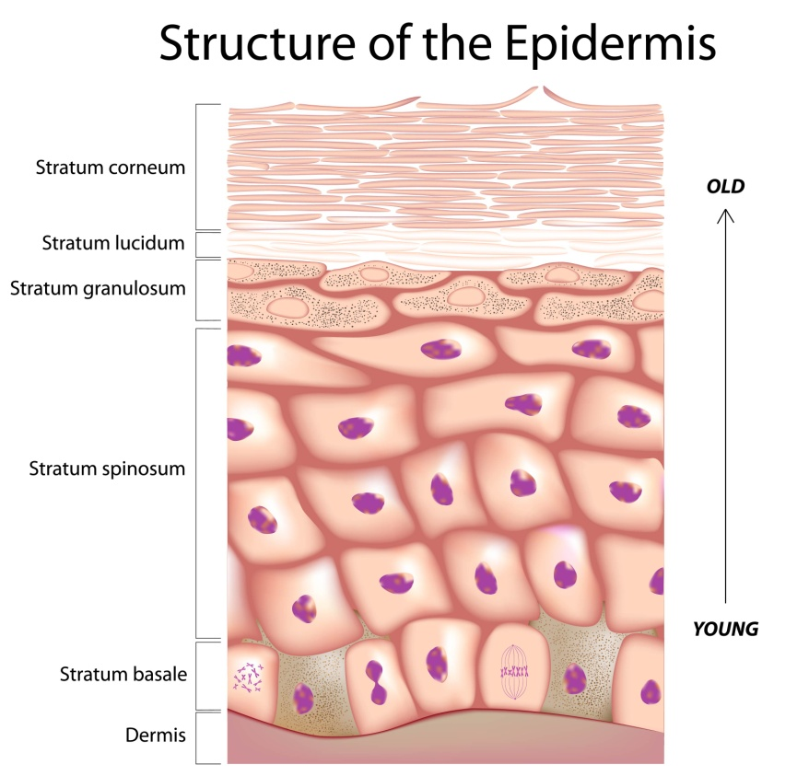
Skin’s Own Defense Mechanisms
Epidermal Cell Turn Over: It is responsible for continuous skin renewal. The outermost layer grow old and shed dead skin (Turnover time – 24-40 days)
The skin barrier regulates hydration and maintains water content in the skin. The sebum produced by the sebaceous glands and sweat by sweat glands, together contribute to skin emollience by forming the hydrolipid layer of the skin
Natural Sun Protection: On sun exposure the epidermis produce pigment melanin that shields the other cells of the skin from sun damage, that cause tanning
Melanin absorbs UV radiation and blocks free radical generation, protecting the skin from sun damage and ageing
Skin Formula 9
Product Training

Slide 5
Skin
Care

Slide 6
Skin Care
Skin that is clear, smooth, and radiant proclaims good health and gives tremendous confidence to how you feel about your appearance
Following some fundamental rules and daily skin care regimen, you can flaunt a healthier, smoother and younger skin at any age

Slide 7
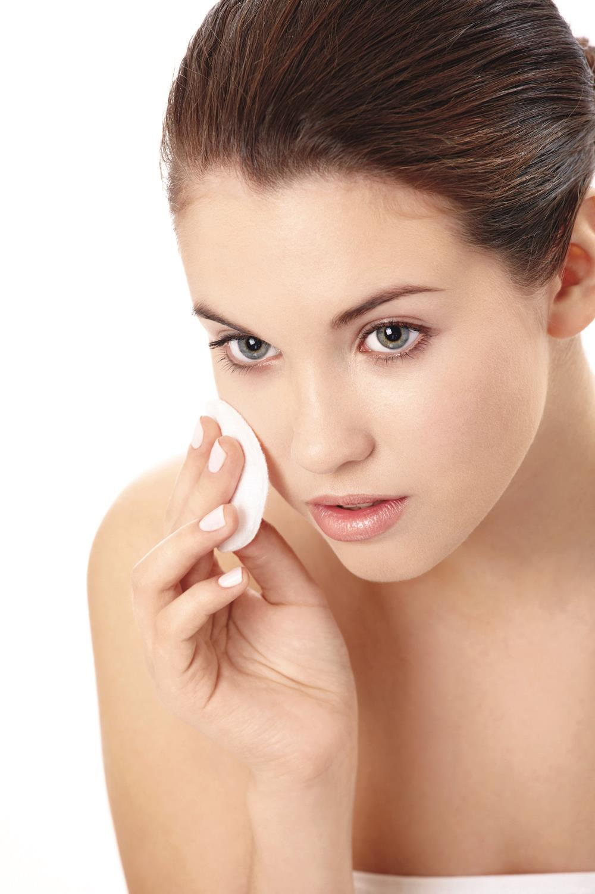
Skin Care
A basic skin care regimen may include the following:
Cleanse It meets the skin’s basic need
to be free of excess oil, dirt and pollutants
Tone prepares the skin to receive benefits
from other products, it calms and soothes the
skin and minimizes the appearance of pores
and balances the skin’s pH
Hydrate or Moisturize provides vital
lipids, replenish moisture and key
repair for optimal night time recovery
Protect meets the skin’s basic need of guarding against harmful UV rays and environmental stressors, and a night regimen to repair damaged and dull skin
Skin Formula 9
Product Training

Slide 8
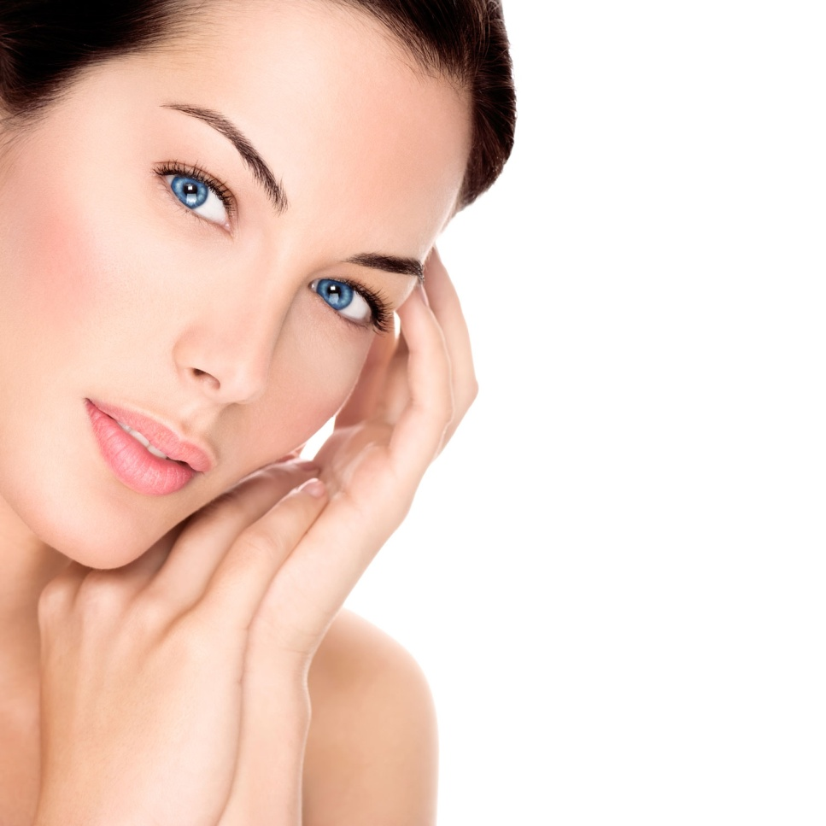
Skin Care
The skin also has advanced needs that can be met by incorporating additional regimen steps designed to address specific concerns, especially in our late 20’s
Every age has its own unique concerns and these concerns vary with age and skin type, for which the skin care regimen also varies accordingly
Skin Formula 9
Product Training

Slide 9
Skin Nutrition –
Beauty Inside

Slide 10
Skin Nutrition – Beauty Inside
Keep your skin functioning at its youthful best by identifying the best diet, nutritional supplements, and skin care products to help compensate for biological changes
Have a well balanced and healthy diet
Including skin healthy nutrients in your diet like Vitamin A, B, E, C, omega 3, antioxidants, biotin, zinc and selenium,
These can benefit the skin in a
number of ways
Skin Formula 9
Product Training

Slide 11
Skin Nutrition – Beauty Inside
Drinking 1.5-3L of water daily gives a dewy and supple skin
Excessive smoking, alcohol, overeating, sweets and fried food can have ill effects on your skin
Including 30-40 mins of activity 3-4 times a week, such as jogging, brisk walking, swimming or yoga also benefits the skin
Exercise promotes healthy circulation and help remove toxins from the body that keeps the skin healthy and vibrant
Skin Formula 9
Product Training

Slide 12
The Ageing Phenomenon

Slide 13
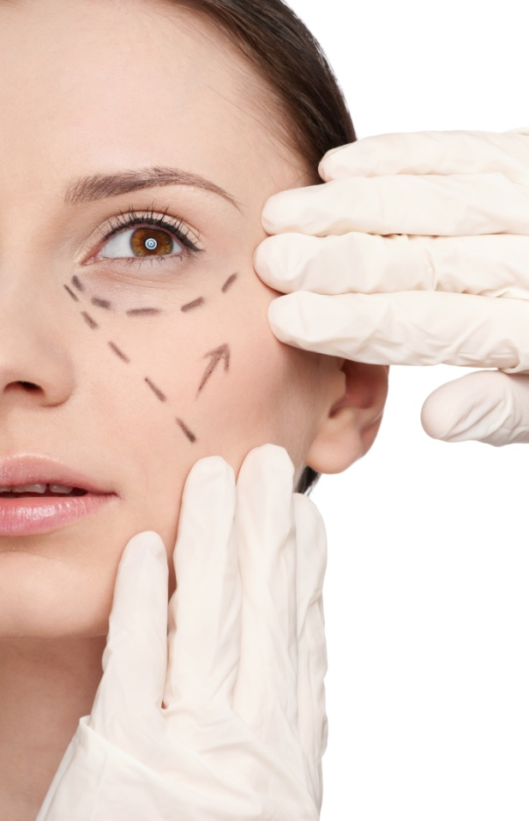
The Ageing Phenomenon
Aging is an inevitable and natural part of life
It’s happening to all of us, and the skin tells it all!
Minimal skin care in your teens can start to catch up with you in your 30s
Suddenly, your reflection appears years older than it needs to
Skin Formula 9
Product Training

Slide 14
The Ageing Phenomenon
Skin aging results from the deterioration of structures in the skin and the slowing of healthy skin functions
There are several factors that effect skin ageing:
Genetic factors – DNA damage
Oxidative stress – free radical damage
Hormonal imbalance
Lifestyle disorders – excessive smoking, alcohol, stress, poor sleeping habits,
Poor Diet
Environmental Pollution
Prolonged sun exposure, harsh skin care products and improper cleansing techniques

Slide 15
The Ageing Phenomenon
The defense mechanisms of the skin work slowly causing various physiological changes in the skin
Ageing is associated with
The skin becomes dryer than usual, due to excessive trans-epidermal water loss (TEWL) and reduced activity of sweat and sebaceous glands
Fine lines and wrinkles – due to decreased collagen levels
Slower rate of cellular renewal – low cell turnover – dull and rough complexion and uneven skin tone
Reduced vascular network
Permanent hyper-pigmentation at certain areas of the skin causing age spots or freckles due to excessive unprotected sun exposure and other factors
Skin Formula 9
Product Training

Slide 16
Age
Related
Problems

Slide 17
Age Related Skin Problems
Dry and dehydrated skin
Wrinkles – reduction in collagen
Dull, rough complexion and uneven skin tone
Age spots – hyper-pigmentation
Skin Formula 9
Product Training

Slide 18
Problem No.1
Dry and dehydrated skin
Skin Formula 9
Product Training

Slide 19
Dry and Dehydrated Skin
A major function of the skin is to provide a protective barrier at the interface between the hostile external environment and internal organs
Healthy, young skin maintains appropriate moisture levels through the skin barrier that uses three main mechanisms to hold water
Epidermal Lipids – that are orderly arranged in the outermost epidermal layer (stratum corneum) to form a barrier to trans-epidermal water loss (TEWL) from the dermis. It act as a cement to the skin cells and seal them together
These lipids include ceramides, cholesterol and fatty acids
natural moisture absorbing agents within the stratum corneum referred to as Natural Moisturizing Factors (NMF) (e.g.: sebum triglycerides, hyaluronic acid)
Hydrolipid film – made of water and lipids which is an emulsion of sweat and sebum that forms a protective layer contributing to skin emollience and suppleness
Skin Formula 9
Product Training

Slide 20
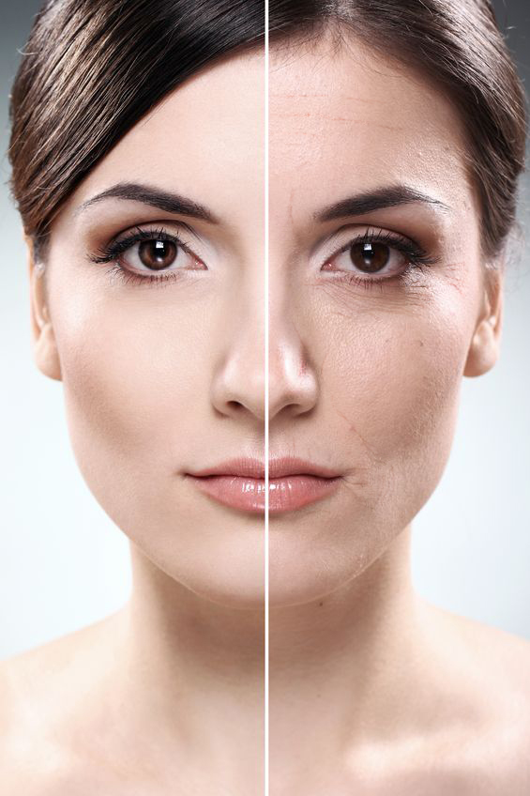
Dry and Dehydrated Skin
As we age, the skin produces fewer of these lipids and NMFs, and reduced activity of sweat and sebaceous glands that causes the hydrolipid film to weaken
All these factors fail to seal enough water within the skin, resulting in increased TEWL that in-turn results in dryness and itchiness
Skin Formula 9
Product Training

Slide 21
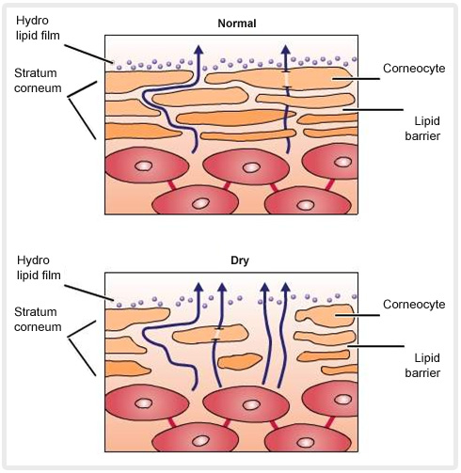
The Skin’s Barrier Function
Skin Formula 9
Product Training

Slide 22
Solution
Skin Formula 9
Intense Hydration Cream
Breathe life into your skin
Skin Formula 9
Product Training

Slide 23
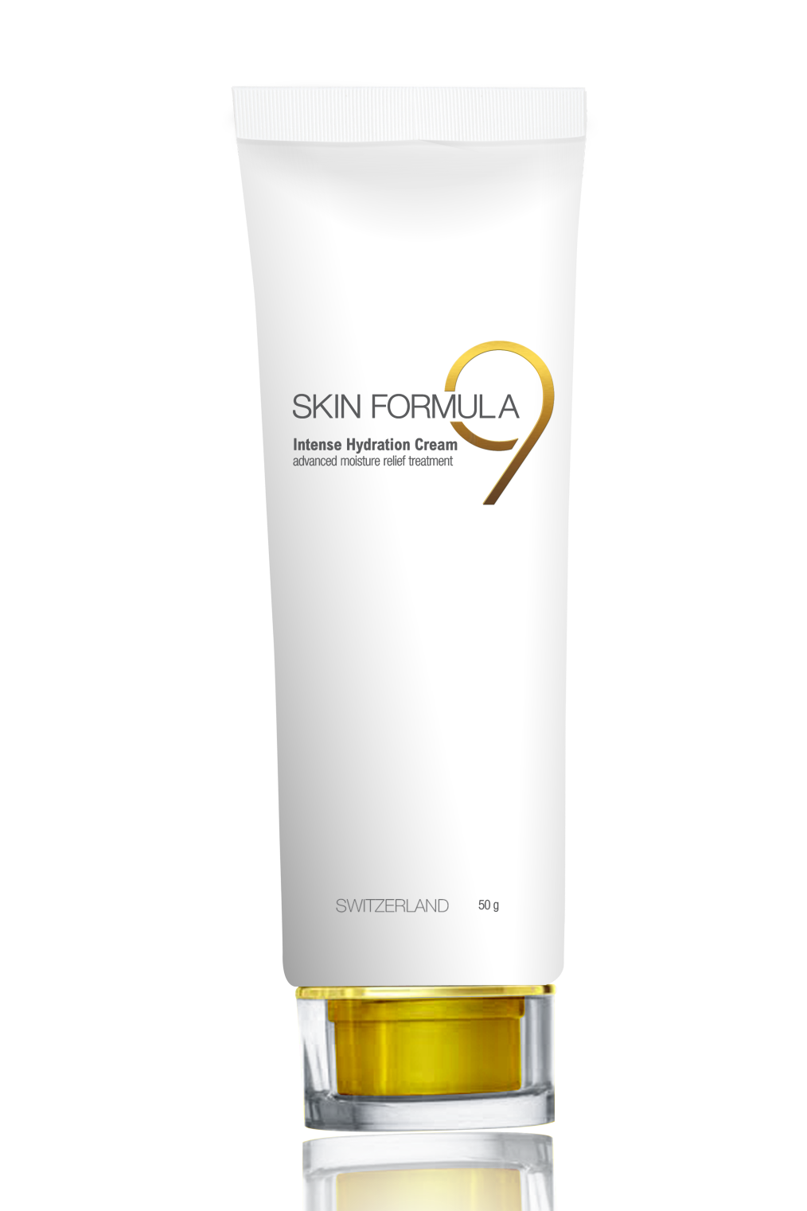
Intense Hydration Cream
Advanced moisture
relief treatment
for dry dehydrated skin

Slide 24
Intense Hydration Cream
Key Features-
Rich hydrating cream for dry dehydrated skin
Moisturizes and nourishes skin from deep within
Forms a protective layer on the skin and shields against water loss
Provides sustainable hydration for longer periods
Boosts collagen synthesis and provides anti-aging and regenerative benefits
Skin Formula 9
Product Training

Slide 25
Intense Hydration Cream
How to Use -
Spread few drops of Intense Hydration Cream evenly onto thoroughly cleansed face and neck using gentle, circular and upward strokes
Use whenever skin feels dry and patchy to give an instant boost of hydration treatment to the skin
For best results use twice daily
Skin Formula 9
Product Training

Slide 27
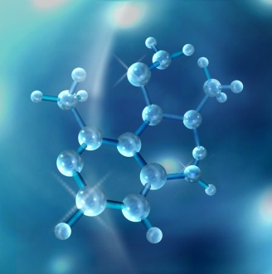
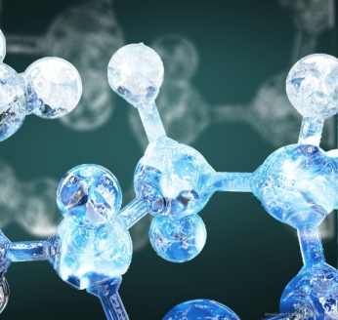
Active Ingredients
Multi-dimensional Moisturizing Complex | Multifunctional Emulsifying Agent | Natural Antioxidant Complex
A complementary blend of botanical peptide actives that act at different levels of the skin At the epidermis – it limits TEWL and helps retain water At the Dermal-Epidermal Junction it improves structural integrity & increased epidermal nourishment At the Dermis – it boosts hyaluronic acid and collagen synthesis for in-depth and sustainable hydration and improves elasticity | It has emollient and moisturizing action on the skin It is composed of natural fatty acid esters that substitute the lost fatty acids in the skin It has water absorbing properties | Contains strong plant based antioxidants that protects the skin from excessive oxidative stress and free radicals that causes premature ageing of the skin
Skin Formula 9
Product Training

Slide 28
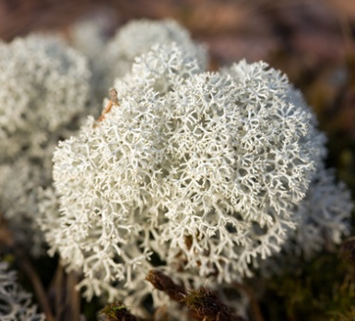
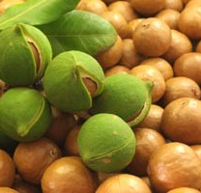
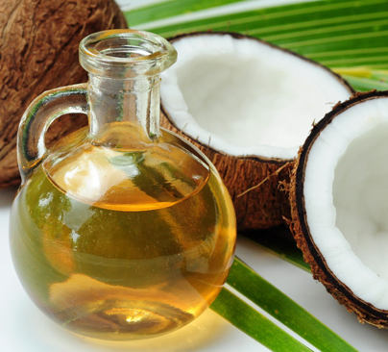
Active Ingredients
Iceland Moss | Organic Macadamia Nut Oil | Coconut Oil
It possesses an exceptional capacity to absorb water and store in its cells It offers deep moisturizing benefits to the skin owing to its polysaccharides, galactomannans and glucans | It has nourishing & skin-conditioning properties It contains palmitoleic acid, which possesses anti-aging benefits Absorbs easily and quickly into the skin leaving the skin feel soft and supple without any greasy residue | It has soothing, moisturizing and film-forming properties It is rich in Vitamin E, which is a strong antioxidant and has skin conditioning benefits
Skin Formula 9
Product Training

Slide 29
Problem No.2
Wrinkles – reduction in collagen
Skin Formula 9
Product Training

Slide 30
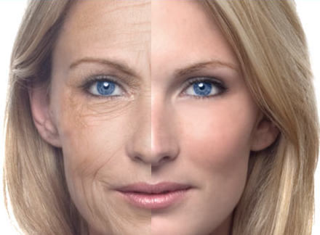
Wrinkles – Reduction in Collagen
Wrinkles is a result of decrease in skin’s structural protein – collagen
Collagen - found in the dermis, provides a mesh-like framework of support and strength for the skin
It gives strength and durability, responsible for smooth plump appearance of young healthy skin
With age, collagen production decreases and collagen fibers degrade at a faster rate
Skin Formula 9
Product Training

Slide 31
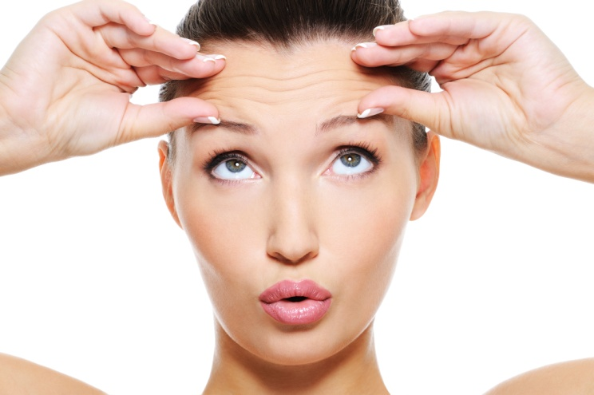
Wrinkles – Reduction in Collagen
Areas with less support begin to cave in and wrinkles begin to form
Multiple factors lead to decreased collagen levels
Natural decline in messenger molecules that trigger collagen production with age
Increase in the enzyme collagenase which breaks down collagen
Increased amounts of free radicals due to UV exposure
Free radicals damage collagen strands and stimulate collagenase activity
Skin Formula 9
Product Training

Slide 32
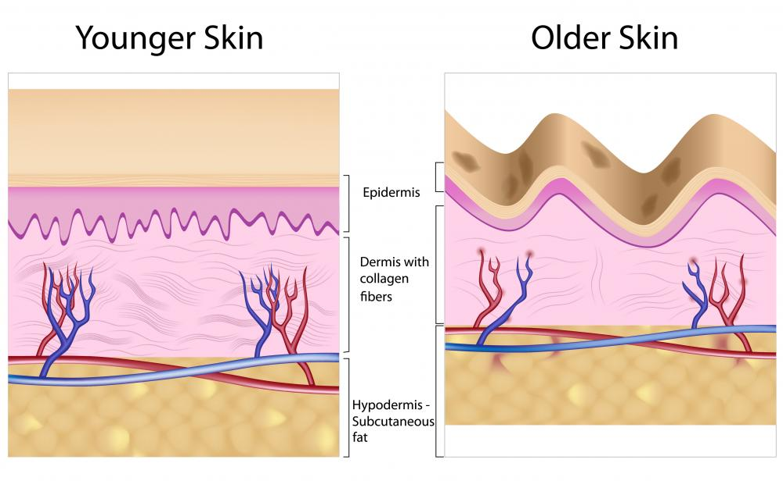
Reduced Collagen Synthesis
Skin Formula 9
Product Training

Slide 33
Solution
Skin Formula 9
Youth Elixir
Secret of youth in a bottle
Skin Formula 9
Product Training

Slide 34
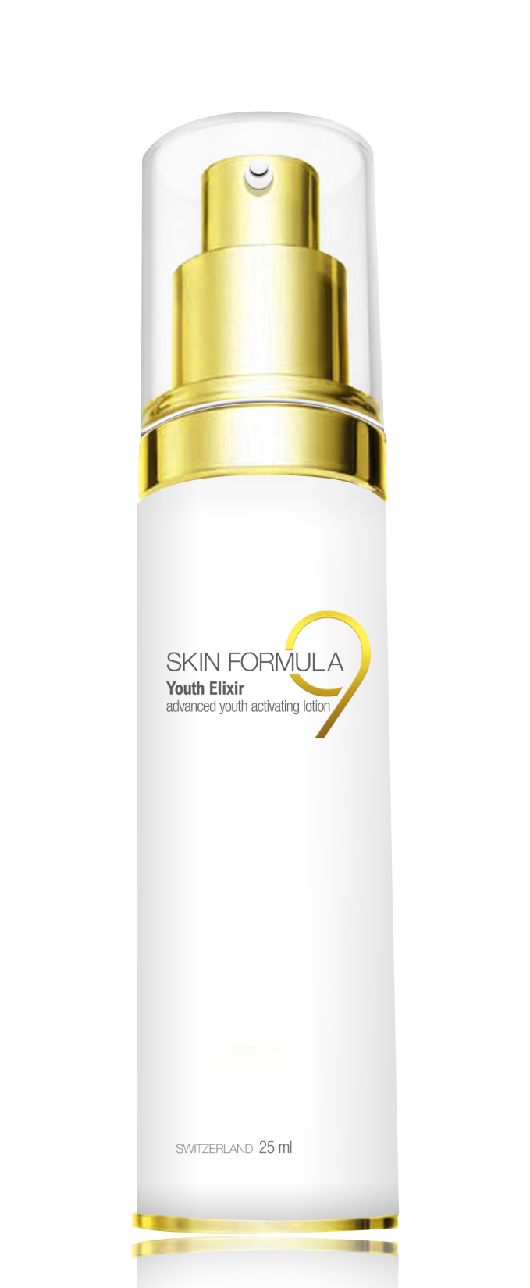
Youth Elixir
Advanced youth
activating lotion
for dull aging skin

Slide 35
Youth Elixir
Key Features -
An exquisite blend of special ingredients
Boosts the skin’s elasticity and suppleness by stimulating collagen production
Dramatically reduces the appearance of fine lines and wrinkles
Contains precious gold dust that enhances radiance and gives a warm glow
Diminishes roughness and provides long-term hydration
Skin Formula 9
Product Training

Slide 36
Youth Elixir
How to Use -
Smooth few drops of Youth Elixir treatment evenly over thoroughly cleansed face and neck in upward circular motions
Allow it to get fully absorbed into the skin for a few minutes for it to start working on the deeper layers of the skin
Follow by a suitable day cream if applied in the day
For best results apply twice daily
Skin Formula 9
Product Training

Slide 38
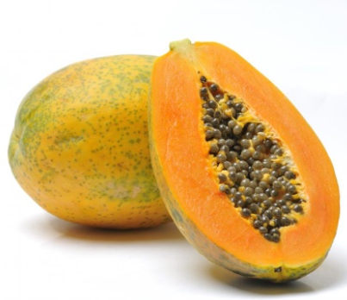
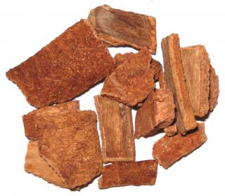
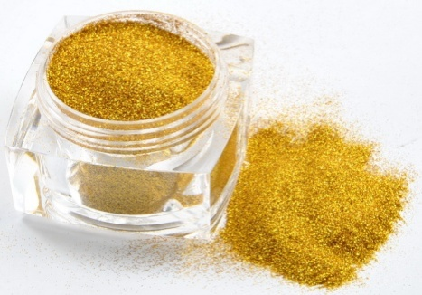
Active Ingredients
ATP + Papaya + Algin Blend | Chuchuhuasi Extract | Gold Powder
The Moisturizing and Revitalizing blend effective on all 3 levels of the skin Energy source to stimulate and activate cellular metabolism Reduces TEWL Increases both short term and long term hydration Papaya – a source of Vit. A and enz. Papain, help remove dead cells and improve tone and texture of the skin by promoting healthy vibrant complexion | A multifunctional botanical active obtained from the bark of an Amazonian rainforest tree It has tonic activity on micro-circulation and stimulant action on cell metabolism A potent antioxidant, anti-inflammatory and healing extract | It enhances skin radiance It helps to maintain skin elasticity and firmness Its effect is enhanced by Gold Pearlescent Pigment – This photo reflective agent gives a subtle shimmery effect that delivers beautiful color and effect to the skin and excellent coverage and luster
Skin Formula 9
Product Training

Slide 39
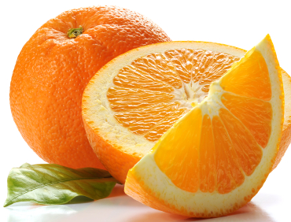
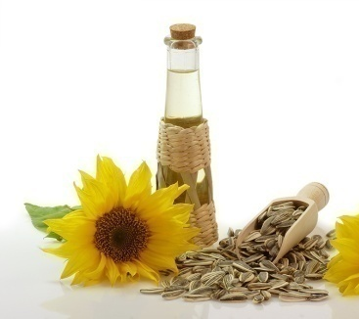
Active Ingredients
Sodium Hyaluronate | Vitamin C | Sunflower Seed Oil
Has strong moisturizing and film-forming properties Promotes suppleness elasticity and tone It travels deep down into the dermis to combine with, maintain and attract water It also promotes skin/blood microcirculation and nutrient absorption, and helps maintain normal metabolism This result in smoother, softer skin with decreased wrinkles and an all-around fuller appearance | It helps to fight premature ageing by boosting collagen production in the dermis as a cofactor in its synthesis Reduces appearance of wrinkles, improves skin elasticity and firmness Neutralizes free radicals Lightens dark age spots and reduces acne formation It increases circulation of blood that promotes healthy and vibrant complexion | An excellent film-forming agent that provides restructuring, regenerative and moisturizing benefits Rich in antioxidant vitamins, A, C and E Helps to maintain youthful appearance Sooth appearance of existing wrinkles
Skin Formula 9
Product Training

Slide 40
Problem No.3
Dull, rough complexion with uneven skin tone
Skin Formula 9
Product Training

Slide 41
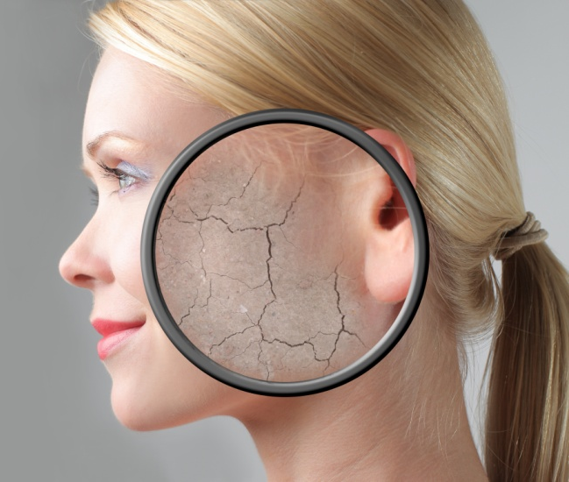
Dull, Rough Complexion with Uneven Skin Tone
Healthy, young skin remains smooth and radiant because fresh, new cells are brought to the surface as older cells are continuously shed
The skin cells in the bottom layer of the epidermis (stratum basale) constantly divide, forming new keratinocytes. This regenerative process is called Skin Cell Renewal or Cell Turnover
Skin Formula 9
Product Training

Slide 42
Dull, Rough Complexion with Uneven Skin Tone
The rate of skin cell renewal decreases with age, causing cells to become more sticky and not shed as frequently
Skin becomes thinner and more susceptible to environmental damage, especially UV rays
This makes the skin appears dull and rough in texture
Skin Formula 9
Product Training

Slide 43
Dull, Rough Complexion with Uneven Skin Tone
Several factors contribute to the decline of Cell Turnover with age
Weakened blood vessels in the dermis and flattening of dermal papillae decreases the surface area between the dermis and epidermis across which nutrients can diffuse
This causes decrease in nutrient and oxygen supply to the basal cells in the lower epidermis and cell division decreases
UV exposure can also penetrate the epidermis damaging basal cells, and slow the rate of cell division
Failure to exfoliate the surface of the skin with physical and chemical exfoliators for the purpose of smoothing the skin that stimulate cell renewal
Skin Formula 9
Product Training

Slide 44
Solution
Skin Formula 9
Repair Sleeping Mask
Wake up to a flawless you
Skin Formula 9
Product Training

Slide 45
Repair Sleeping Mask
Nourishing
night renewal therapy
for damaged undernourished skin
Skin Formula 9
Product Training

Slide 46
Repair Sleeping Mask
Key Features -
Anti-oxidant rich mask with skin restructuring and regenerating properties
Provides the triple benefits of brightening, toning, moisturizing
Helps repair UV damage and reduces the signs of aging
Enhances hydration and fights acne
Skin Formula 9
Product Training

Slide 47
Repair Sleeping Mask
How to use -
Apply a thin and even layer over thoroughly cleansed face and neck before going to bed
Massage gently using circular strokes
Leave it overnight and allow it to work on your skin’s reconstruction mechanism while you are asleep
Gently wipe with a warm wet wash cloth in the morning to experience a soft, supple and renewed skin
For best results use the treatment two – three times a week
Skin Formula 9
Product Training

Slide 49
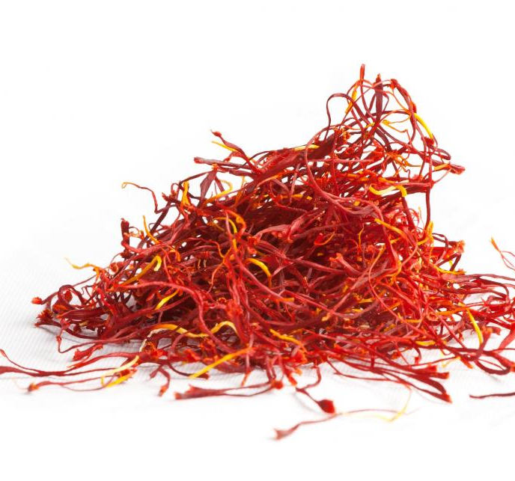
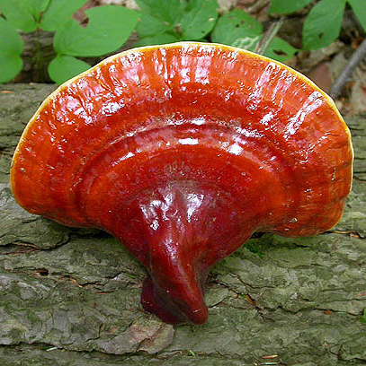
Active Ingredients
Saffron | Dendrobium Flower Extract | Ganoderma Extract
It has exfoliating properties that aids in clearing and brightening up the complexion It is an excellent skin lightening agent that helps to lighten skin tone dramatically It can also help create a brighter and clearer complexion because of its antibacterial properties | It enhances skin quality by keeping the skin moist, soft and radiant It is rich in skin conditioning polysaccharides that help to hydrate skin for longer time Its amino acids helps to repair skin proteins damaged due to oxidative stress | It is a powerful antioxidant and an excellent anti-ageing agent It is rich in polysaccharides making it an ideal moisturizing agent It also has nourishing and remineralizing properties owing to its high content of amino acids, proteins and minerals
Skin Formula 9
Product Training

Slide 50
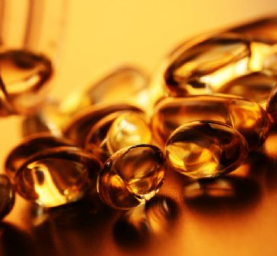
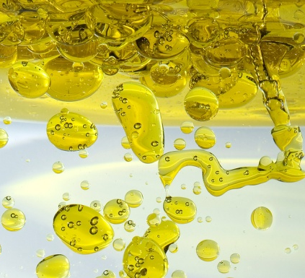
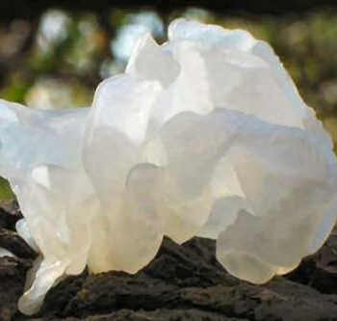
Active Ingredients
Niacinamide (Vitamin B3) | Vitamin E | “Silver ear” Mushroom Extract
Increase ceramide and free fatty acid levels in skin, prevent skin from losing water content, and stimulate microcirculation in the dermis Helps in treatment of wrinkles, by stimulating collagen synthesis Brightens skin complexion by interfering in the transfer of melanin Strengthens the stratum corneum by increasing the rate of skin surface renewal to help reverse the appearance of past damage | It has strong antioxidant and moisturizing properties Relieves dryness and promotes healing Speeds up cell regeneration that helps to lighten scars, acne and wrinkles | It has a strong botanical moisturizing sugar molecule – Tremella polysaccharide which is a strong hydrating agent It forms a comfortable and flexible film at the skin surface - improves skin’s water holding capacity and suppleness It is also a strong antioxidant that prevents skin damage by environmental pollutants
Skin Formula 9
Product Training

Slide 51
Problem No.4
Age spots – hyper-pigmentation
Skin Formula 9
Product Training

Slide 52
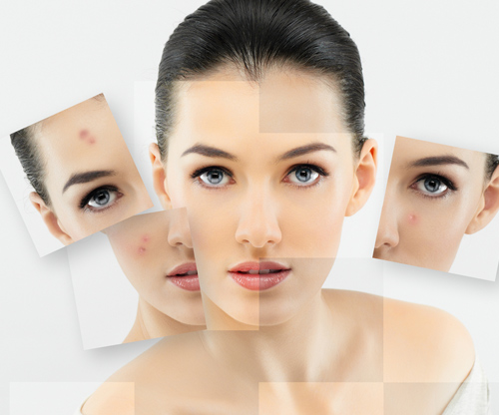
Age Spots – Hyper-pigmentation
Melanin is produced by melanocyte cells in the lowest layer of the epidermis (stratum basale)
It is a photo-protective pigment that absorbs and scatters UV radiation and helps protect healthy skin from stress of mild UV exposure
Excessive exposure to sunlight can cause melanocytes to multiply rapidly
High level of melanin production by some melanocytes and not by others results in blotchy, uneven freckle like appearance
- This results in age spots
Skin Formula 9
Product Training

Slide 53
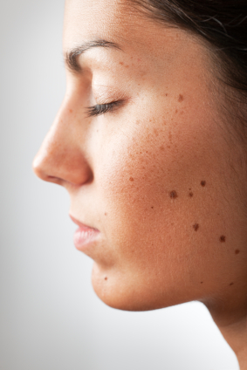
Age Spots – Hyper-pigmentation
Many factors contribute to pigmentation:
Hormone imbalance that occur with advanced age result in fewer melanocytes, any external stimuli (or inflammatory response) cause them to cluster together and trigger excessive melanin production
Inflammation – caused by sunlight or skin irritation, may directly lead to activation of melanocytes to release excessive melanin
Skin Formula 9
Product Training

Slide 54
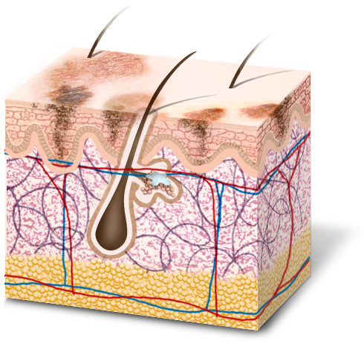
Age Spots – Hyper-pigmentation
Female hormones – estrogen and progesterone, can also trigger hyper-pigmentation sites on the skin (common in pregnancy)
UV rays that penetrate the skin and damage melanocyte DNA, can stimulate melanocytes to enlarge and cluster together
Acne – an inflammatory condition, can also trigger melanin production
Poor skin care habits can lead to skin irritation – that triggers hyper-pigmentation by melanocytes
Skin Formula 9
Product Training

Slide 55
Solution
Skin Formula 9
Brightening Treatment
Reveal Your True Radiance
Skin Formula 9
Product Training

Slide 56
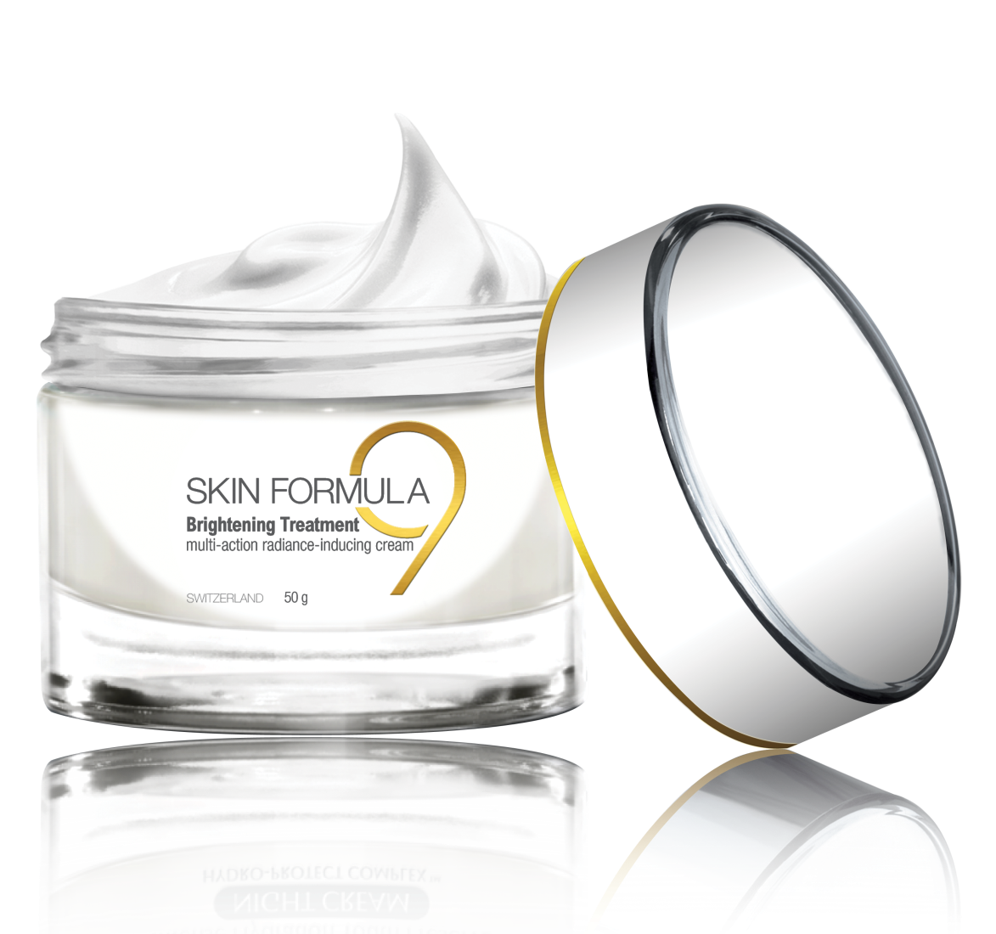
Brightening Treatment
multi-action
Radiance inducing
cream for
dull uneven skin
Skin Formula 9
Product Training

Slide 57
Brightening Treatment
Key Features -
A corrective radiance-inducing multi-action formula
Lightens freckles and age spots
Clarifies skin to give a flawless even complexion
Detoxifies the skin and efficiently fights free radicals
Hydrates the skin and attenuates skin imperfections
Skin Formula 9
Product Training

Slide 58
Brightening Treatment
How to use -
Apply few drops on thoroughly cleansed face and neck
Follow by spreading evenly all over the face and neck in gentle circular and upward strokes
Allow it to get fully absorbed into the skin for it to work in the deeper layers of the skin
Follow by using a suitable day cream
For best results use the treatment twice daily
Skin Formula 9
Product Training

Slide 60
Active Ingredients
Claripure Stem Cell Blend | Daisy Flower Extract | Narcissus Flower Wax
It boosts the skin’s cleaning and recycling system by avoiding accumulation of damaged proteins and free radicals It helps to clarify the skin by eliminating impurities at the cellular levels It detoxifies skin cells It reduces the proliferation of acne causing bacteria It decreases the formation of melanin | The skin lightening agent derived from daisy flower helps fight pigmentation disorders Lightens freckles and age spots, providing even skin tone It influences the biochemical pathways involved in melanin synthesis | This specialized wax has an emollient effect on the skin It has both calming and astringent effect
Skin Formula 9
Product Training

Slide 61
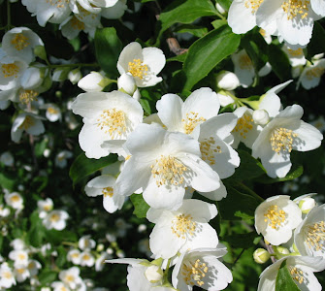
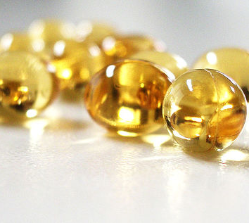
Active Ingredients
Jasmine Flower Wax | Niacinamide (Vitamin B3) | Acacia Flower Wax
It is a natural skin conditioner with regenerative and relaxing properties It has a relaxing fragrance contributed by the flower itself that helps to calm the senses | It brightens skin complexion by interfering in the transfer of melanin all over the skin It significantly reduces age spots, yellowing and blotchy spots by increasing the rate of skin surface renewal to help reverse the appearance of past damage Strengthens the skin by increasing resistance to barrier damage - keeps the skin hydrated Stimulates collagen synthesis - increases skin’s elasticity and helps smooth wrinkles | It is a natural skin emollient and skin conditioning agent It has calming and skin protecting properties
Skin Formula 9
Product Training

Slide 62
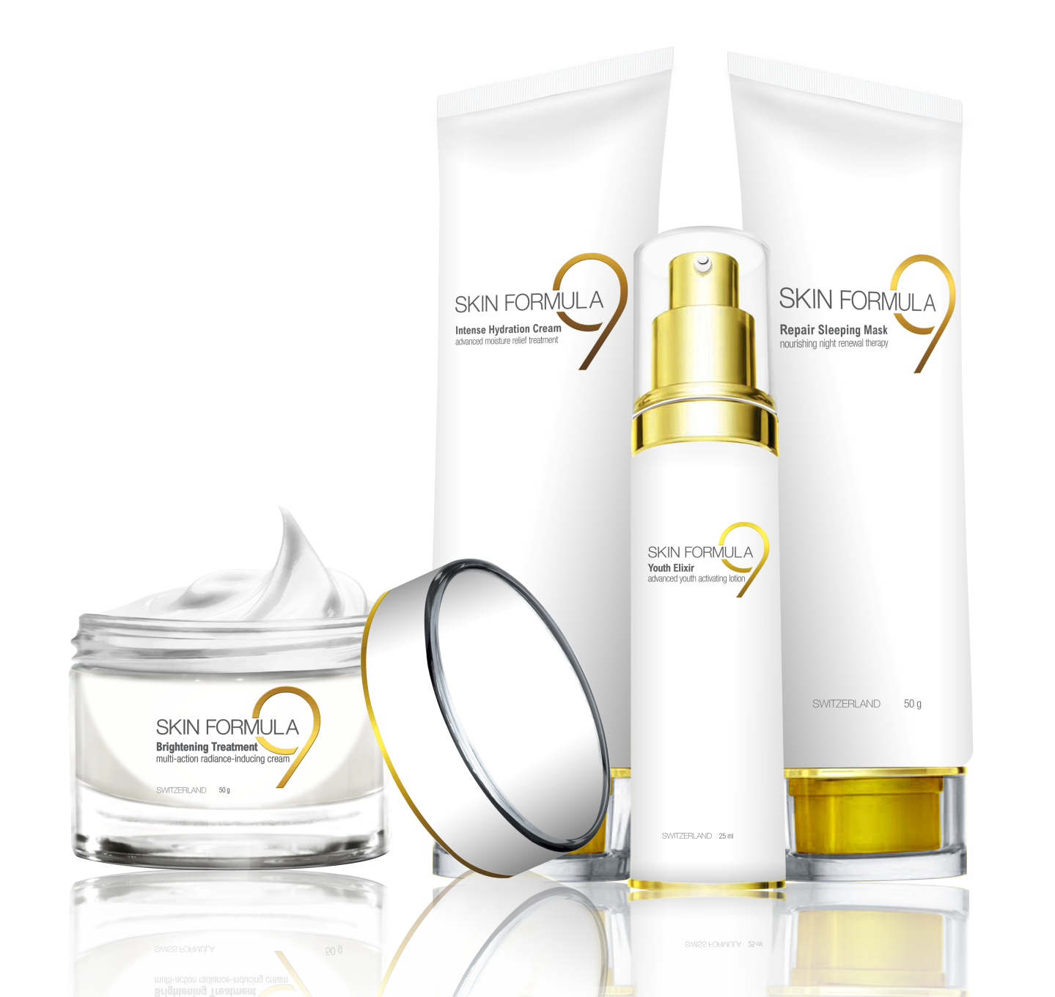
The Skin Formula 9 Range

