Slide 2
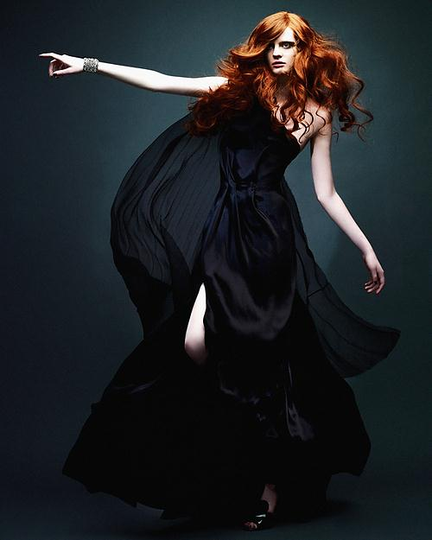
Flawless beauty
demands a little
mystery each day!

Slide 3
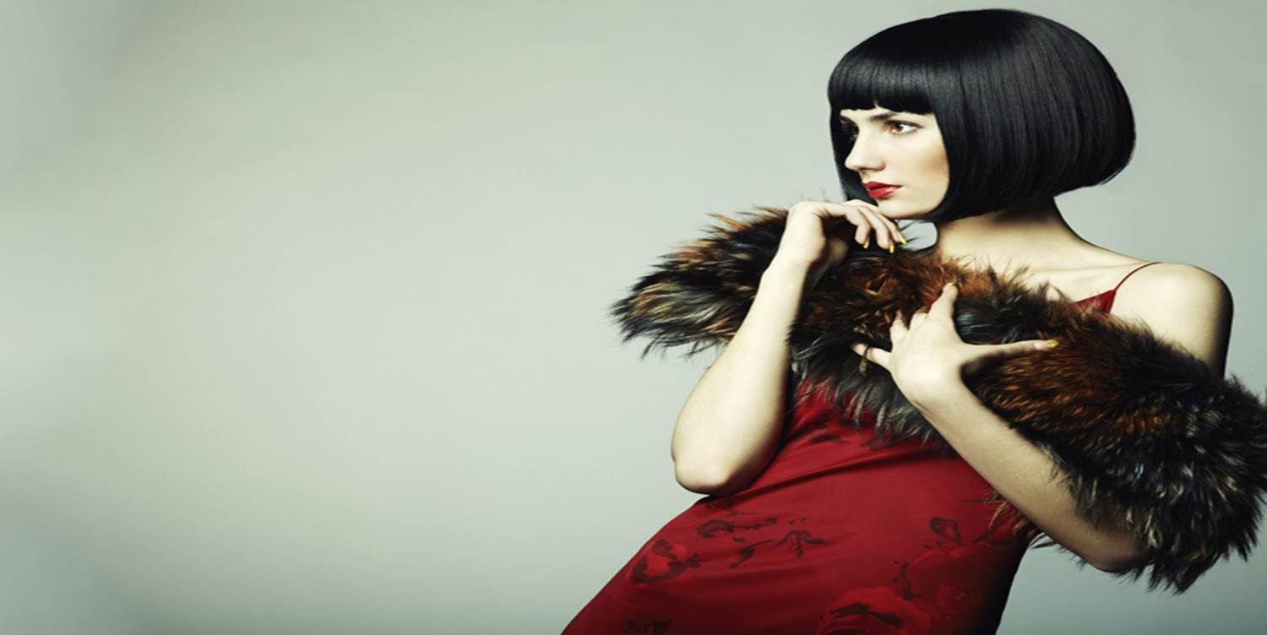
COLOuR Cosmetics Industry overview

Slide 4
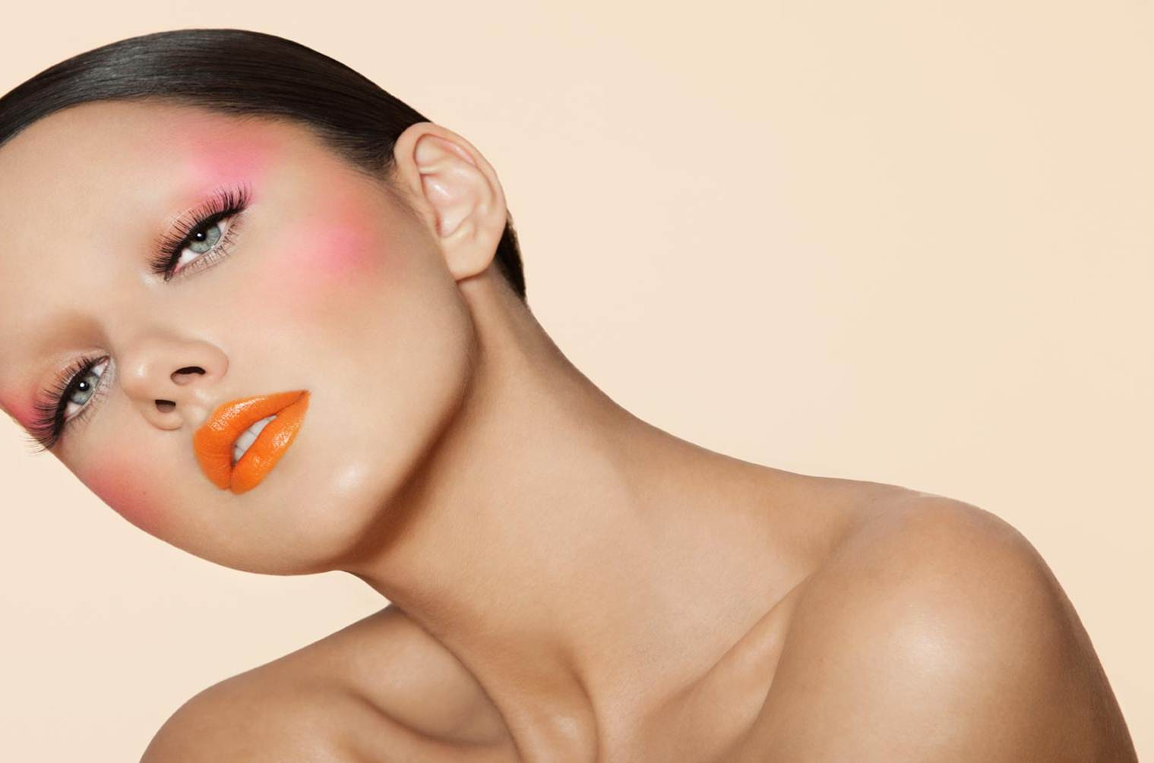
Trends To Watch Out!
The trend indicates a growing demand of beauty and cosmetics products in small towns.
Growing at a CAGR of 18 percent, Indian cosmetic industry is estimated to be around Rs 537 billion and forecast to reach Rs 1,032 billion by 2018. And rural, which currently contributes 30 percent, would surely add a major chunk.
Women's nail colour segment in India is estimated to be Rs 250 crore market.
Source: RNCOS, a market research firm

Slide 5
Organized Colour Cosmetics Market
According to “Indian Cosmetic Sector Forecast to 2015”, the color cosmetics market witnessed a CAGR of more than 25% during 2013-2015.:
Source: RNCOS, a market research firm

Slide 6
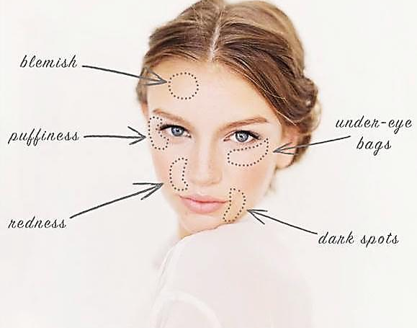
Why Do We Need Cosmetics
A recent experiment revealed that women pictured wearing cosmetics were evaluated as healthier, more confident, and even having greater earning potential than the same women wearing no makeup*. This suggests that makeup has a potentially useful role.
To enhance the natural beauty
It simply serves as a booster to ones natural self-confidence.
A woman may wear makeup to give her face a more youthful appearance.
Excellent for covering up flaws. For example, puffy eyes after a busy schedule, dark circles under eyes. It can also serve to brighten the face and camouflage blemishes, visible pores, uneven tone , pimples, age spots and even some scars.
*Nash, Fieldman, Hussey, Leveque, & Pineau, 2003

Slide 7
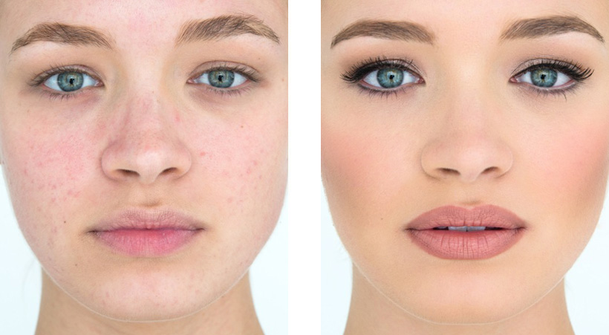
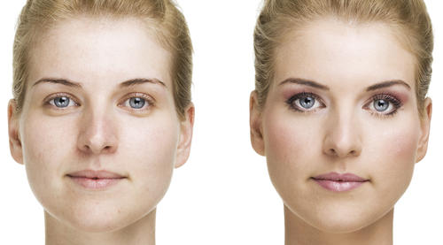
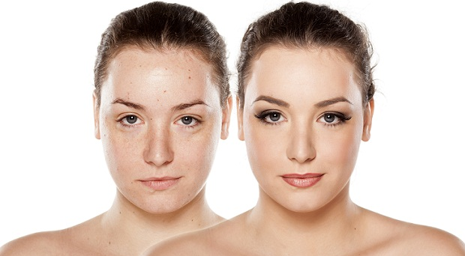
Significant transformation!

Slide 8
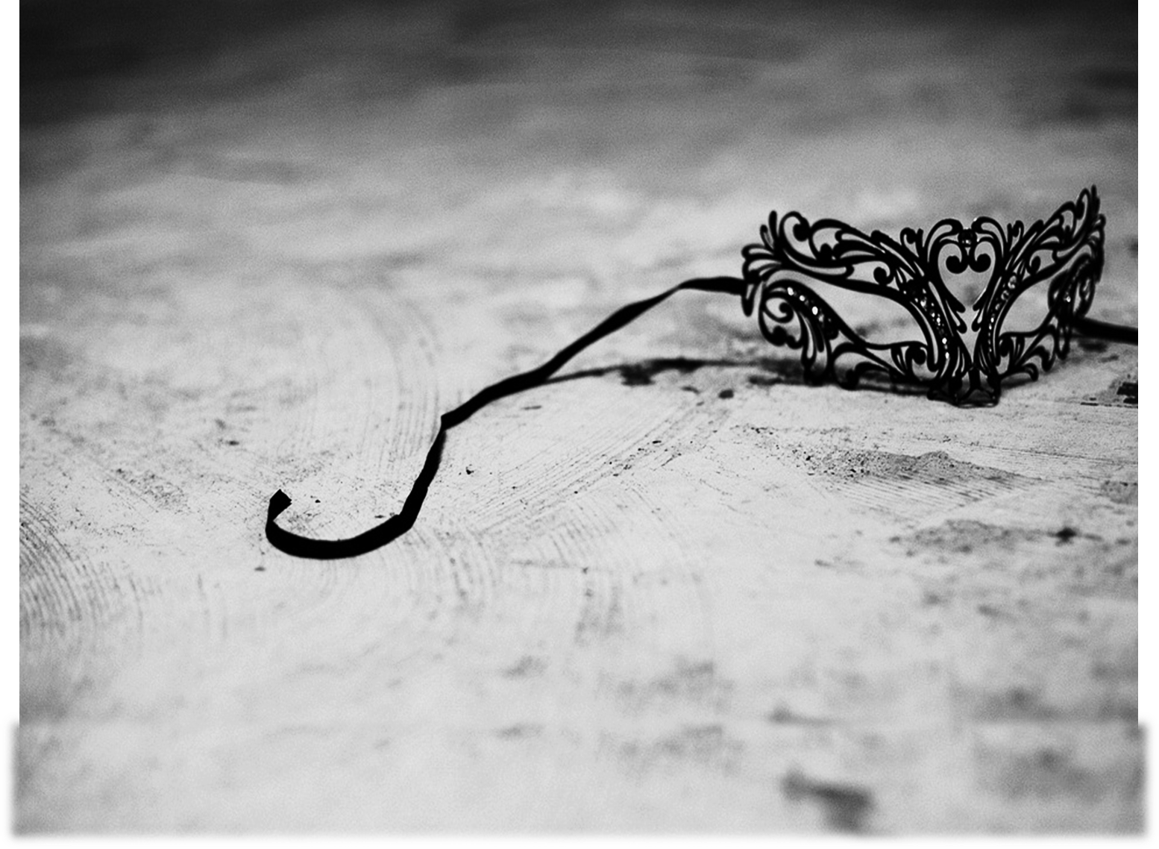
Masked in mystery the modern woman is a wind of change, carrying success, confidence along with her beauty.

Slide 10
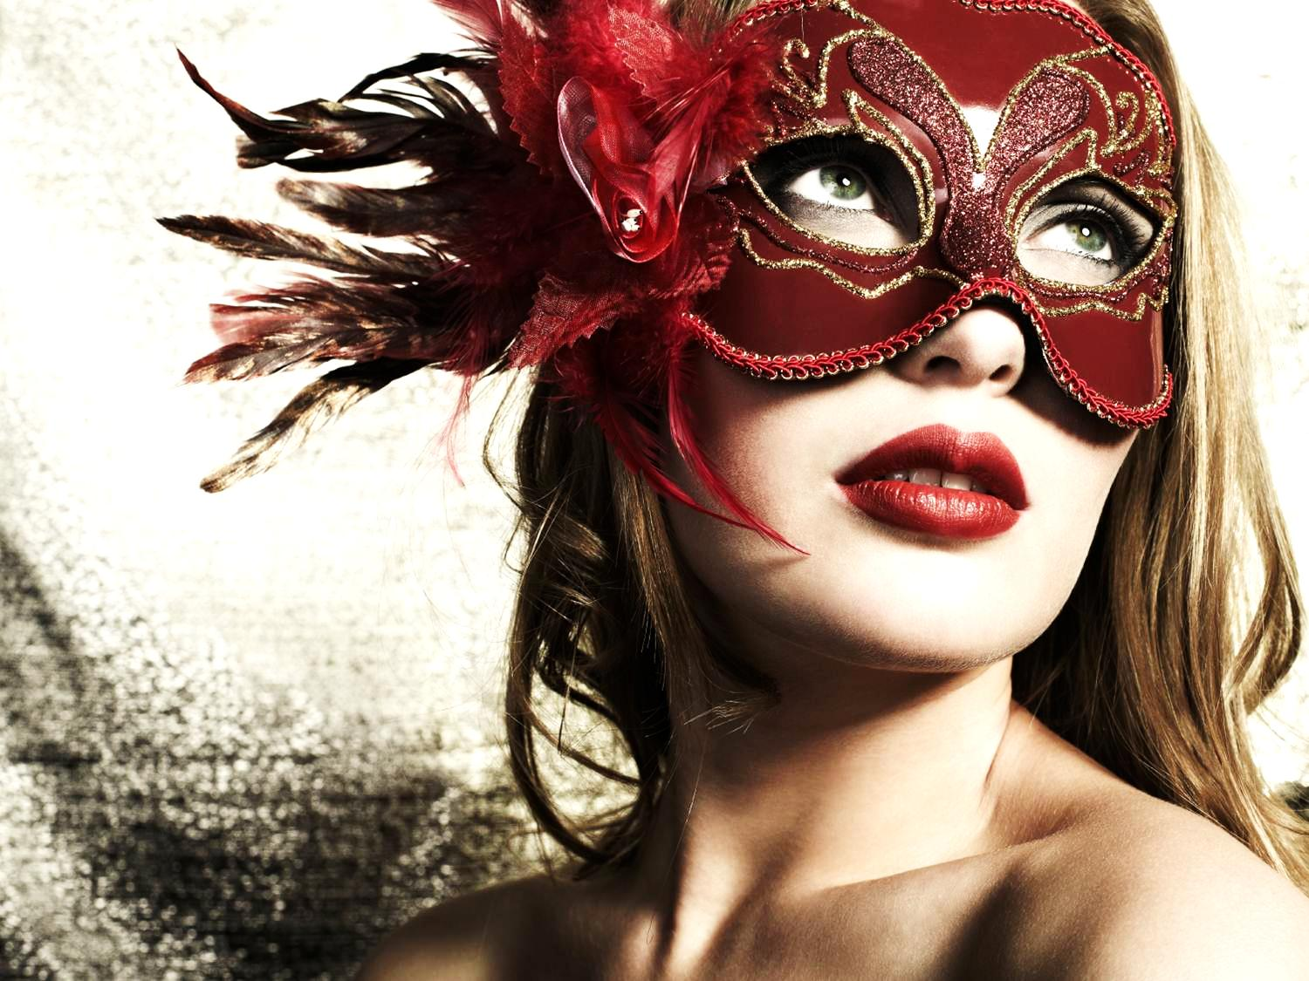
Flawless beauty demands a little mystery each day!
Holds a mystery in her eyes and a secret in her heart.
She is the queen of her world.
She is fierce.
She is strong.
She is mistral, the wind of change that cuts through the clouds
and brings freshness all around.
She questions, she answers, she leads.
She has many faces, many hues, many moods but the fire in her burns with the same intensity throughout.

Slide 11
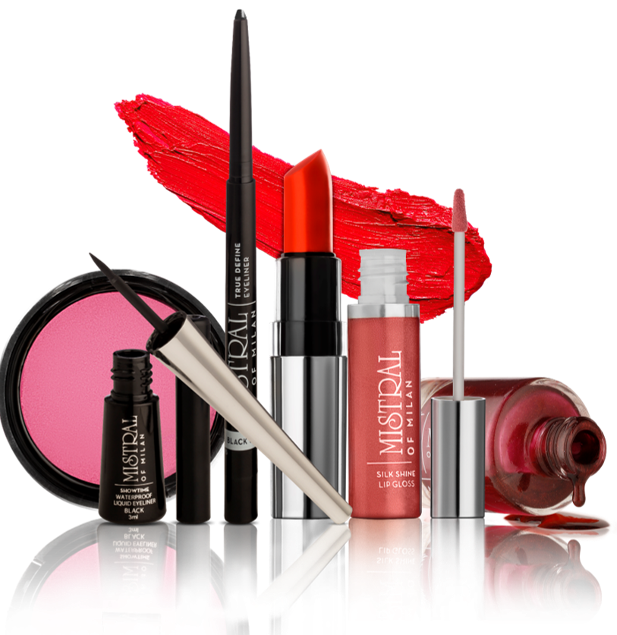
Vestige Presents

Slide 12
FACE

Slide 13
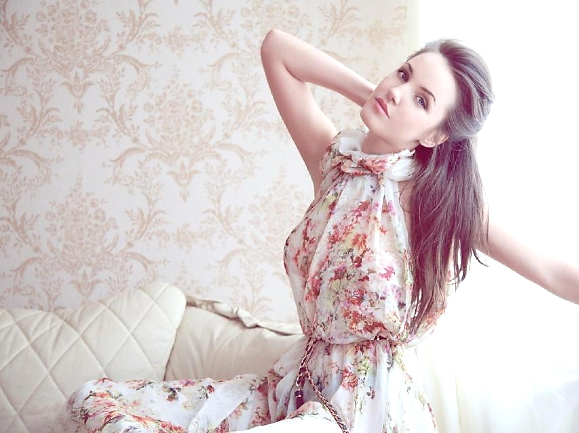
Perfect Blend Liquid Foundation
Looks natural on skin. Gives a super coverage and a translucent matte finish. It is light and velvety to touch, it minimizes flaws and pores, without clogging them.
Easy to apply, it dries quickly and is not greasy or sticky!
With Advanced Luminous Technology which deeply moistures the skin giving to the skin a radiant color and a silky glow.
It has UV filters and SPF 30 which protects the skin from UV rays.
Enriched with sweet almond oil, rich in proteins, carbohydrates, minerals, vitamins A and B

Slide 14
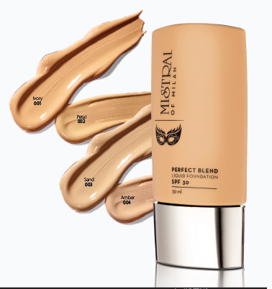
Mistral of Milan Perfect Blend Liquid Foundation
Shades | MRP | DP | BV | Product
Ivory 001 | 450 | 385 | 231
Petal 002 | 450 | 385 | 231
Sand 003 | 450 | 385 | 231
Amber 004 | 450 | 385 | 231

Slide 15
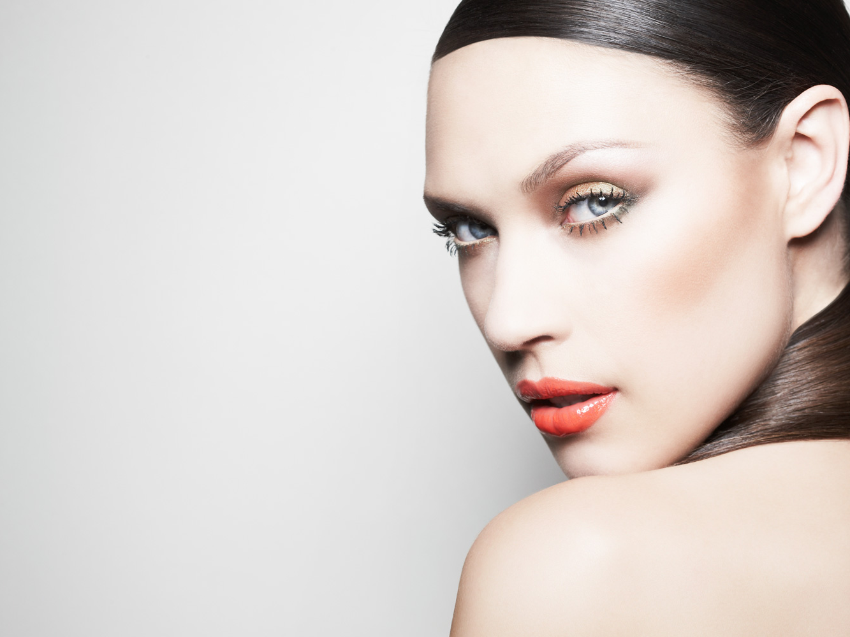
True Look Compact Powder
This wonderful compact powder which will keep your skin shine free.
A daily compact powder which absorbs the excesses of sebum and highlights the hidden beauty of your skin!
Make it your daily beauty tool, making your skin soft, silky and moreover, refreshingly matt
gives the wonderful silky feel to the skin
very spreadable and velvety finish
it lets skin breath
Paraben free

Slide 16
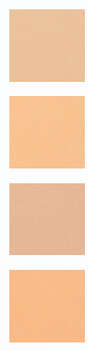
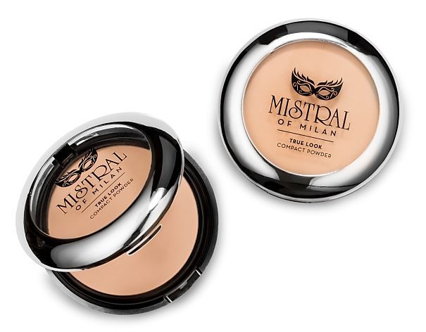
Mistral of Milan True Look Compact Powder
Shades | MRP | DP | BV | Product
Light Ivory 001 | 350 | 300 | 180
Light Petal 002 | 350 | 300 | 180
Light Sand 003 | 350 | 300 | 180
Light Amber 004 | 350 | 300 | 180

Slide 17
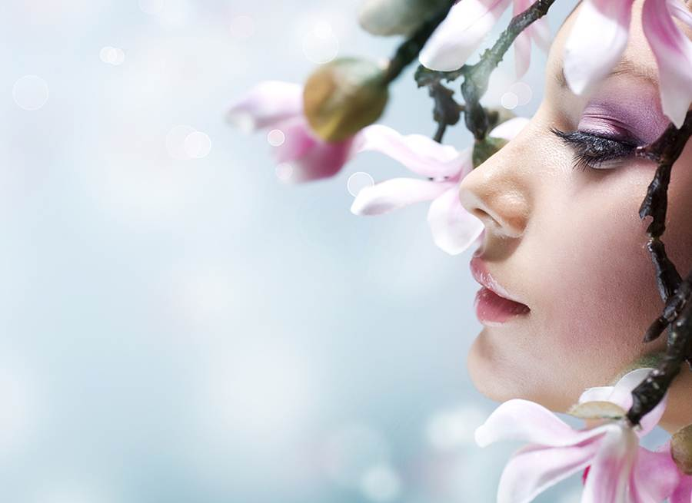
Silk Glow Blush
For a flushed effect that is vivid and so natural!
it builds up nicely and its finish is absolutely velvety and great.
it's the one for you!
Spreadable
High payoff of colors
Silky effect
Natural flush effect
Gives a satin velvety finish
Paraben free

Slide 18
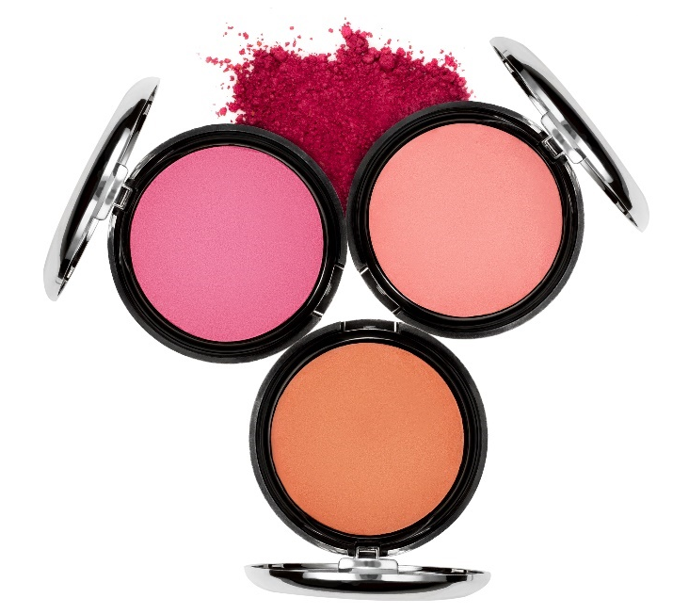
Mistral of Milan Silk Glow Blush
Shades | MRP | DP | BV | Product
Desire 001 | 450 | 380 | 228
Sun Kissed 002 | 450 | 380 | 228
In Love 003 | 450 | 380 | 228

Slide 19
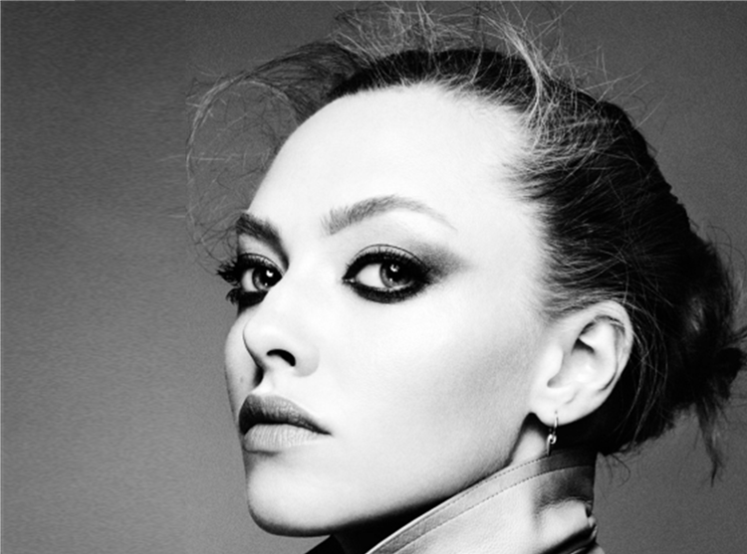
EYES

Slide 20
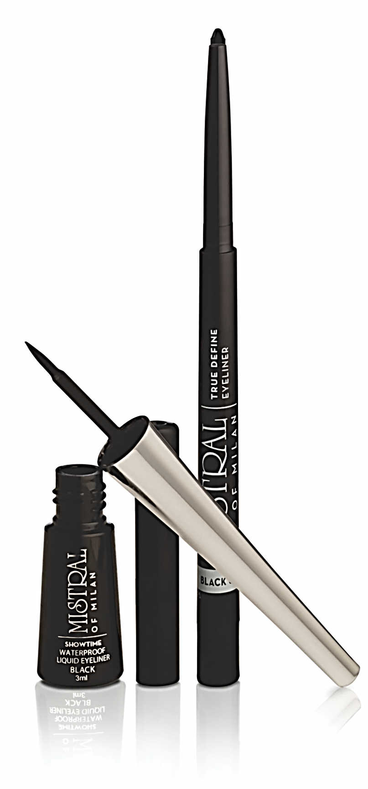

Slide 21
True Emotion Eyeshadow
A great versatile trio which can be developed in different color according to your desire and mood.
Soft and pleasant and it allows the skin to breath, making the texture highly suitable for warm weathers.
Its color is wonderfully vivid and intense, giving you attractive and deep eyes.
Easy application. Light texture which spreads easily.
Pearly look

Slide 22
Mistral of Milan True Emotion Eyeshadow
Shades | MRP | DP | BV | Usage
Obsessive Smokey Trio (Snow + Slate + Charcoal) 001 | 550 | 465 | 279 | rich and vibrant colours, which gives an effortless and seamless finish. Also contains a double side applicator for precise application.
Happy Pink Trio (Champagne+ Candy + Plum) 002 | 550 | 465 | 279
Power Brown Trio (Desert+ Mocha+ Java) 003 | 550 | 465 | 279

Slide 23
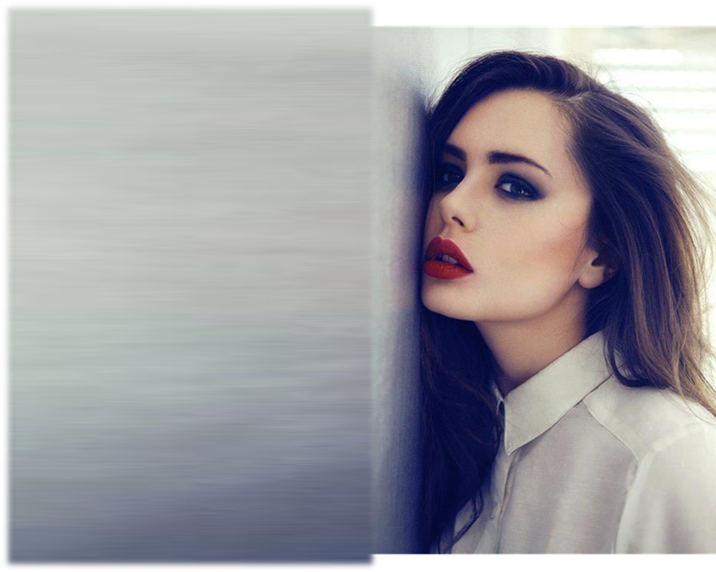
Deep Define Kajal
Shaped for custom precise application.
Soft comfortable texture to add the darkest shade evenly on your eyes with a single stroke.
It is long lasting with a special blend of conditioning agents.
Shades | MRP | DP | BV
Black 001 | 199 | 170 | 125

Slide 24
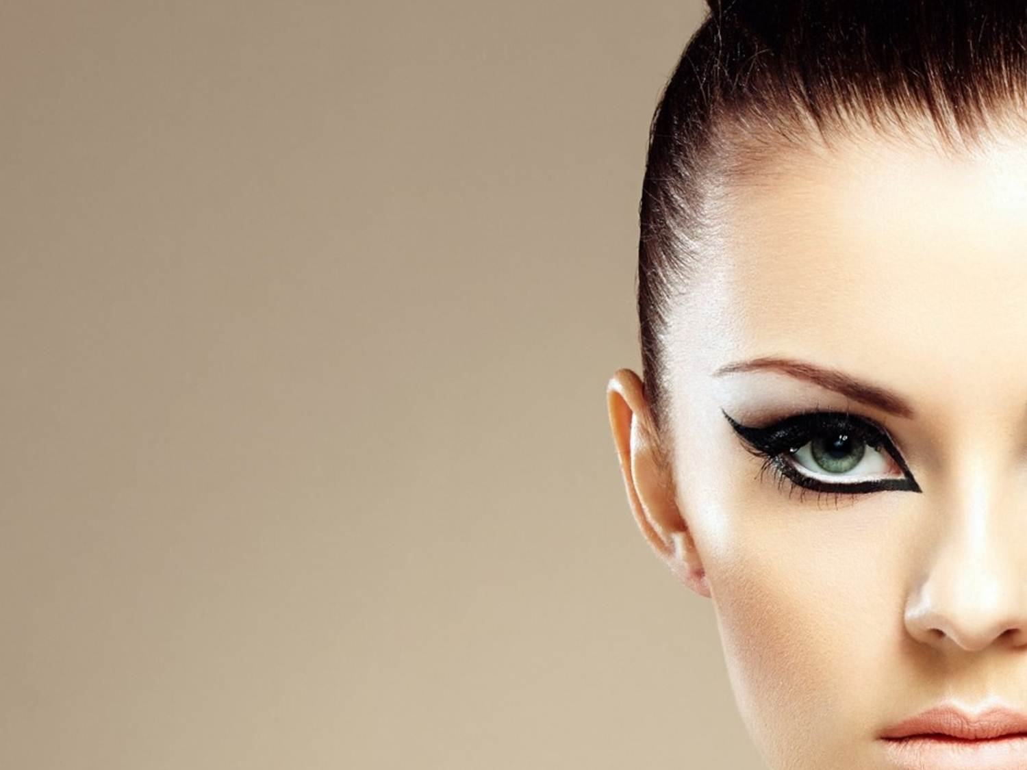
Showtime Waterproof Liquid Eyeliner
The application is very easy and with it’s perfect consistency you can create a deep and uniform line in the first coat!
Long lasting and water resistant.
Extra strong look with deep pigmentation.
Paraben free
Shades | MRP | DP | BV
Black 001 | 345 | 290 | 174

Slide 25
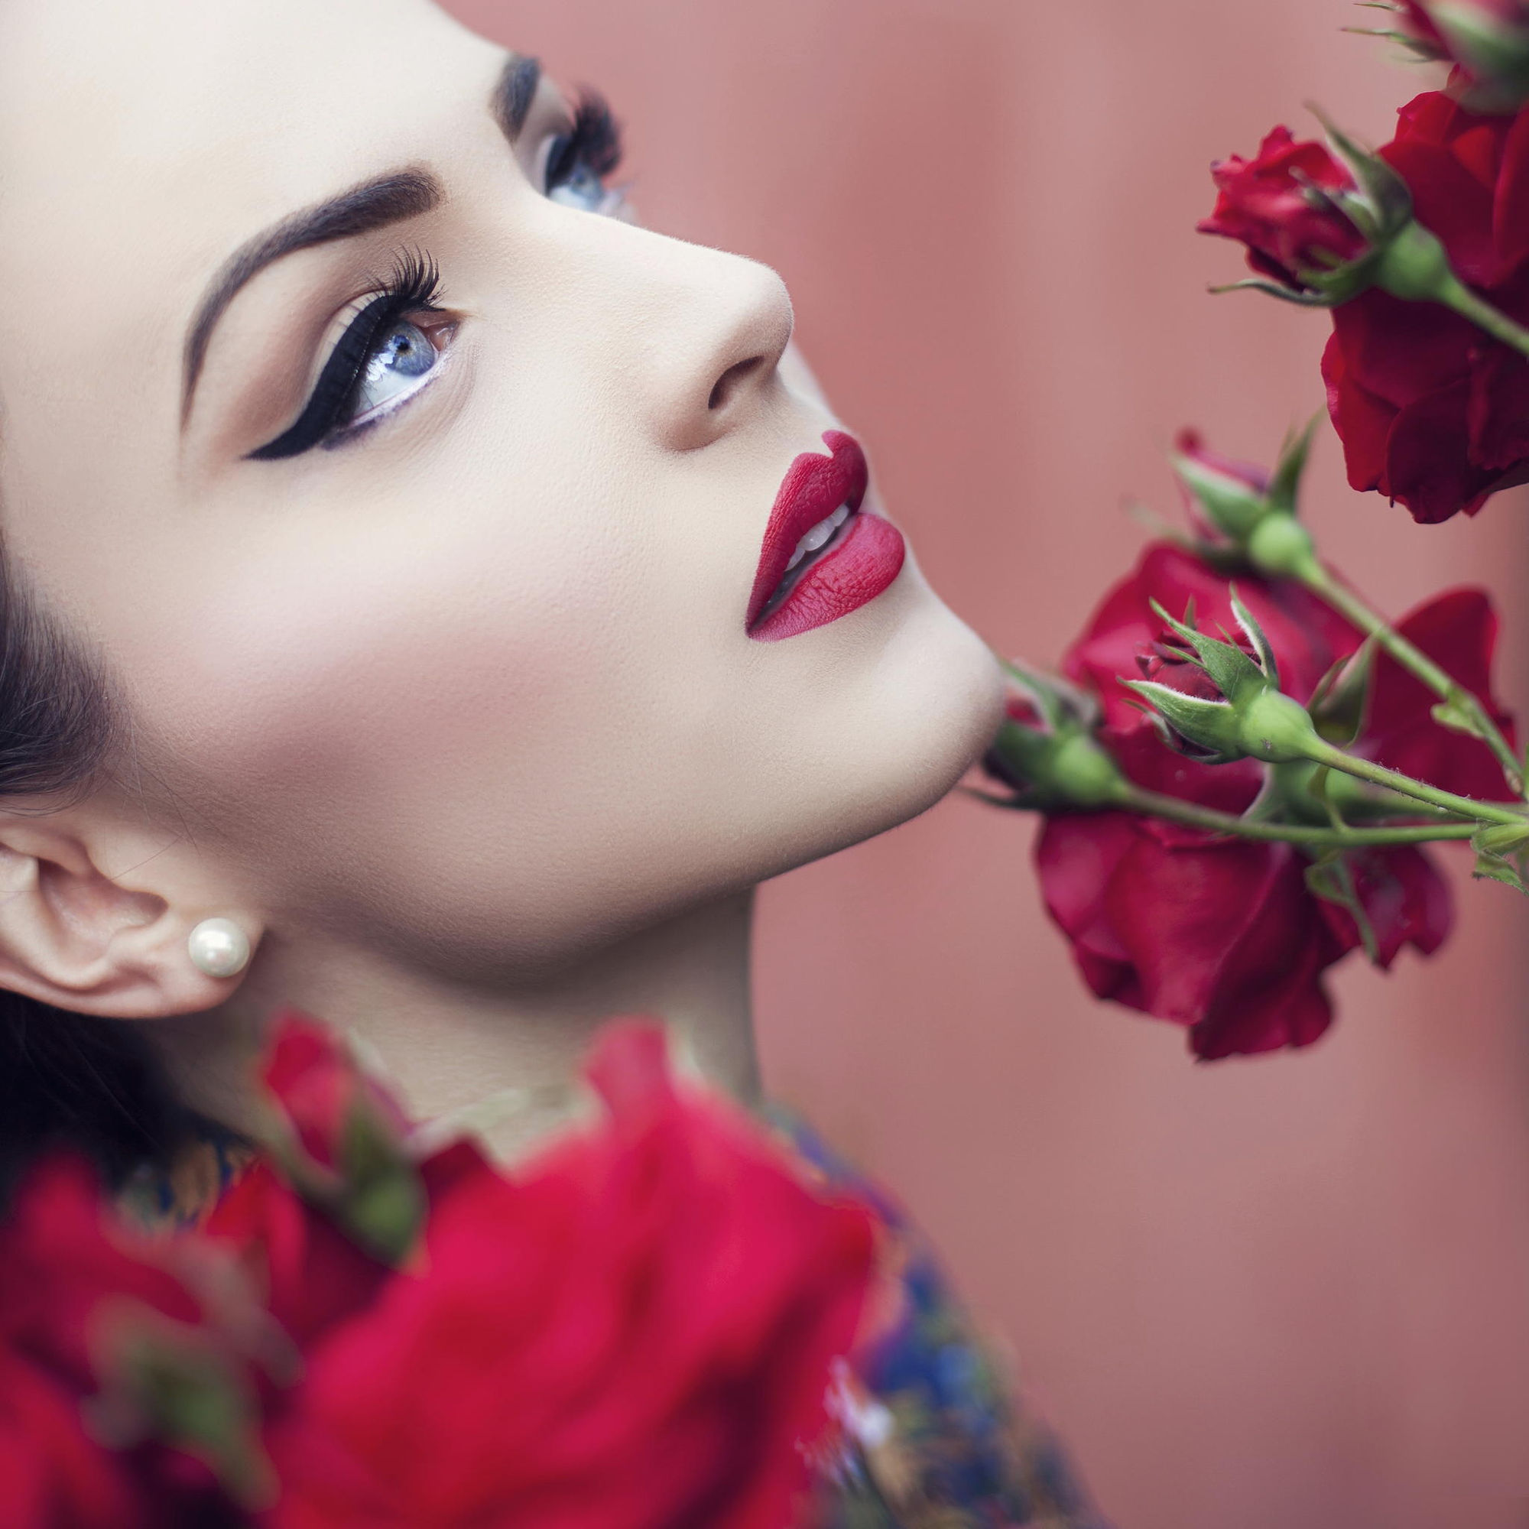
True define Eyeliner Pencil
Highly pigmented formula with intense pay off to achieve best results with one application.
Superb, powdery soft texture with long lasting result
Matt with intense finish
Shades | MRP | DP | BV
Black 001 | 290 | 250 | 125

Slide 26
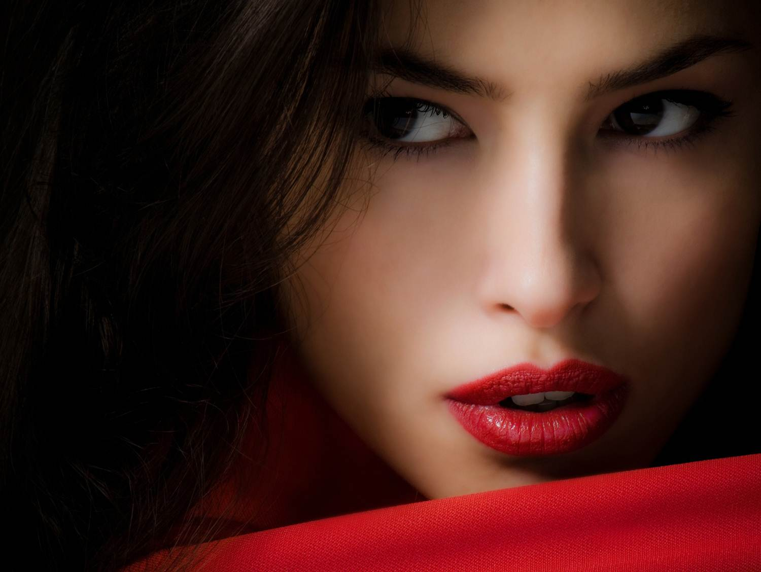
LIPS

Slide 28
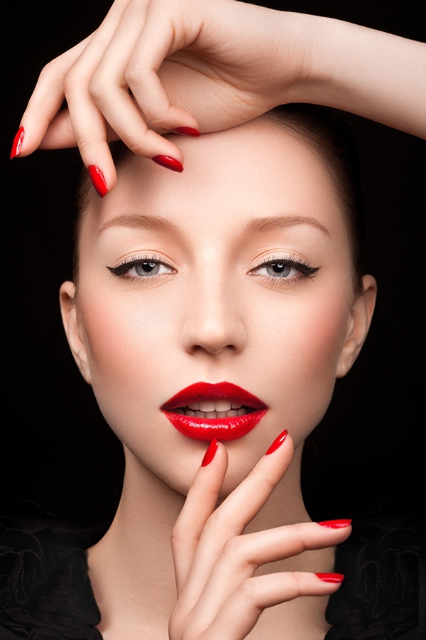
Classic Crème Lipstick
A classic lipstick, with a soft and creamy texture which spreads on your lips effortlessly making them supple and intense.
It gives perfect coverage with moisturizing action.
Create a thin and comfortable layer on the lips, keeping them soft and smooth. Do not dry out the lips, while taking care of them.
its texture is ultra soft on the lips , making this lipstick the most lovable beauty accessory.
Paraben free

Slide 29
Mistral of Milan Classic Crème Lipstick
S. No. | Shades. | MRP | DP | BV
1 | Marry Me Red 001 | 450 | 390 | 234
2 | Marooned 002 | 450 | 390 | 234
3 | Sugar Candy 003 | 450 | 390 | 234
4 | Rose Wine 004 | 450 | 390 | 234
5 | Hot Pink 005 | 450 | 390 | 234
6 | Berry Bomb 006 | 450 | 390 | 234
7 | Choco Delight 007 | 450 | 390 | 234
8 | Caramel 008 | 450 | 390 | 234
9 | Brownie 009 | 450 | 390 | 234
10 | Butterscotch 010 | 450 | 390 | 234
11 | Pink Lips 011 | 450 | 390 | 234
12 | Siren 012 | 450 | 390 | 234
13 | Lovey Dovey 013 | 450 | 390 | 234
14 | Dusty Rose 014 | 450 | 390 | 234
15 | Grapevine 015 | 450 | 390 | 234
16 | Mandarin 016 | 450 | 390 | 234
17 | True Magenta 017 | 450 | 390 | 234
18 | Blackcurrant 018 | 450 | 390 | 234
19 | Desirable Fig 019 | 450 | 390 | 234
20 | Dark Chocolate 020 | 450 | 390 | 234
21 | Coffee Mocha 021 | 450 | 390 | 234
22 | New Love 022 | 450 | 390 | 234
23 | Cashmere 023 | 450 | 390 | 234
24 | Forever 024 | 450 | 390 | 234
Shades | MRP | DP | BV | Usage
Obsessive Smokey Trio (Snow + Slate + Charcoal) 001 | 550 | 465 | 279 | rich and vibrant colours, which gives an effortless and seamless finish. Also contains a double side applicator for precise application.
Happy Pink Trio (Champagne+ Candy + Plum) 002 | 550 | 465 | 279
Power Brown Trio (Desert+ Mocha+ Java) 003 | 550 | 465 | 279

Slide 30
Silk Shine Lip Gloss
Gives a glossy and wet finish to your lips. It will brighten up your face!
This liquid lip gloss feels fairly light on the lips and has a sweet aroma.
Moreover, you can put it on top of your lipstick or wear it alone.
Comfortable to wear with creamy soft texture.
Create a thin and comfortable layer on the lips, keeping them soft and smooth by preventing moisture from leaving the skin.
Paraben free

Slide 31
Mistral of Milan Silk Shine Lip Gloss
Shades | MRP | DP | BV
Sexy 001 | 320 | 270 | 162
Romance 002 | 320 | 270 | 162
Sensational 003 | 320 | 270 | 162
First Date 004 | 320 | 270 | 162
Seductive 005 | 320 | 270 | 162
First Crush 006 | 320 | 270 | 162

Slide 32
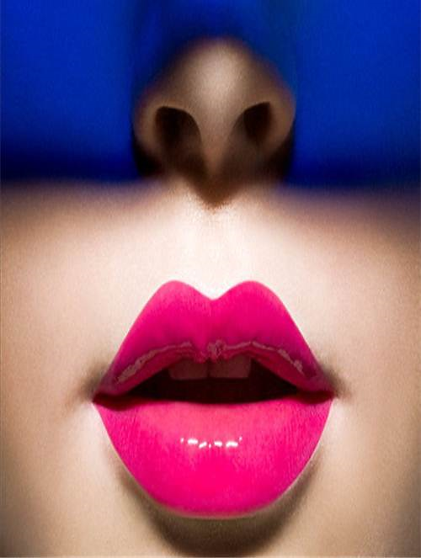
Long Wear Liquid Lipstick
Everlasting colour liquid lipstick collection with rich velvet matte finish that gives your lips a feather light texture and ultimate comfort. A truly unique and luxurious product that spreads smoothly and evenly. It gives your lips a super intense colour that stays all day long. A synergy of waxes and jellifying agents prevents dryness and gives comfort all day.

Slide 33
Mistral of Milan Long Wear Liquid Lipstick
Shades | MRP | DP | BV
Plum Tart 001 | 575 | 500 | 300
Peach Candy 002 | 575 | 500 | 300
Cinnabon 003 | 575 | 500 | 300
Walnut Crush 004 | 575 | 500 | 300
Red Velvet 005 | 575 | 500 | 300
Wine Mousse 006 | 575 | 500 | 300

Slide 34
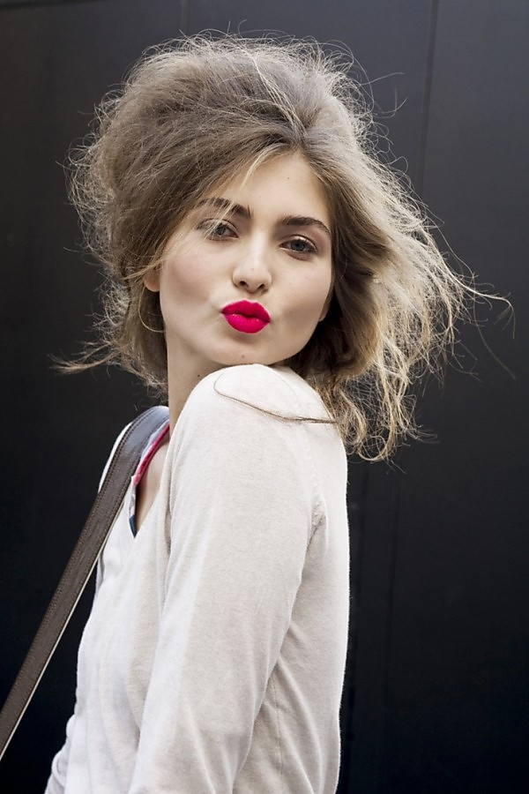
Ultra define lip liner
super soft and creamy, comfortable application and super gliding.
Excellent even colour pay-off with high coverage.
Comes with semi matt finish which goes well with any form of lip color.
waterproof and long-lasting (4 hours and more) no feathering or transfer.
With vitamin E and C which preserves moisture and has anti aging as well as antioxidant properties.
free of preservatives.

Slide 35
Mistral of Milan Ultra define lip liner
Shades | MRP | DP | BV
Cherry red 001 | 415 | 360 | 216
Deep Maroon 002 | 415 | 360 | 216
Perfect Pink 003 | 415 | 360 | 216
Classic Brown 004 | 415 | 360 | 216

Slide 36
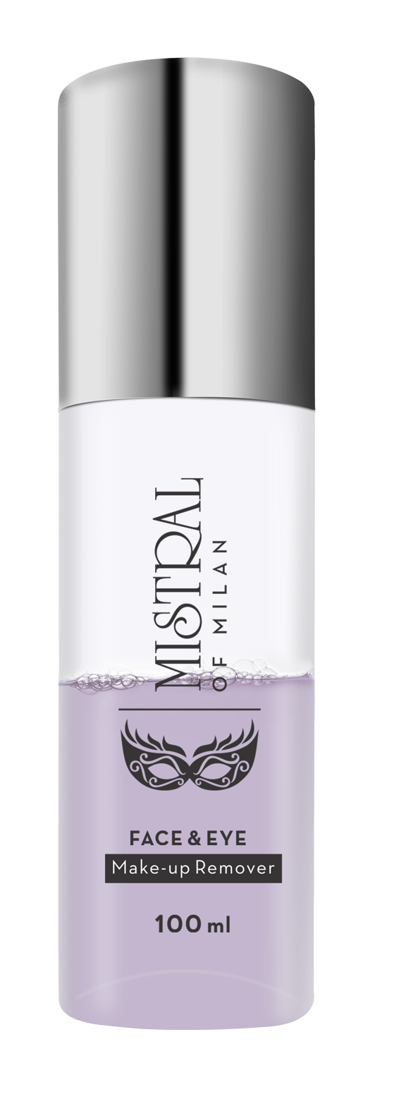
MAKE-UP
REMOVER
This bi-phase makeup remover instantly clears the skin of makeup and impurities. It gets activated by just shaking the bottle and removes stubborn, long lasting and waterproof eye, face and lip makeup leaving the skin soft and smooth.
MRP | DP | BV
400 | 350 | 210

Slide 37
NAILS

Slide 38
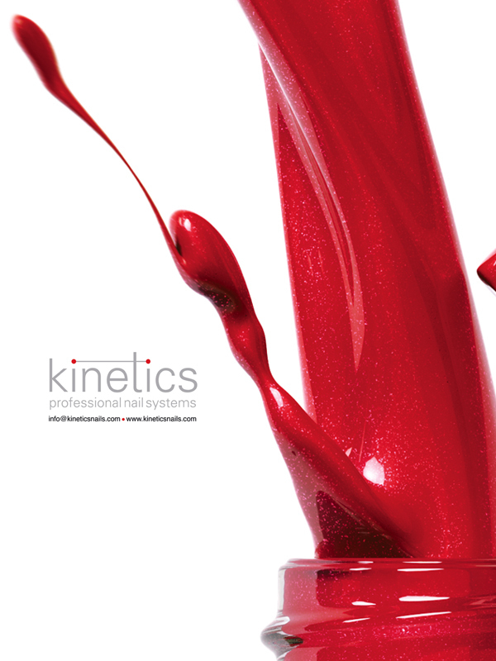
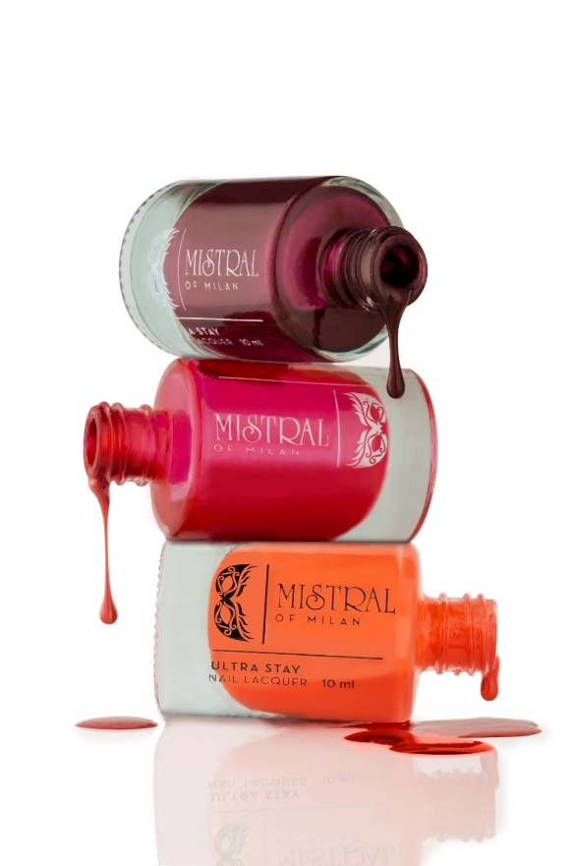
Mistral of Milan Ultra-Stay Nail Lacquer
Product | Shades | MRP | DP | BV | Usage
Ultra-Stay Nail Lacquer | 25 | 200 | 170 | 102 | Revives the appearance of your finger and toe nails with ultra-long stay from Day 1 to Day 7. high voltage ultra-shine finish along with an one-stroke ease of application. Contains a special UV filter that prevents discoloration.

Slide 39
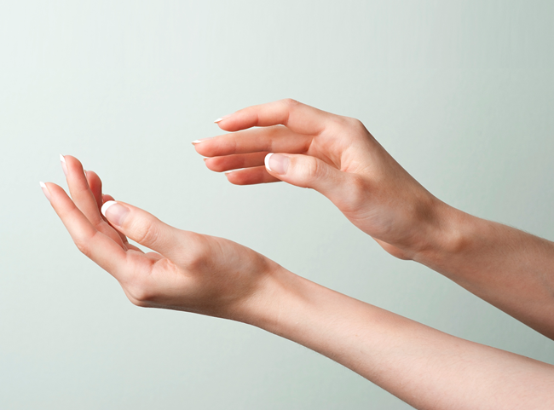
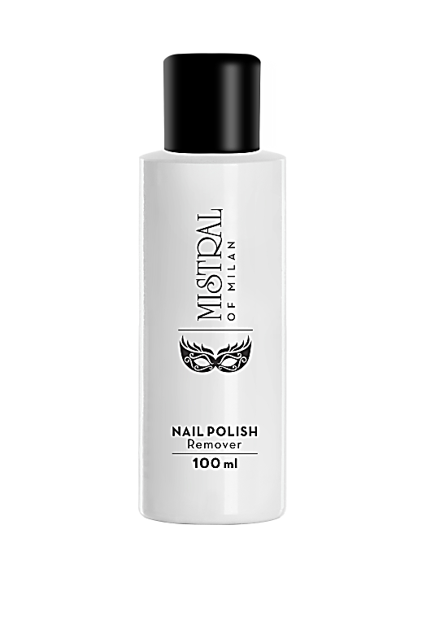
Nail Polish Remover
Acetone free conditioning formula that effectively removes nail polish without causing dryness. Enriched with Vitamin E and sweet almond oil that provide nourishment and leave your nails looking healthy and smooth.
MRP | DP | BV
180 | 160 | 96

Slide 40
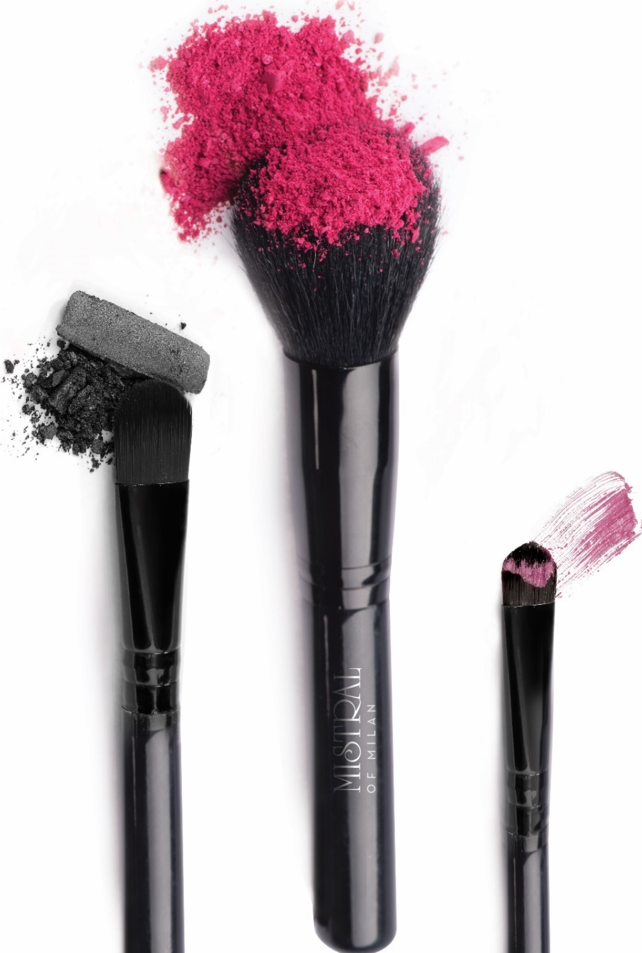
Mistral of Milan Makeup Brushes
Blush Brush
The perfectly shaped brush allows smooth and even application of the powdered blush more precisely both in terms of the amount of colour and position.
Eye Shadow Brush
Special shape of the brush is designed especially for eyes so that the deposit is not made in patch but gets distributed and blends evenly. Always use separate brushes for shading and highlighting.
Lip Filler Brush
This brush is an ideal accompaniment to lipsticks. It is perfect for detailing along the lips and applies colour evenly and consistently.

Slide 41
Thank you!

