Slide 2
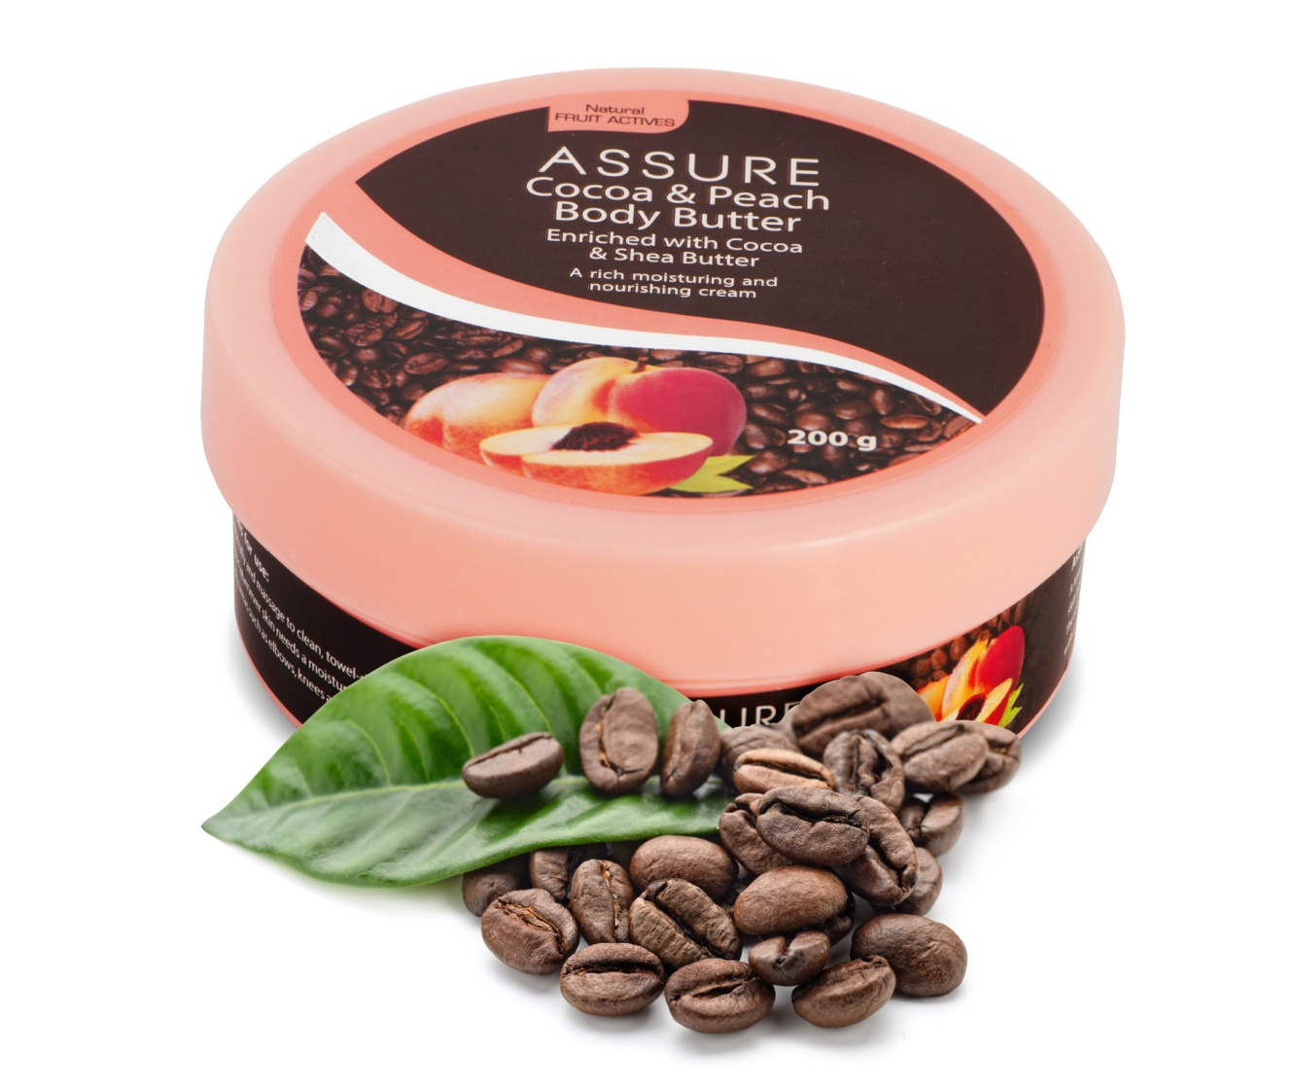
New ASSURE COCOA & PEACH BODY BUTTER
Enriched with
Cocoa & Shea Butter

Slide 3
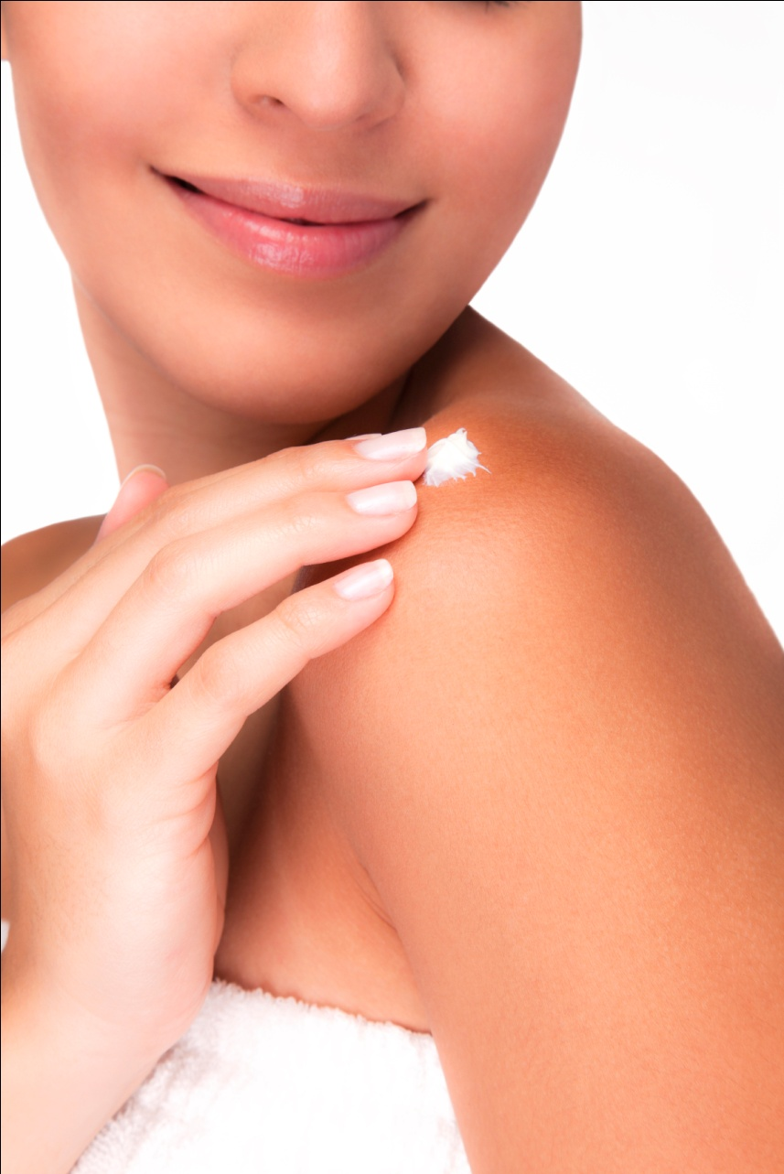
Assure Cocoa and Peach Body Butter
Enriched with Cocoa and Shea Butter
Why do we need to use a Body Butter?
There are many areas in our body that remain extremely dry at all times – like elbows, knees, neck area, cuticles of hands and feet and others
These areas need a moisture boost of rich moisturising agents like body butters
Body Butter is a unique combination of rich moisturising butters and essential oils that deeply hydrates the skin for long time
The Product
Rich butter cream whipped to provide lighter and easier application, melts into the skin providing long lasting moisturisation without leaving greasy residue.

Slide 4
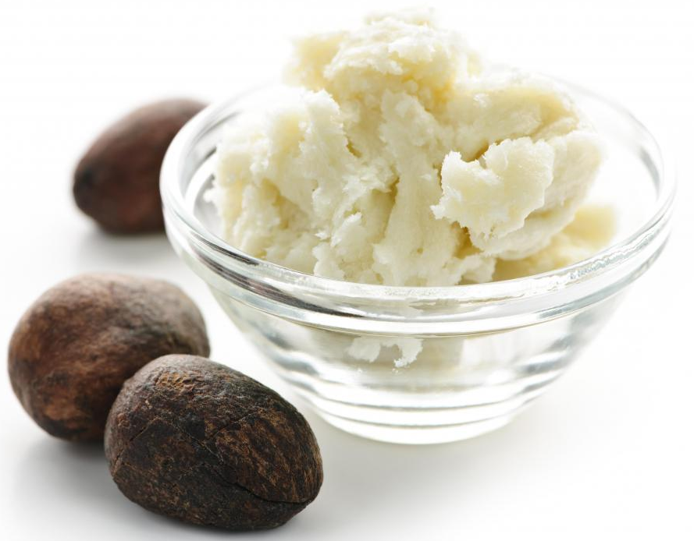
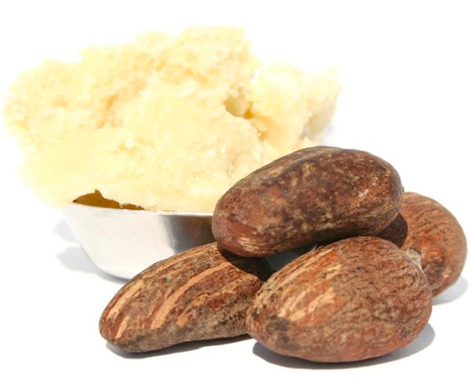
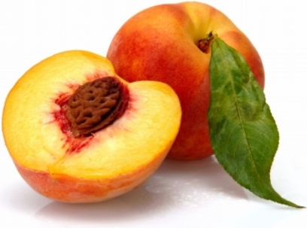
Assure Cocoa and Peach Body Butter
Enriched with Cocoa and Shea Butter
The Performance (Key ingredients)
Cocoa and Shea Butter: Extracted from seeds of cocoa and shea nuts, these butters provide intense moisturisation to dry and chapped skin
Peach Fruit Extract: A rich source of skin nourishing vitamins, minerals and fatty acids that provides anti-aging benefits to the skin. It helps to maintain elasticity and firmness of the skin
The Benefits
It provides long-lasting intense moisture to dry skin, leaving the skin feeling beautifully silky, with a gorgeous glow
The butters melt into the skin, penetrating deep to nourish and condition the skin
Instantly provides smooth, supple, silky and super-soft skin
It’s sweet scent leaves the skin feeling fresh and energetic

Slide 5
Assure Cocoa and Peach Body Butter
Enriched with Cocoa and Shea Butter
The Application
Apply a liberal amount on dry areas of the body and massage until completely absorbed
Use as often as needed

Slide 7
Thank you Quiz

